Slide 1
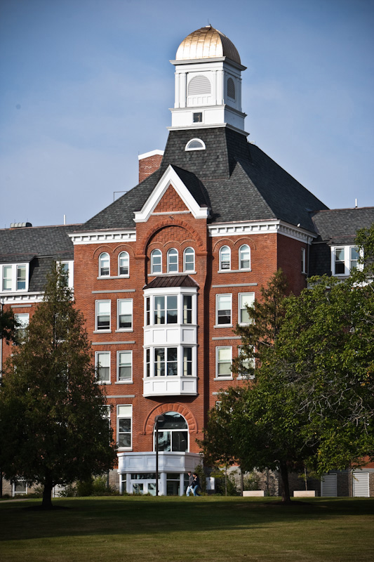
Person-Centered-Planning and your Students at College
Developing Inclusive Higher Education Options
Amy Dwyre D’Agati
adwyre@umd.edu
Notes:
AIAI Grant UDL Example ~ Towson University
Title: PersonCenteredPlanning
Faculty Developer: Amy Dwyre
Course/Program or Department: University of Maryland College Park
Notes: 1 file

Slide 2
Why does anyone go to college?
Get away from mom and dad
Become more independent
Have fun
Learn
TO GET A BETTER JOB!!!
Should that be any different for students with intellectual disabilities???

Slide 3
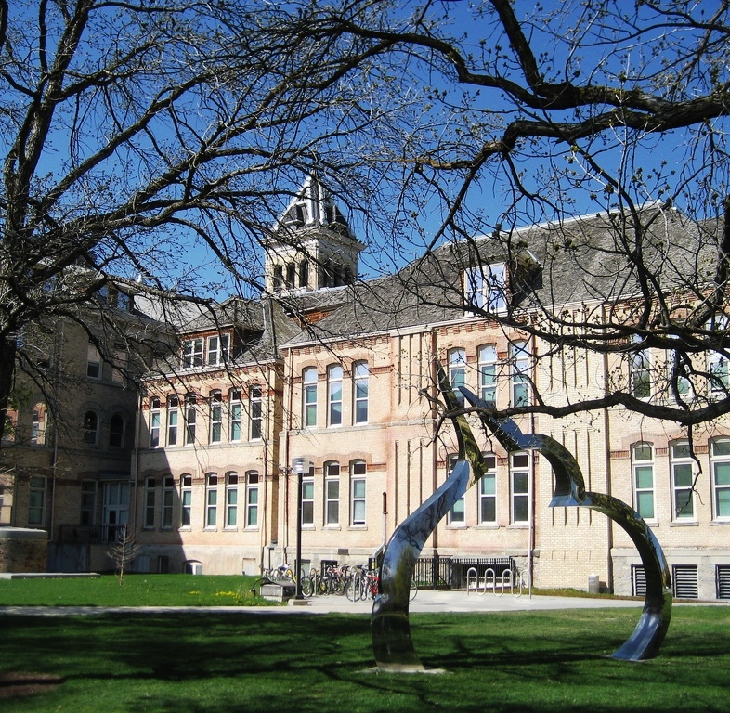
The Transformative Power of College
Classes
Friends
Networks
Content
Exposure
Independence
Failure
Perspective

Slide 4
Getting to know students: How PSE settings help
Student groups
Campus activities
Extra-curriculars
Peer mentors
Coursework
Variety of environments – NOT special ed!

Slide 5
The Differences between High School and College: Advocacy & Planning
High School
College
Parents actively involved
Schools encourage parental participation
Parents talk directly to student’s teachers regularly
Students are expected to advocate for themselves
Parent involvement may be discouraged at times
College professors do not regularly communicate with parents of students
Notes:
High School: Parents are actively involved in advocating for appropriate services and supports for their children. Schools reach out to parents and their participation is required. Parents talk directly to their child’s teachers on a regular basis.
College: Students are expected to advocate for themselves. Parent involvement is not always actively sought, and may be discouraged at times. College faculty and staff do not typically communicate with parents directly.
Impact on students with ID: This difference highlights the importance of self-advocacy skills. Students should be actively participating in their IEPs while in high school. They should be learning to speak for themselves and to advocate for their own needs. It also reminds parents that as their sons and daughters grow up, their role of parent becomes one of supporter and coach; no longer are they able to coordinate their child’s educational services. One successful strategy that has been used to assist the student to make this big leap into self advocacy is the use of forms or letters that a student can use to introduce themselves to a faculty member and explain their learning needs.

Slide 6
TRADITIONAL PLANNING | PERSON-CENTERED PLANNING
PERSON
Focus on deficits | Focus on strengths, capacities
Top-down planning | Person and their family are the key informants
Professionals opinions matter most | Balance of formal and informal viewpoints
Reliance on standardized assessments and disability labels | Focus is on the dreams and desires of the person
GOAL
Working through a segregated system of support | Equality
Ameliorization of deficits | Quality of life in the community
FOCUS
Needs of the service delivery system or support structure | Individual needs, preferences, strengths and capacities of the person
TEAMS
Person and family in a passive role | Person and family at the center
All support provided by paid professionals, what is available is dictated by professionals | Cooperative efforts among family, friends, community groups and support agencies to provide support for an inclusive life.
NATURE OF SUPPORTS
Highly prescriptive education, support and work options based on disability label and "readiness for community living" | Highly individualized education, support and work options based on individual dreams, preferences and capacities.

Slide 7
Build a Positive Personal Profile
environmental preferences
dreams & goals
values
talents, skills, & knowledge
interests
life & work experience
specific challenges
learning styles
dislikes
creative possibilities & ideas
positive personality traits
support system
creative solutions & accommodations
Notes:
Let's review the components of the Positive Personal Profile. We will briefly review each component. A complete description may be found under Resources.
At a glance, you will see that this frames the job seeker in a very positive way—seeking to bring out the positive attributes and interests of the individual. Now lets look at each component…..
Dreams and Goals: Dreams and long-term goals enable us to think of the "big picture" of our lives. Dream careers of most people fall into six primary categories
Caring for others
Being a performer (public speaking, singing, broadcasting)
Leading or working for an organization that makes a difference
Owning a business
Generating ideas (planning, training/teaching, organizing, and/or writing)
Any job that you are competent to perform, needs your needs, and has a minimum of negative factors for you.
As an employment consultant you may not agree with the career dream that seems unattainable, or even realistic. A strategy that works will is to turn it into a statement. So one of youor career dreams is to play professional baseball. At this point in time, your goal is to work in the field of professional sports. At this stage, your job is not to determine whether a career goal is realistic or not, but to acknowledge the individual's expressed interests
During your work with job seekers, you will assisting them learn more about their career interests and helping them find a job that has some relation to their long-term career interest. Sometimes that involves helping them find work in the setting, for example, a sports arena.
Interests: Things are things that grip and hold your attention; things that energize you physically, mentally, emotionally, and/or spiritually. Interests are frequently expressed through hobbies, leisure-time pursuits, recreation, and avocations—as well as through occupations.
Exposure precedes interest. Often people with disabilities and other life barriers have a narrow set of interests, or not expressed interest simply because there has never been a chance to get out in the world and see what exists. Also, bear in mind that people also have things that they really have no interest in- or things they dislike. In getting to know another person, it is just as important to identify those "non-interests" as well as interests.
Talents, Skills, and Knowledge: Everyone has certain abilities with which they seem to have been born; sometimes these are referred to as "natural gifts". These talents might be in the arena of athletics, music, art, creative writing, and other forms of expression. But they can also be represented by a warm smile and ability to get along with others, an aptitude for taking things apart and putting them back together again, a knack for noticing small details, curiosity, and ability to express empathy.
Most career resources talk about work-related skills in terms of "people, data, and things". If you ask someone "what have you always had the knack for?" you are likely to get at their skills and knowledge. Ask job seekers to think of times in their lives when they have been complimented. What skill were they mainly using?
Learning Styles: Sometimes called "multiple intelligences," learning style refers to the manner in which an individual naturally prefers to receive, process, and express information. Psychologist and researcher Howard Gardner and others have identified the following learning styles:
Bodily Kinesthetic, Musical, visual-spatial, Intrapersonal, Interpersonal, Verbal-linguistic, Mathematical-logical
Thomas Armstrong, in his book, Seven Kinds of Smart (1993) refers to people with these learning styles or intelligences as being "body smart, music smart, picture smart, self smart, people smart, work smart, and logic smart".
Learning styles have significant implications for how we acquire and use skills, perform tasks, relate to others, and approach life. Frequently, the learning styles of people with disabilities and other life barriers are overlooked or discounted.
Values: Values may be thought of as our life philosophies; our unique perspective on what is important to attain in life and in our careers. What we value in life may be reflected in what we do, say, and think. It is closely related to our personality and temperament.
In term of careers, values may be reflected in such things as a person's desire for high status, a minimum annual income, an easy job, casual or formal dress code, wearing a uniform, a specific geographic location or working at home, short training time, making a difference, perform in a variety of tasks, working alone or with people, being their own boss, little or no supervision, working indoors or outdoors, opportunities for self-expression, and so forth.
Positive Personality Traits: What are the things about a person's character that are genuinely recognized and appreciated by others? Beautiful smile? Ability to stay focused on a detailed task? Willingness to learn new things? Triumph over hardship? Frankness? Talent for listening to others? Sense of humor?
Each of us have certain personality traits that are less than ideal. Maybe we are hyper-critical of certain people, or we get tired and grumpy in the afternoon, or we talk too much. These are examples of normal human behavior; but they are certainly not traits that will win us points in the working world. Part of getting to know someone is discovering the positive aspects of their personality.
Environmental Preferences: go hand in hand with temperament, values, and personality. If you are the unflappable type you may be well-suited to career areas and jobs that are high-pressure in nature; If you are the type who thrives in being outside most of the time, an indoor job with no windows would probably not be a good setting for you. If you do your best work in a quiet setting, alone—being employed in a factory would likely be a poor environmental match for you. Think about the implications for the person who craves routine, schedules, and predictable tasks, landing a job in a setting where the duties shift daily if not hourly. Maybe a recipe for "failure".
Another aspect of personality is called "temperament." Temperament is more than simple mood; rather it is an outlook or attitude, or even philosophy about life. Consider a person's temperament in relation the job tasks, the unique rhythms of the work environment and the workers.
Dislikes: To one extent or another, all of us have dislikes—things in which we have no interest in, or would prefer to avoid if possible, or things that make us uncomfortable for a variety of reasons. A good question to ask each job seeker is "what is a job, or a job setting, or type of work task that you know you do NOT want to do?" If someone has had previous work experience and tell you they didn't like the job, as them "What was it about the job you didn't like?" Too often people are encouraged to take jobs that really go against their core dislikes—again this is usually a recipe for failure, when it comes to job performance and retention.
Life and Work Experience: This is one of the most overlooked areas in getting to know job seekers, particularly those individuals who may have had very limited, or no, previous job experiences. Employers want to know that a candidate has specific skills to accomplish specific company goals. How they acquire the skills may be less important. People acquire skills through formal education and training, previous volunteer or paid jobs, and community service. Skill acquisition comes from informal training (a neighbor teaching you how to repair a car engine, a senior teaching you the use of the internet); and self-training (the young man with quadriplegia who teaches himself to cook using adaptive equipment).
Some of us are fortunate to have learned many skills through on-the-job experiences (preparing budgets; selling products; detailing cars, bagging groceries; taking blood samples). Other life experiences come into play as well. Often it is through our hobbies and recreational activities that we acquire specific skills. When getting to know job seekers, try to ascertain what they—and/or people who know them well-have accomplished in their lives. What are they proud of?
Life and work experiences may prove very valuable as you assist the job seeker in finding a satisfying job.
Support System: This refers to the unique "circle of support" each of us has around us. For some of us this support system might be quite extensive while for others the circle may be very small-or non-existent. Who might be in our circle of support? It might include family members, significant others, friends, acquaintances, neighbors, co-workers, and class mates. We may even consider ourselves to be in that circle. These are all people who are not paid to provide support to us. Then there are supporters who may receive pa7ment for being in our support circle, such as teachers, counselors, therapists, medical personnel, personal assistant, social workers, job coaches, human service organizational personnel, government agency representatives, and so forth.
For many people with disabilities and other significant life barriers, their support systems tend to be overly represented by "paid supporters" and underrepresented by volunteer supporters. This may primarily be due to society's tendency to shelter, protect, "take care of"—and intentionally or inadvertently isolate people with disabilities. The challenge to those who advocate for and support people with disabilities, then, is to help individuals build their social networks, hence their network of supporters.
Specific Challenges: The word "challenge" may be synonymous with the words barrier, limitation, deficit, weakness, pet peeve, shortcoming, roadblock, hindrance, problem, difficulty, or obstacle—but it can also refer to risk and adventure!!! In fact, life may be thought of as a series of opportunities and challenges.
Sometimes people face challenges because of opportunities they have never had, such as individuals who cannot articulate the kinds of jobs they would like because they have had little exposure to the work world. And some people encounter a lifetime of challenges because of poor choices they have made, for example, people with criminal records, or those who are in abusive relationships. People this disabilities are often thought of being challenged because of their disability. In fact, each person is affected by his/her disability in different ways. The disability itself is not the challenge, rather it is the specific effects of the disability. For example, cognitive disability or mental retardation is not a specific challenge, but not being able to read is. Having severe cerebral palsy is not a specific barrier; however, having unintelligible speech is a definite challenge.
A critical part of developing a positive personal profile is to identify those specific challenges that may get in the way of a person's pursuit of his/her dreams and goals.
Creative Solutions and Accommodations: Once we have identified the specific challenges in our lives we can begin to think of creative solutions and accommodations. An accommodation may be thought of as any strategy that effectively alleviates, or lessens the impact, of a specific challenge. Consider a young man who is blind and whose family would not let him ride the city bus for fear of his safety. What might happen if a mobility specialist took his family with him on the bus, to demonstrate the young man's skill at getting around? This is an example of an accommodation.
Accommodations are creative solutions to specific challenges or barriers. They range from the commonsense to the highly technological. They fall into three primary categories:
physical accommodations, such as equipment, devices, and modified spaces and buildings;
special services, such as those provided by interpreters, translators, personal assistants, job coaches, medical personnel, therapists, parole officers, and so forth
creative thinking and common sense problem-solving (by far, the most frequently needed and used category of accommodation!)
Creative Possibilities and Ideas: Have you ever been doing something mundane and ordinary, like the laundry or walking down the street—when suddenly a idea pops into your head? Possibly you get a spark of insight into a solution for a problem with which you have been grappling. As you assist job seekers develop their own Positive Personal Profile, you are likely to find yourself thinking of all kinds of ideas, such as job possibilities, things to explore, actions to take, people to meet, and other "What-ifs". Rather than waiting, we would encourage you to record all thoughts and ideas, regardless of how random or unrealistic they might seem, at the time you think of them. There will be plenty of opportunity to sift through all the ideas later (and to generate additional ones); however, these initial thoughts are often gems to polish.
Resources: What is a Positive Personal Profile
Positive Personal Profile Form

Slide 8
PROCESSES
Career Assessment
Person-centered planning
Community-based
Matching coursework/extracurricular
Connect classes to career
Explore interests through clubs
Soft skills
Career exploration, search, acquisition
Internships, try-outs, on-campus experiences
Support and Follow-along
Post-hire consulting
Staff support for job maintenance

Slide 9
Make opportunities INCLUSIVE
Inclusion in regular academic coursework
Engagement in campus life
Integrated competitive employment
Development of Self-Determination skills and Independence

Slide 10
Standard I: Academic Success
Quality Indicators:
Access to a variety of college courses attended by students without disabilities
Address issues impacting course access (placement tests, accommodations, mentors/tutors, faculty training, etc.)
Provide students with skills to access academics (resources for access or funding)

Slide 11
Standard 2: Career Development
Quality Indicator:
Provide employment supports and experiences
Person-centered planning
Trained job developers/coaches
Quality work-based learning
Paid work experiences
Connection with adult service providers
Collection of employment outcome data

Slide 12
Standard 3: Campus Membership
Quality Indicators:
Access and support to participate in existing social organizations, facilities and technology on campus
Clubs and organizations
Residential life facilities and activities
Technology for social communication
Social activities facilitated by students without disabilities, with natural supports

Slide 13
Standard 4: Self-Determination
Quality Indicators
Ensure student involvement in and control of the establishment of personal goals
Ensure development and promotion of self-determination skills
Have a process for family involvement (with clearly defined roles)

Slide 14
Standard 5: Alignment with College Systems and Practices
Quality Indicators:
Offer a meaningful credential or outcomes by the institution
Provide access to academic advising
Provide access to college campus resources (admissions, counseling centers, housing, transportation, etc.)
Collaborate with faculty and staff
Adhere to college schedules, policies, procedures and communications

Slide 15
Standard 6: Coordination and Collaboration
Quality Indicators:
Establish connections and relationships with key college departments
Assign a designated person to coordinate program-specific services

Slide 16
Standard 7: Sustainability
Quality Indicators:
Use diverse sources of funding (financial aid, grants, waiver funds, vocational rehabilitation)
Have a planning and advisory team (campus personnel, disability services, disability agencies, community agencies, local business leaders, workforce development, youth and families)

Slide 17
Standard 8: Ongoing Evaluation
Quality Indicators:
Conduct evaluation of services and outcomes regularly
Key stakeholders
Student satisfaction
Student exit data
Student follow-up data
Review and adjust based on results

Slide 18
Planning for Postsecondary options while still in high school
Roles and Responsibilities
of all parties: Student, Family, Transition Teacher, Special Education Administrator

Slide 19
Role of Transitioning Student
Person-Centered Planning: add postsecondary options to discussions; research college options
College selection: Visit campuses, select college that best matches goals, complete forms
Academics: choose list of preferred courses and create a schedule
Accommodations: register with disability support services, gather documentation, prepare to discuss support needs

Slide 20
Role of Transitioning Student
Plan for support: describe what help is needed to be successful
IEP: Identify PSE goals
Transportation: practice public transportation, or apply for accessible transportation
Schedule: Begin practicing using a daily schedule
Funding: Determine costs and funding sources with support

Slide 21
Role of Family
Person-Centered planning: Assist youth in identifying strengths, and needs
College selection: Take youth on tours, review what they see, list pros and cons, review difference between high school and college
Academics: assist youth in coursework selection, etc.
Accommodations: remind youth of successful accommodations already in place

Slide 22
Role of Family
Plan for support: Discuss with team the support family can provide (transportation, cell phone, etc.)
IEP: Emphasize PSE goals and supports at the tam meetings
Transportation: review back-up plans
Schedule: work with youth and team; emergency plans
Funding: determine parent contributions

Slide 23
Role of Transition Teacher
Person-Centered Planning: Support student to determine goals and research college options
College selection: Prepare for campus visits/attend; debrief youth
Academics: prepare youth for picking coursework
Accommodations: Review past accommodations, assist student to gather documents and go to Disability Support Services

Slide 24
Role of Transition Teacher
Plan for Support: work with youth and mentors on providing needed supports
IEP: Assist student/advocate for PSE goals; offer college prep activities as part of curriculum
Transportation: Conduct mobility training or accessible transportation arrangement; train student in back-up plans and to carry phone numbers
Schedule: Work with team to determine supports for a daily schedule
Funding: research funding options and support on paper work

Slide 25
Role of Special Ed Administrator
Person-centered planning: promote PSE options to youth and families; offer trainings to staff
College selection: determine college partnerships; start partnerships where they do not exist; participate in PSE planning meetings
Accommodations: help youth and families get access to necessary documentation

Slide 26
Role of Special Ed Administrator
Plan for support: give input on fading supports; contact college partner to confirm they have knowledge
IEP: Emphasize PSE options for Transition Planning
Transportation: allow access to youth to participate in public transportation training
Schedules: Attend parent meetings to promote individualized schedules; make flexible community-based services available, including training for staff on how to provide it
Funding: forecast number of students going to PSE to prepare a budget and pan with college partners each fiscal year prior.

Slide 27
Role of Faculty/Instructors at the College
What do you see your role as?

Slide 28
Role of Faculty/Instructors at the College
Awareness of student plan for supports
Communicate with student and staff openly
Suggest potential changes
Incorporate more classroom UDL strategies
Be open to allowing opportunities

Slide 29
Critical Elements
Connecting college experience with employment
Providing access to college coursework
Connecting the experience to real outcomes

Slide 30
Positive outcomes for Institutions of Higher Education (IHE’s)
Mission of Diversity
Enhanced collaborations
Increased revenue
Student Opportunities
Opportunities for faculty and staff
Funding opportunities

Slide 31
Positive outcomes for students
Ability to access adult learning opportunities
Expanded social networks
Opportunity to connect learning to personal desired outcome
Individualized and Enhanced Employment outcomes
Socially valued roles and experience

Slide 32
Essential Self-Advocacy Skills
Recognizes strengths and weaknesses
Articulates strengths and weaknesses
Explains disability
Knows when to disclose disability
Understands disability’s impact on performance
Identifies accommodations

Slide 33
Essential Self-Advocacy Skills
Requests accommodations as needed
Identifies when help is needed
Obtains help when needed
Articulates short-term goals
Articulates long-term goals
Outlines steps necessary to reach goals
Identifies potential barriers to goal achievement

Slide 34
QUESTIONS
adwyre@umd.edu

