Slide 1
Introduction to State Library Resource Center (SLRC) Services
Towson Conference for Academic Libraries, July 20, 2022
Jodi Hoover
Digital Resources Manager
Enoch Pratt Free Library
State Library Resource Center
John Jewitt
Manager, Social Science and History
Enoch Pratt Free Library
State Library Resource Center

Slide 2
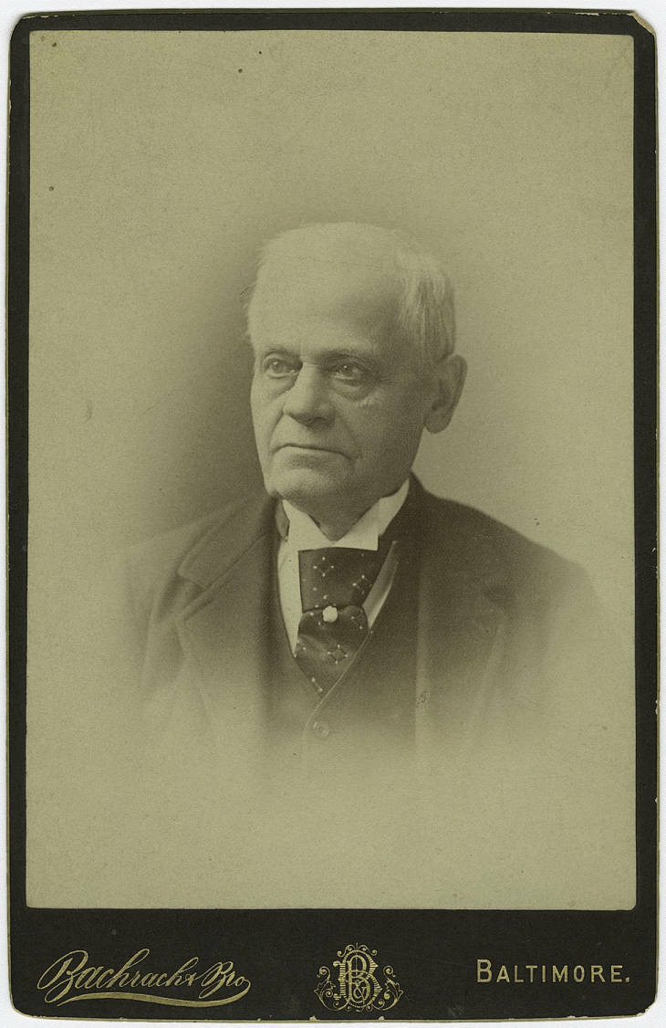
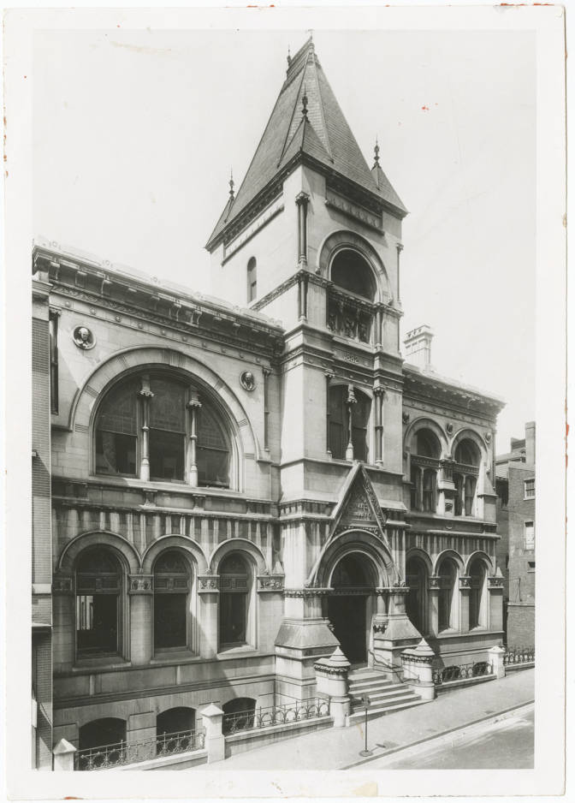
Enoch Pratt Free Library
Images from the Pratt Library Archive in the Digital Maryland Collection. https://www.digitalmaryland.org/

Slide 3
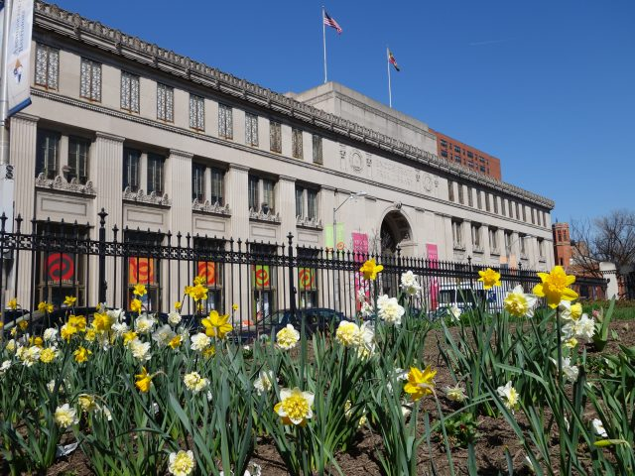

Slide 4
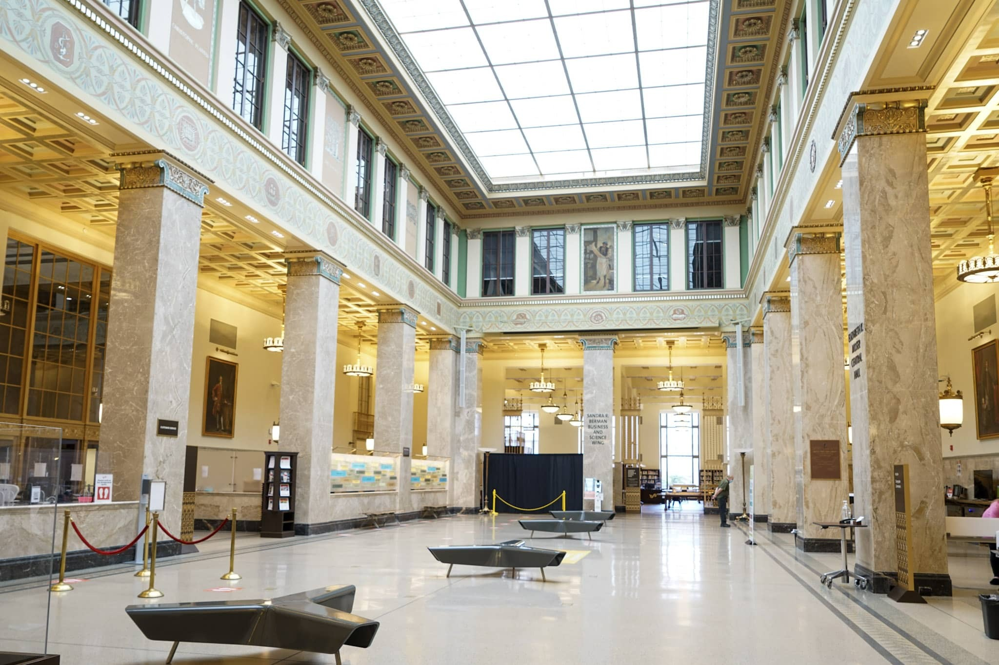

Slide 5
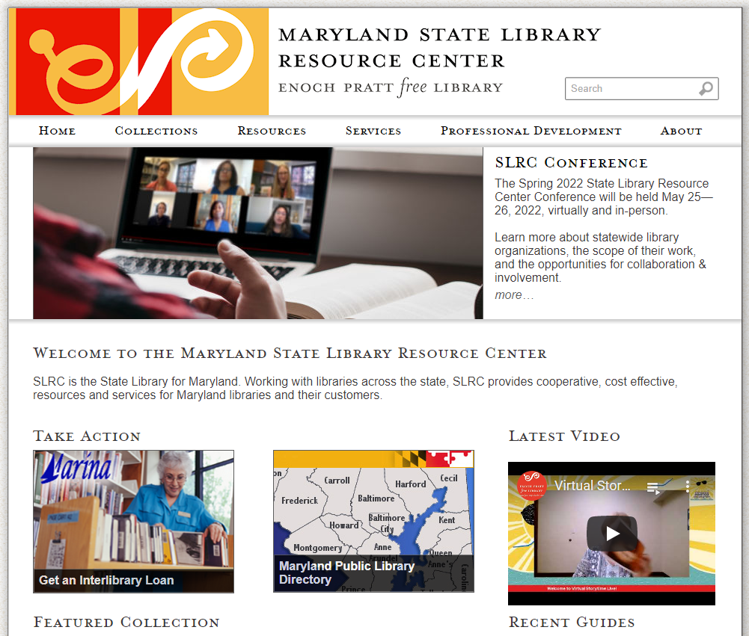
SLRC.info

Slide 6
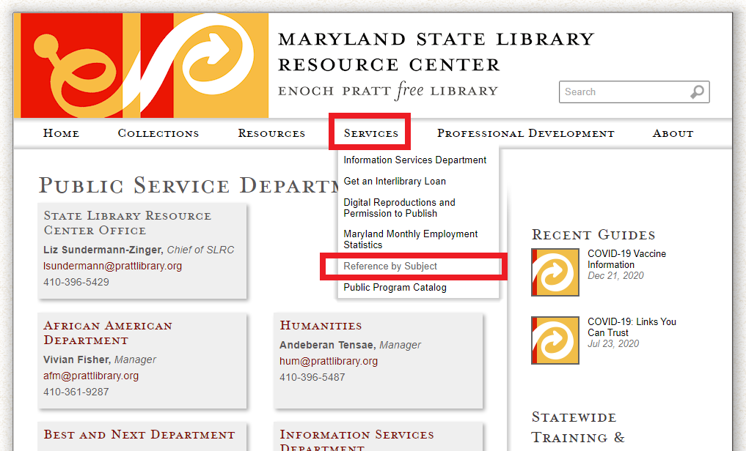
Connect with Us

Slide 7
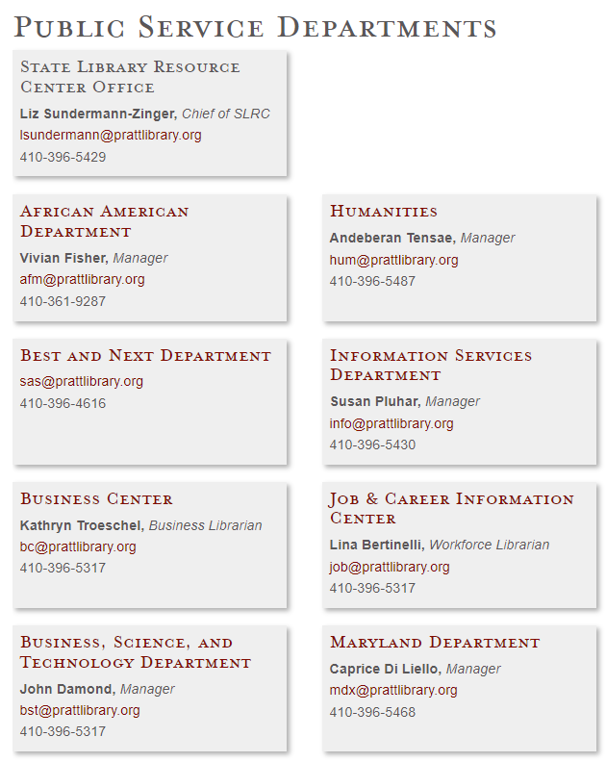
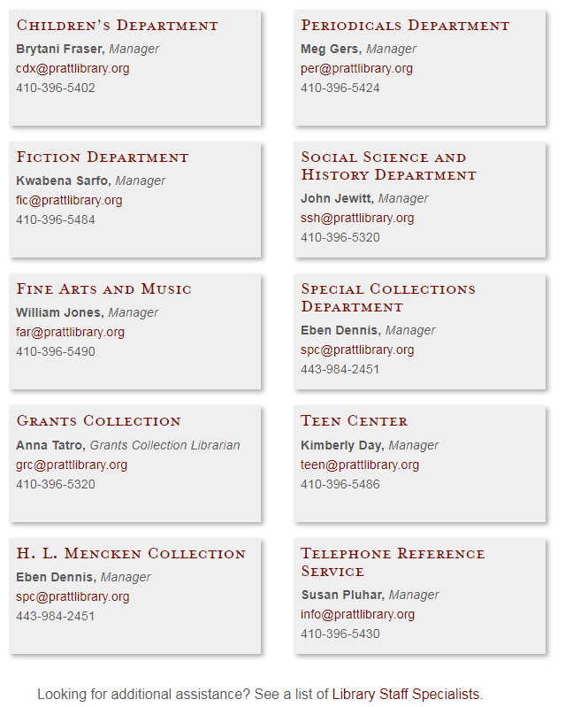
Subject Departments & Contacts

Slide 8
SLRC
Collections

Slide 9
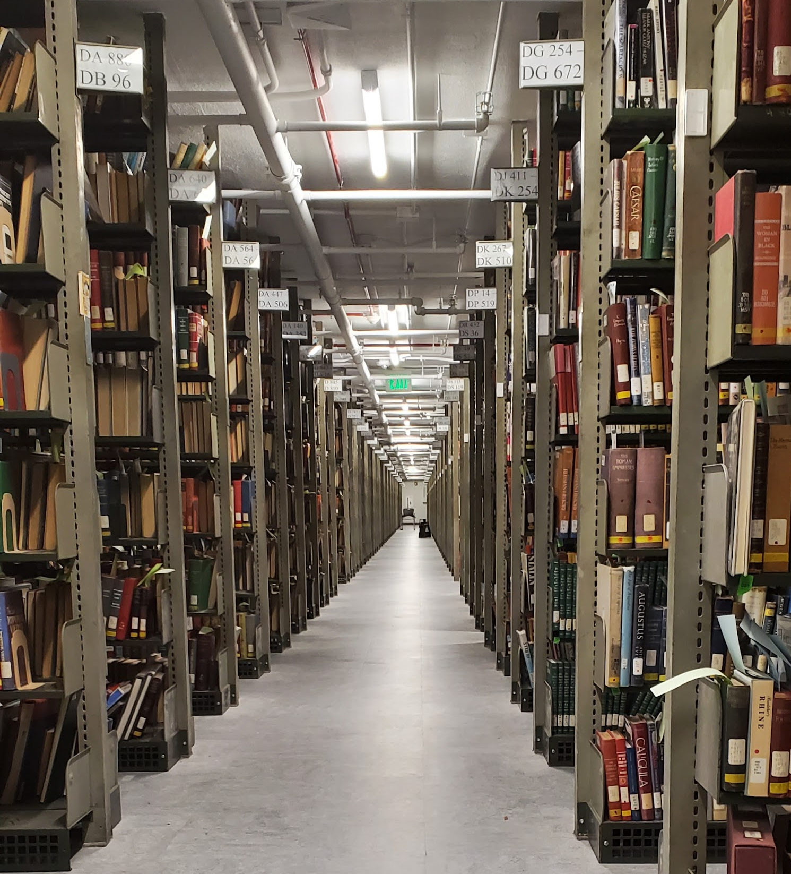
3 below-grade floors of
library materials.
Encompassing an entire
City Block!

Slide 10
Over 2 Million Items including:
SLRC maintains a collection of books, objects and resources that date from the 6th century BCE to the present, including:
100 years of Sears Catalogs
The papers of H.L. Mencken
African American Funeral Programs
Maryland High School Yearbooks
16mm films
Periodicals from the mid-C19th forward
Foundation Center Grants Collection
A sheet music collection of popular songs from the 19th, 20th and 21st centuries in over 3500 songbooks and other sources
Original early automotive repair manuals

Slide 11
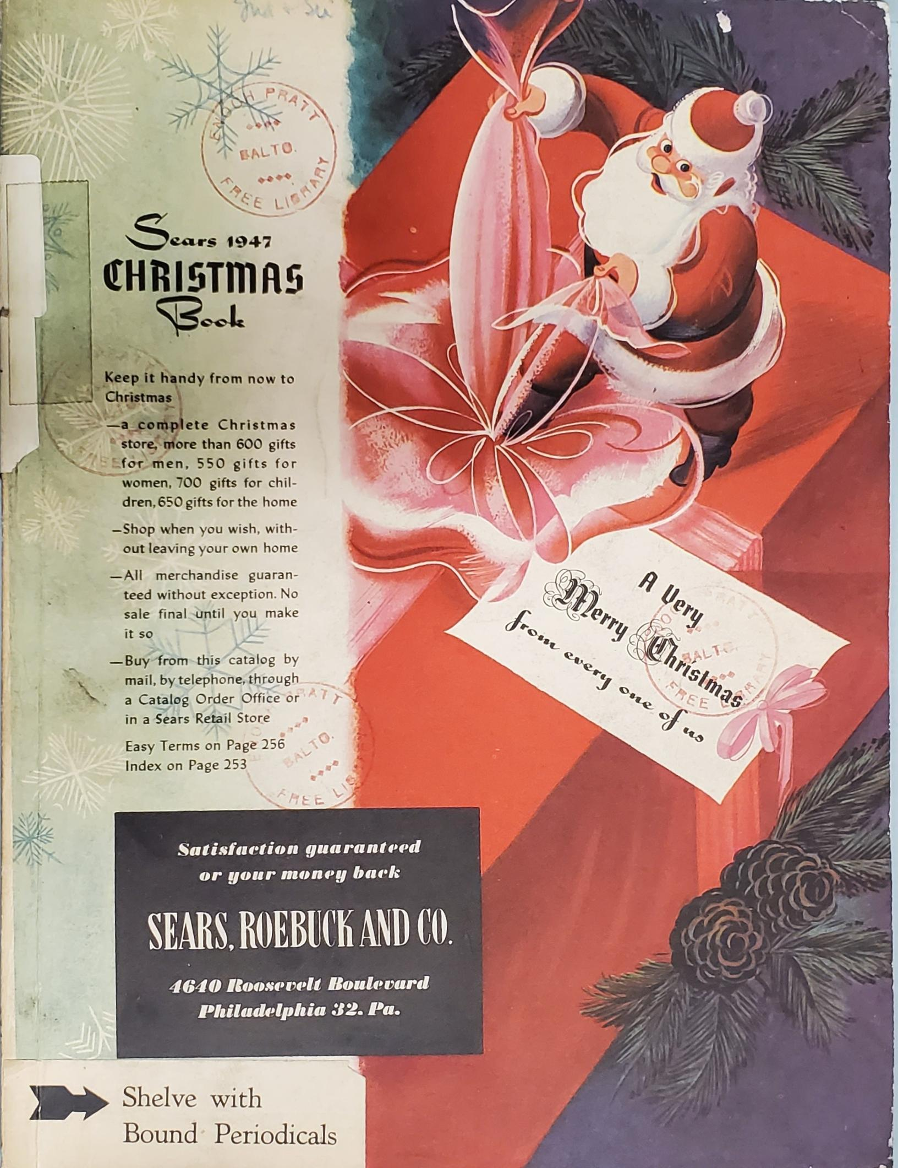
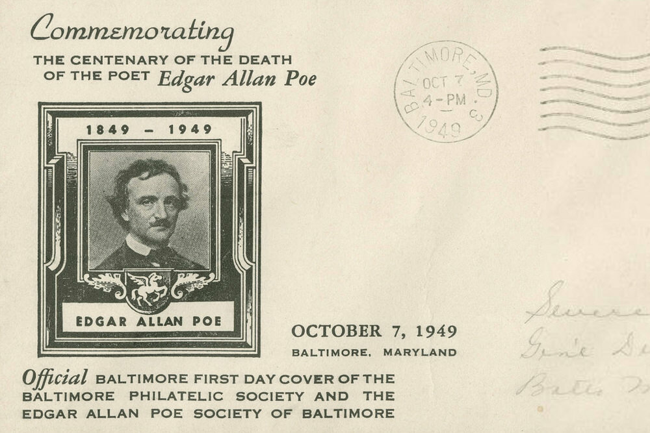
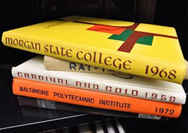

Slide 12
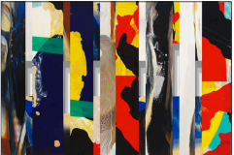
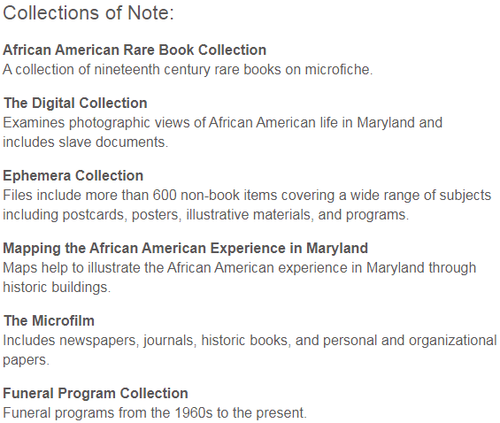
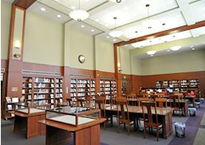
African American Department

Slide 13
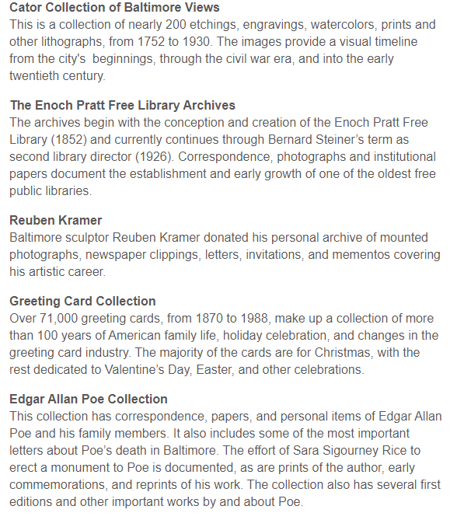
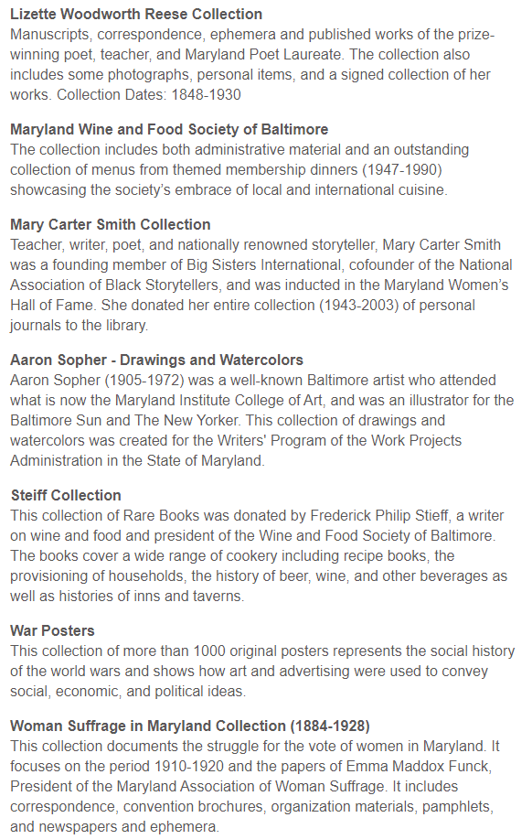
Special Collections Department

Slide 14
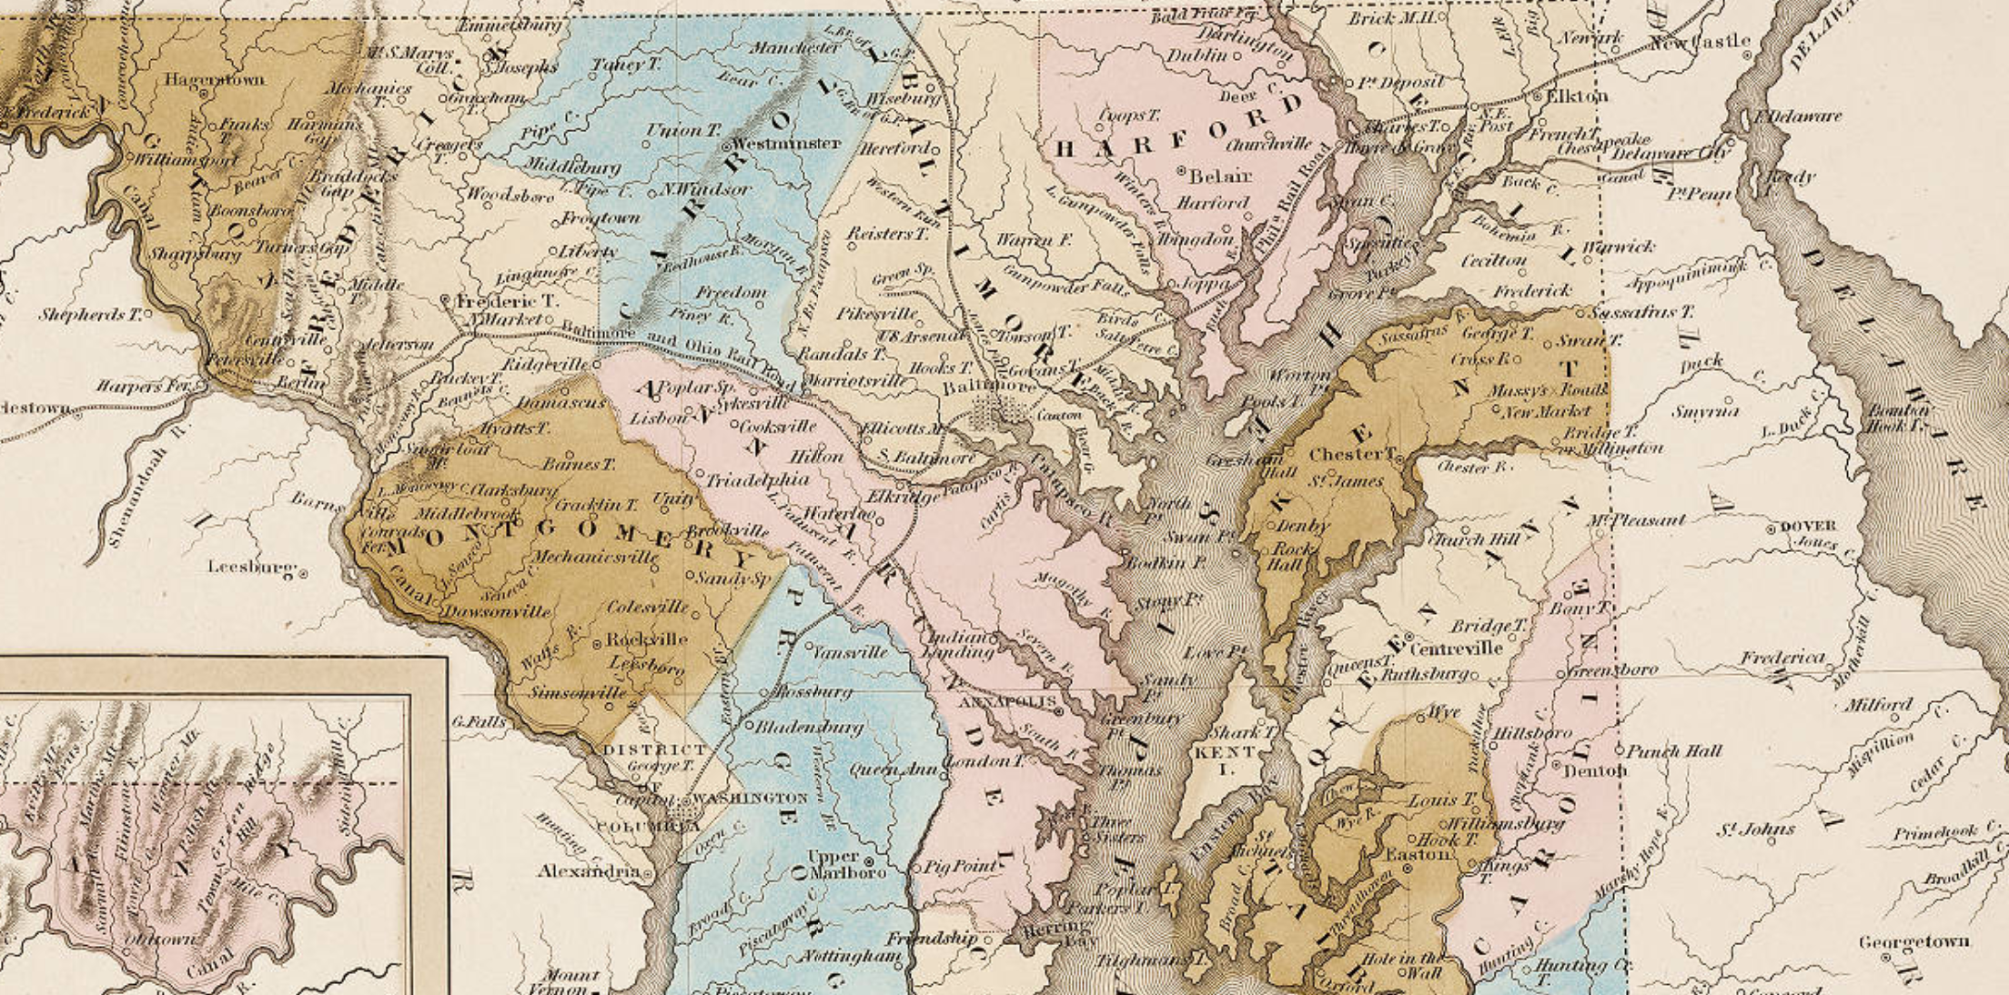
Digital Maryland
www.digitalmaryland .org

Slide 15
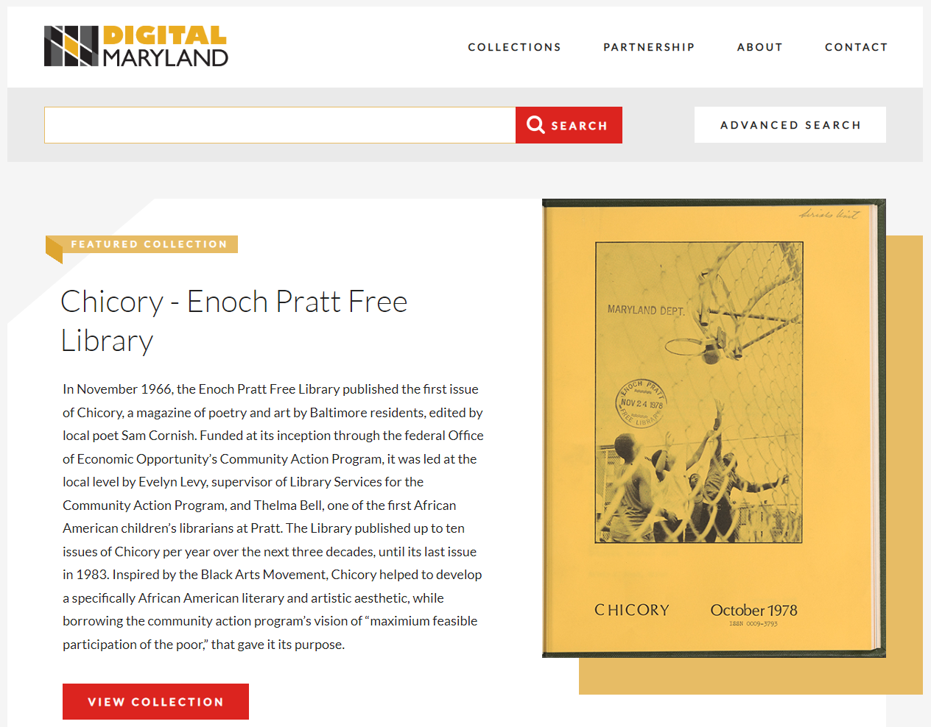

Slide 16
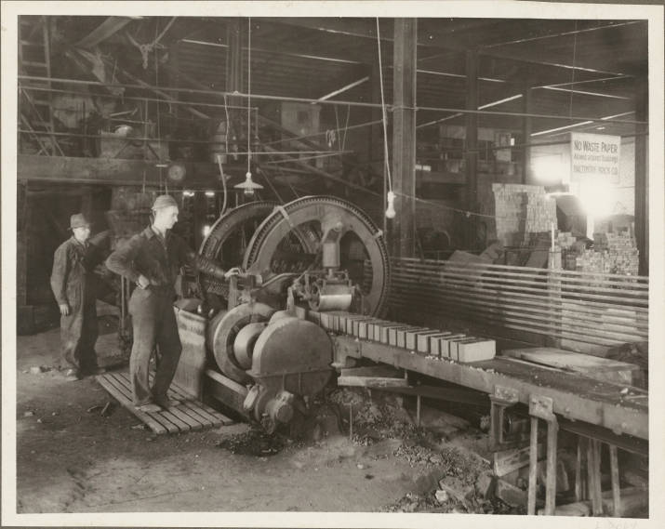
•Genealogy & Family History Research • Historical research •Primary source materials • Images for presentations • Materials for exhibitions • Publications
Baltimore Brick Company Assembly Line, Photographs from the Maryland Department, Enoch Pratt Free Library, Digital Maryland, Identifier mdph1132

Slide 17
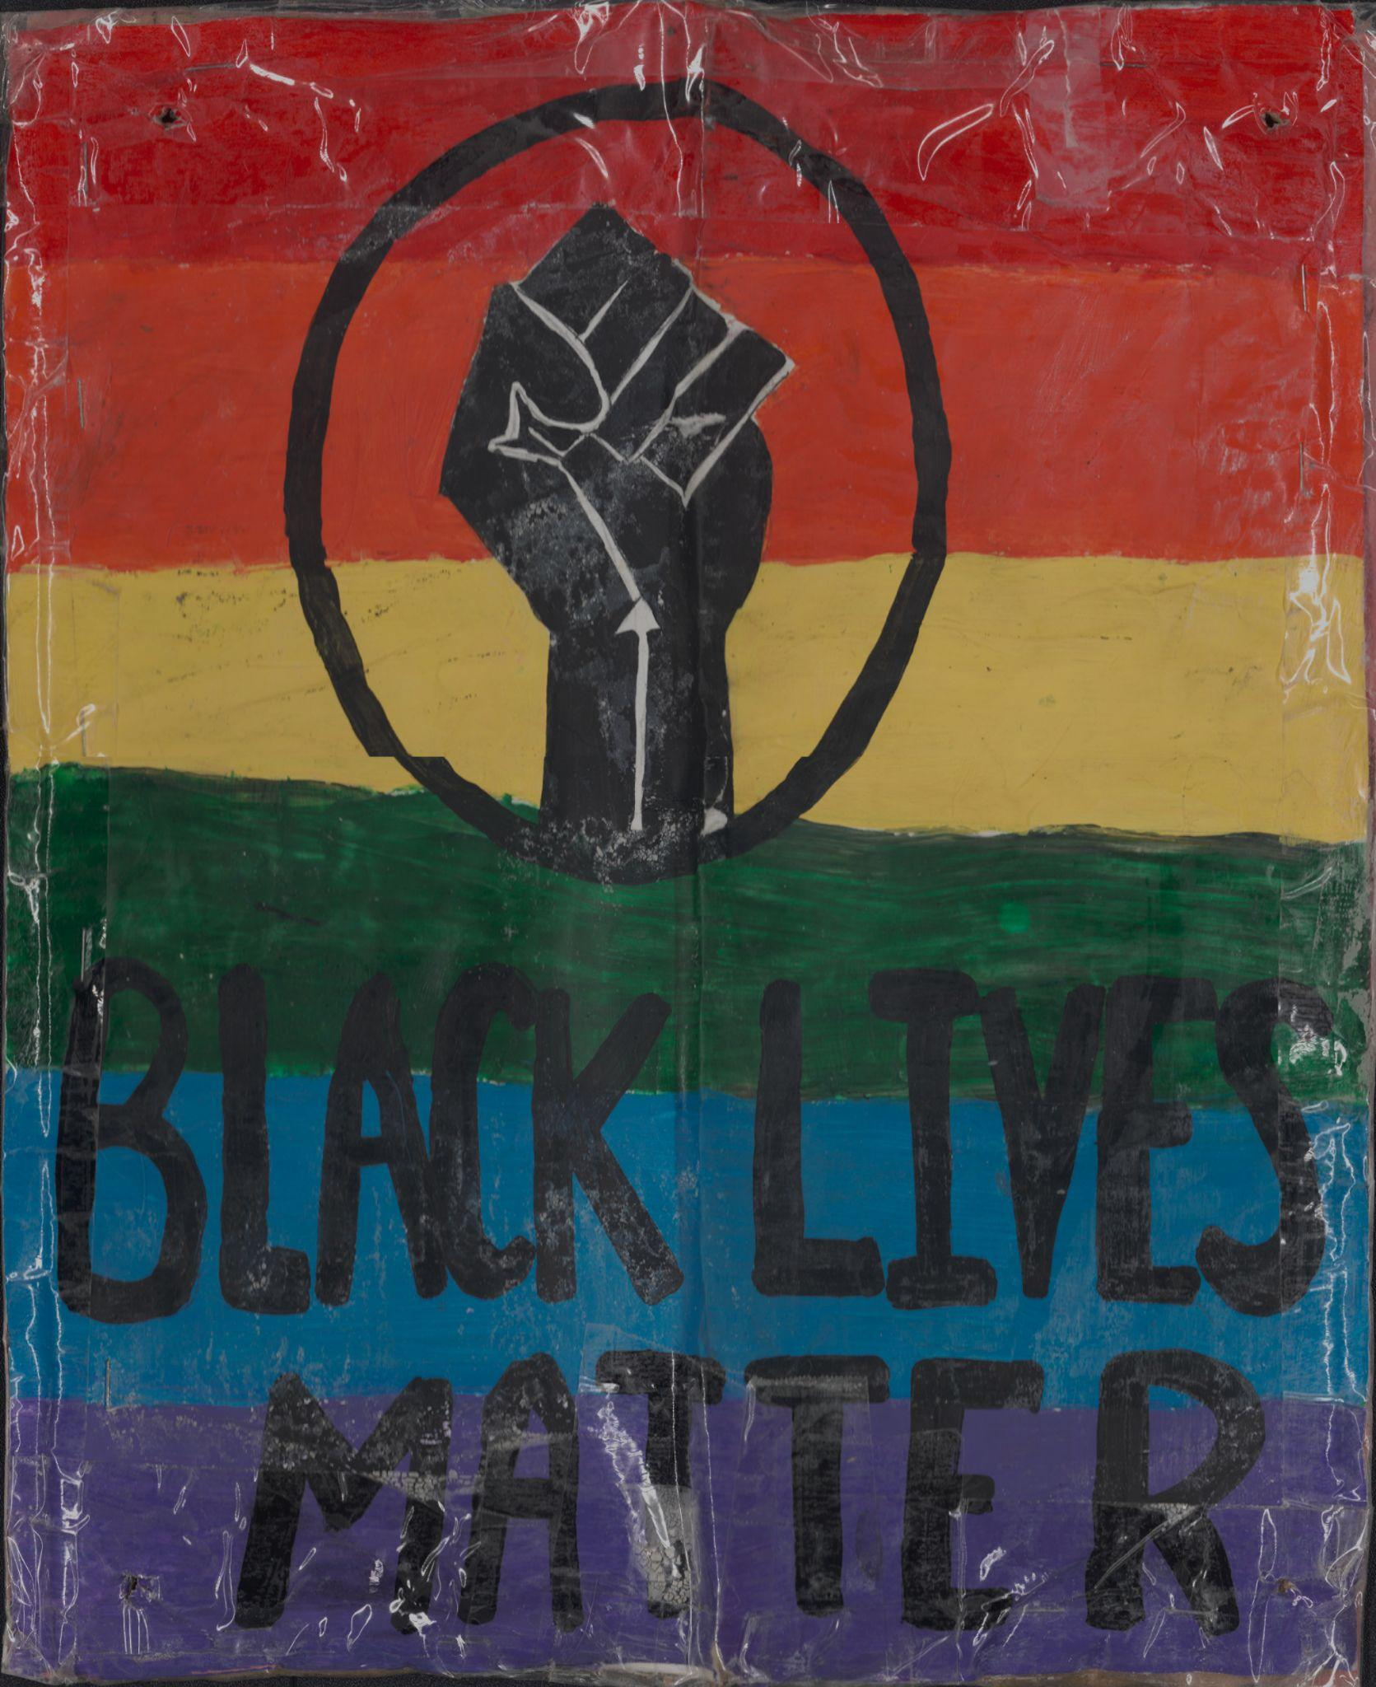
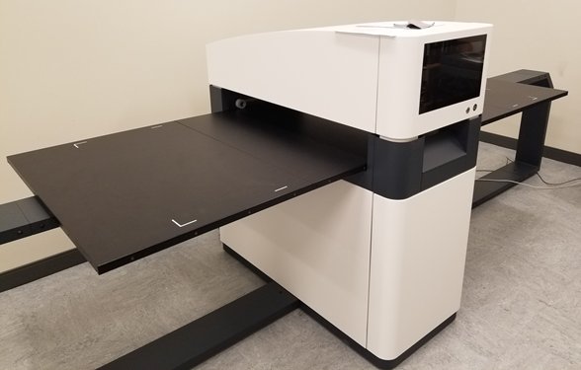
Web Portal · Digital Preservation · Scanning · Education and Outreach · Consulting · Metadata Standards · Networking · Promotion · DPLA Service Hub
Image from Black Lives Matter Memorial Fence Collection scanned by C. Harvey on the WideTek Art scanner.

Slide 19
Maryland State Publications Depository and Distribution Program SPDDP

Slide 21
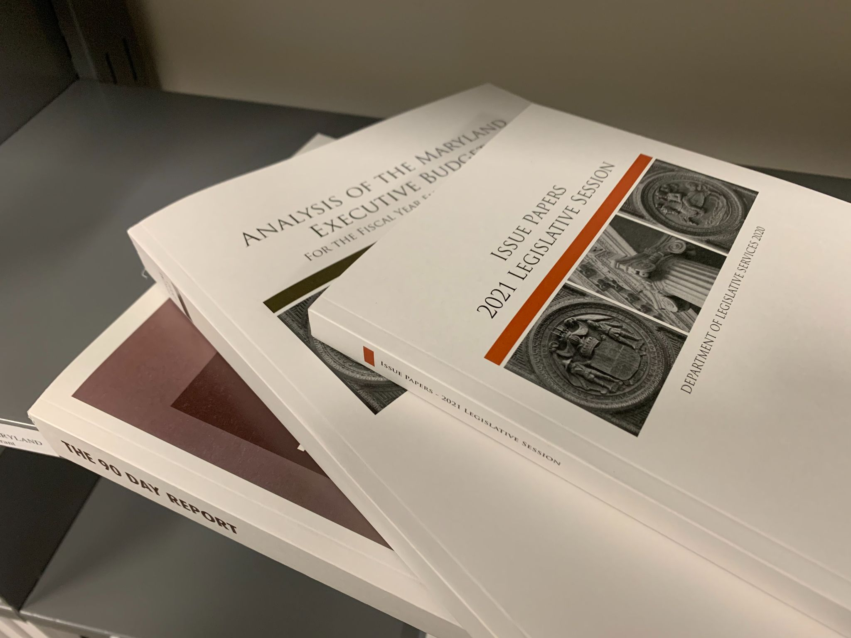
State Document Repository Libraries
Maryland Dept. of Legislative Services
Maryland State Archives
Maryland State Law Library
Enoch Pratt/Maryland Department
University of Baltimore
UMBC
Southern MD Regional Library
University of Maryland, College Park
Frostburg State University
Washington County Free Library
University of Maryland Eastern Shore
Salisbury University
Towson University
Library of Congress

Slide 22
https://mdstatedocs.slrc.info/digital/collection/mdgov

Slide 23
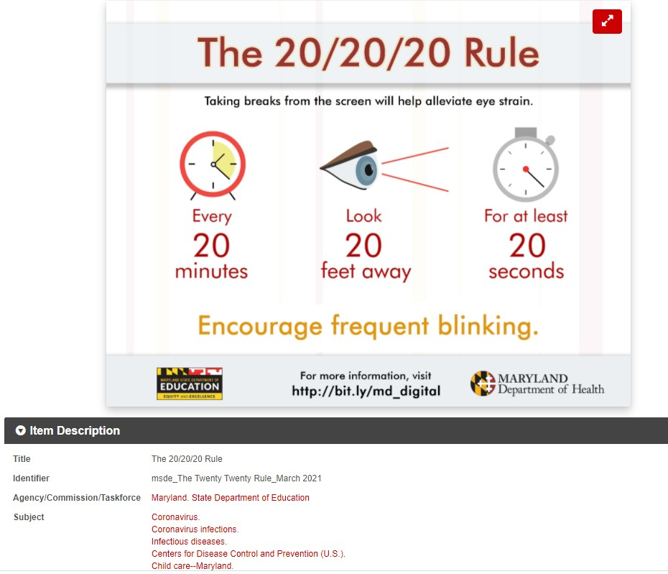

Slide 24
SAILOR Database Project

Slide 25
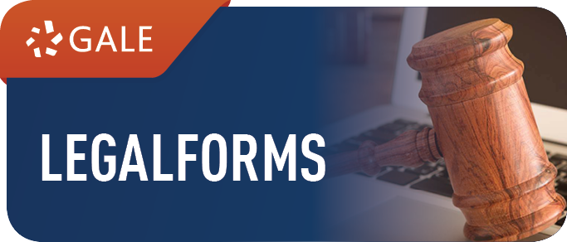
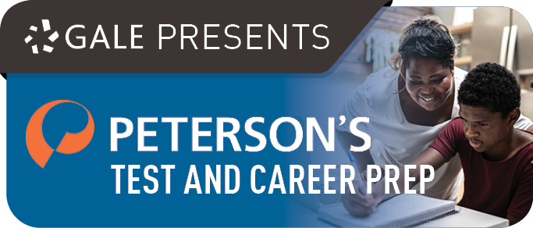
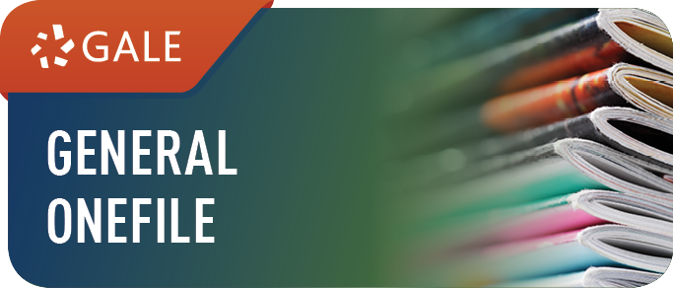
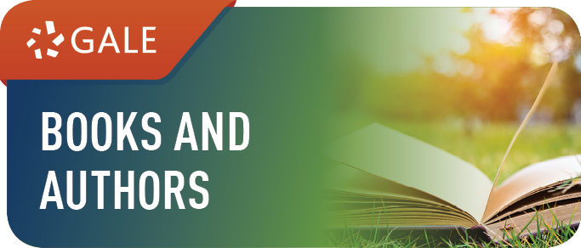
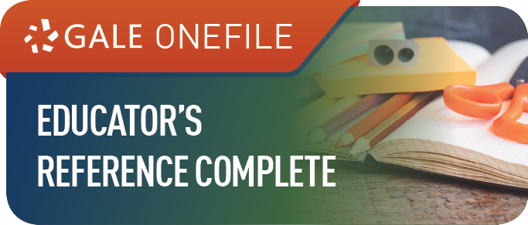
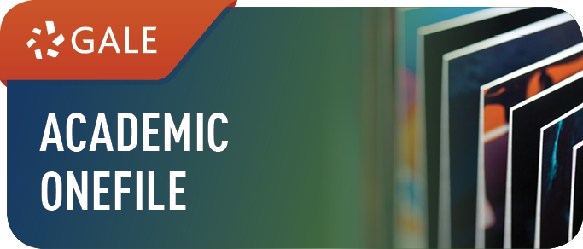
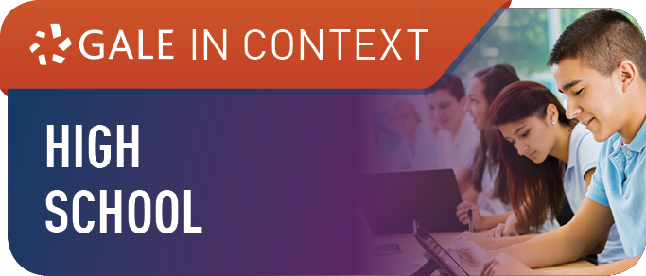
SAILOR Research Databases
Available to all K-12 Public Schools and all Maryland Public Library Card Holders
https://www.sailor.lib.md.us/services/databases/

Slide 26
Maryland Interlibrary Loan Organization
MILO

Slide 27
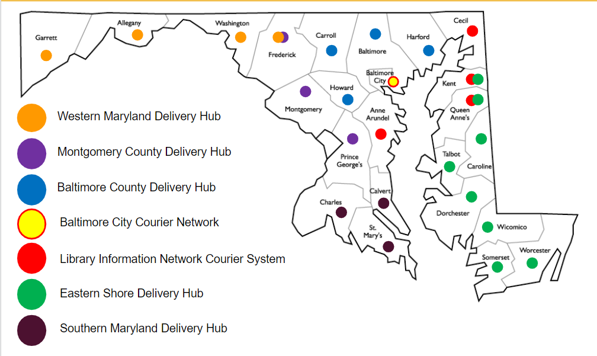
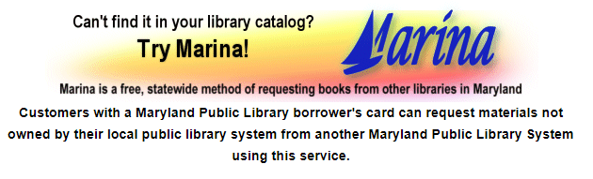
Maryland Interlibrary Loan Organization (MILO)
Maryland Public Library Systems
Borrow Only Partners include:
Allegany Community College
Baltimore City Community College
Carroll Community College
Cecil Community College
Garrett Community College
College of Southern Maryland

Slide 28
Professional Development

Slide 29
Professional Development
Multiple annual themed conferences advertised on Marylib
SLRC Conferences
SAILOR E-Resources Symposium
Circulation Conference
September 28, 2022
Call for proposals open now. https://bit.ly/3uGP0N1
Annual Spring and Fall webinar series on current topics

Slide 30
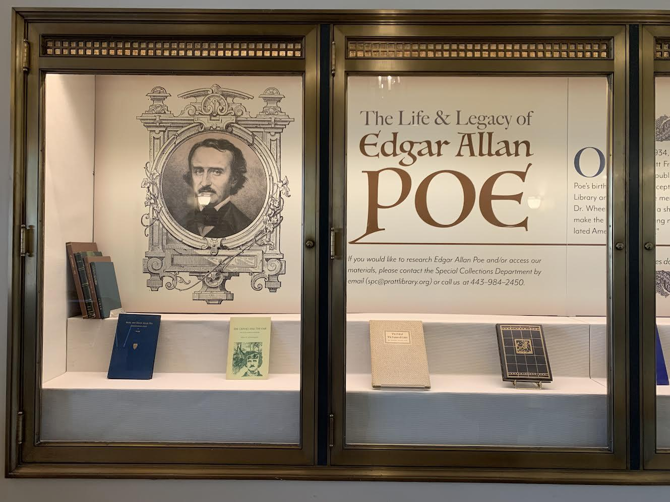
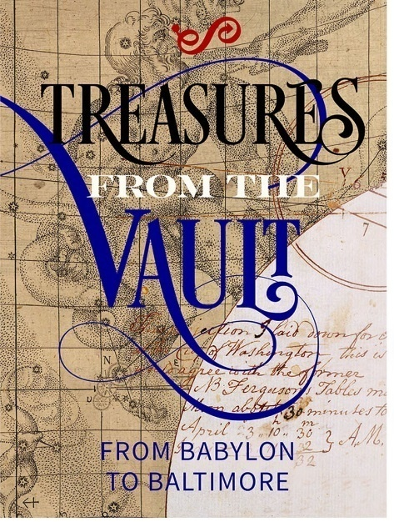
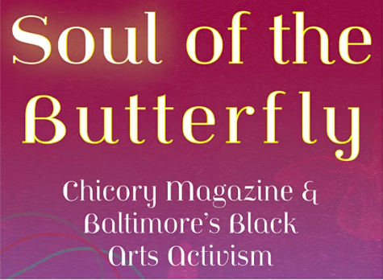

Slide 31
Thank You!
Jodi Hoover
Digital Resources Manager
Enoch Pratt Free Library
State Library Resource Center
jhoover@prattlibary.org
John Jewitt
Manager, Social Science and History
Enoch Pratt Free Library
State Library Resource Center
jjewitt@prattlibrary.org

