Slide 1
Transforming
Academic Library
Orientation
in Times of Change
Kelly Banyas
Research & Instruction
Librarian for Social Sciences
Washington College
kbanyas3@washcoll.edu
Marleen Cloutier
Assistant Professor
Cataloging & Metadata Librarian
University of Scranton
Weinberg Memorial Library
marleen.cloutier@scranton.edu
Jennifer Galas
Systems Specialist
& Web Developer
University of Scranton
Weinberg Memorial Library
jennifer.galas@scranton.edu
Towson Conference for Academic Libraries
July 20, 2022
Notes:
Hello and thank you for viewing our presentation on “Transforming Academic Library Orientation in Times of Change”
This session addresses how librarians at the Weinberg Memorial Library, motivated by the challenges of the COVID-19 pandemic, reimagined and revitalized its orientation activity for incoming first-year students by utilizing a new platform. We will outline the positive changes made in collaboration with multiple departments on campus to transform and ultimately improve the Heritage Hunt program over time. You will learn about steps taken to reduce the program’s impact on staff through automation and will discuss adaptations to the orientation program to expand the experience to other student and University communities year-round with minimal impact on library staff. You will also discover tools and strategies for creating similar orientation sessions at their institutions, including platform testing and modification, marketing of the program, and improving assessment, including analysis of feedback from student participation.
Image credit: Compass Rose # 506622 created by chiara ardenghi from the noun project

Slide 2
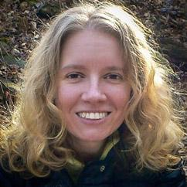
Who we are
Kelly Banyas is the former Research & Instruction Librarian for Student Success at The University of Scranton Weinberg Memorial Library and the current Research & Instruction Librarian for Social Sciences at Washington College.
Marleen Cloutier is the Cataloging and Metadata Librarian in the Technical Services department of the Weinberg Memorial Library at The University of Scranton.
Jennifer Galas is a Systems Specialist and Web Developer in the Library Systems and
Digital Services departments of the Weinberg Memorial Library at The University of Scranton.
Notes:
Now for a little about who we are
Hi my name is Kelly Banyas and I am the former Research & Instruction Librarian for Student Success at The University of Scranton Weinberg Memorial Library and the current Research & Instruction Librarian for Social Sciences at Washington College.
My name is Marleen Cloutier and I am the Cataloging and Metadata Librarian in the Technical Services department of the Weinberg Memorial Library at The University of Scranton.
My name is Jennifer Galas and I am a Systems Specialist and Web Developer in the Library Systems and Digital Services departments of the Weinberg Memorial Library at The University of Scranton.
We are members of the 2021 Heritage Hunt committee responsible for reimagining and organizing The Heritage Hunt, Weinberg Memorial Library’s orientation activity for incoming first-year students.
Image caption: Images of Kelly Banyas, Marleen Cloutier & Jennifer Galas

Slide 3
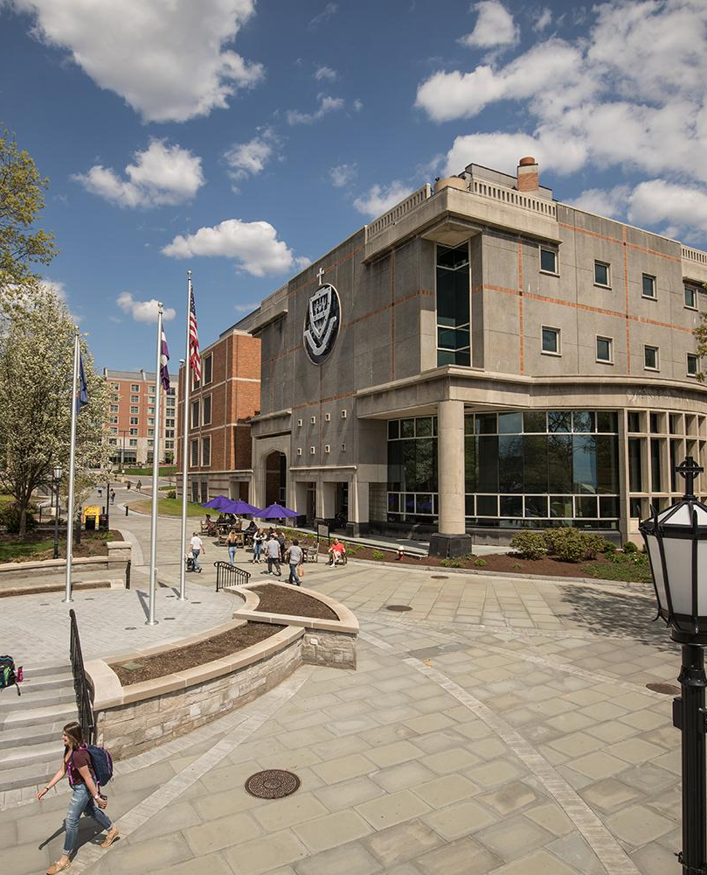
Weinberg Memorial Library (WML)
Catholic and Jesuit University
Located in Scranton, PA
Fall Enrollment 2021
4,692 total
3,487 undergraduate
685 graduate (on-campus - full-time)
281 Full-time Faculty
8 Full-time Faculty Librarians
80,000 s.f. facility includes five floors of accessible collections and study spaces
Notes:
Weinberg Memorial Library is located in Scranton, Pennsylvania on the campus of The University of Scranton, a Catholic and Jesuit University. We enroll just under 5,000 students each fall, the majority being undergraduate students. We also have both on-campus and online graduate programs. There are currently 281 full-time faculty on campus, including 8 full-time faculty librarians. Our 80,000-square-foot facility includes five floors of accessible collections and study spaces.
Image Caption: Exterior view of the Weinberg Memorial Library at The University of Scranton
Image Copyright: University of Scranton

Slide 4
“The library is in a unique position to bridge the academic and social pieces
of the college experience”
- Barbara Eshbach
Notes:
Barbara Eshbach stated that “the library is in a unique position to bridge the academic and social pieces of the college experience” (2020).
Image credit: Compass Rose # 506622 created by chiara ardenghi from the noun project

Slide 5
Academic Library Orientation Programming
Academic library orientation programming is one of the first opportunities for students to be introduced to the library. This type of programming plays a significant role in student learning and development by
Engaging student both academically and socially
Introducing students to library spaces and functions
Identifying library services available to students
Connecting students with library faculty and staff
Providing an opportunity for students to make connections with other students
Notes:
Library orientation programming is a way to bridge that gap. It is one of the first opportunities for students to be introduced to the library and plays a significant role on campus when it comes to student learning and development. Library programming empowers students with knowledge and tools that will help them as they advance through their college experience. Introducing students to library spaces and services helps to relieve the anxiety that may come with the unfamiliar. For many students, this will be their first time on a college campus and for some even the first time using a library. Additionally, this type of programming offers an opportunity for connection not only with library faculty and staff but also socially with other students on campus. Having a positive engagement experience improves student confidence and makes it more likely that students will visit the library, reach out to librarians, and use the library's resources. (Eshbach, 2020; Goldman et al., 2016).
Image credit: Graduation Library #3686255 created by AmrulD from the noun project

Slide 6
Early Orientation Programming at WML
Early library orientation programming efforts included as part of a one-credit
freshman seminar course were not a good fit and lacked student engagement
Repetitive content
Time consuming for Library staff
Lacking timeliness to be useful for students
Students were not retaining the information taught
A 2012 curriculum overhaul and the discontinuation of the one-credit freshman seminar course led to reevaluation of Library's orientation program.
WML needed to develop a new orientation program to match new curriculum format and address issues with the previous orientation programming!
Notes:
Prior to 2012, library orientation programs at the Weinberg Memorial Library took place during one session of a one-credit Freshman Seminar course that all incoming students were required to take. A large-scale University of Scranton curriculum overhaul proposed in 2009 and implemented in 2012 would do away with several required basic courses, including the Freshman Seminar, which was replaced by a new three-credit First-Year Seminar course. As it was originally taught, the library orientation program was not thought to be a good fit for the format of the new seminar course. Teaching the sessions quickly became repetitive and required a large amount of staff time and energy that encroached upon their other duties. And because the library orientation program could be scheduled at any time throughout the semester, students often needed to use the library for their coursework before having any kind of formal introduction to its layout or resources. Additionally, the librarians had noticed a lack of student engagement with their orientation sessions, and they realized throughout the academic year that students were not understanding or retaining the information taught in the sessions.
Image credit: orientation #1574575 created by Massupa Kaewgahya from the noun project

Slide 7
New Orientation Criteria
A Library committee was formed to develop a new orientation format that would meet curriculum goals while providing a more engaging experience for students
Requirements:
Reach 70+% of freshman class
Take place during the first two weeks of the semester
Reduce burden on library faculty
Increase motivation and engagement
Notes:
Therefore in 2012, a group of librarians convened to develop a new orientation format that would meet curriculum goals while providing a more engaging experience for students.
Initial requirements for the new orientation program were to:
Reach a large percentage (at least 70%) of the freshman class
Take place during the first two weeks of the semester, so students would discover library resources before they needed to use them for their classes
Reduce faculty burden by requiring little individual planning per session
Keep librarian motivation as well as student interest high
Image credit: Check box #10759 created by Laurent Sutterlity from the noun project

Slide 8
WML presents… The Heritage Hunt
The orientation program developed
Utilizes a scavenger hunt as a vehicle for orientation content delivery
Augmented reality was considered
Relies on questions accessed from a mobile website using student-owned phones and tablets
Requires that each group of students would need to have at least one Internet-connected device
"Routes" to send each group on a different path through the building
Collaborated with the University IT department to create a signup form to assist in the scheduling and grouping of students
Notes:
As a solution the Weinberg Memorial Library presented…The Heritage Hunt: an orientation program developed to utilize a scavenger hunt as the vehicle for content delivery.
Gamification or game-based learning was gaining in popularity at the time, and several libraries had begun to use activities like scavenger hunts to introduce students to all aspects of their libraries—physical spaces, library staff, and library resources. The committee of librarians decided to develop a similar hunt, expecting that it would be an efficient way to reach their goals for the new program, and would be fun and engaging for students. Rather than relying entirely on technology, the librarians also decided to include a brief period of instruction at the beginning of each session to introduce students to basic library concepts and terminology and explain how they would proceed through the hunt. This would be simple for the librarian to teach and would help the students to understand what they were going to learn and why it was important.
An augmented reality scavenger hunt based on the use of QR codes was initially considered, but the committee was not comfortable with requiring students to download code-reading software on their devices, or with purchasing devices to be used solely for the orientation activity. Instead, the committee decided to use the library's new mobile website as a basis for displaying clues.
A study of University of Scranton students conducted in 2010 showed that only 69% of students owned Internet-capable smartphones at the time, which meant that students would probably need to be grouped together and share devices. This led to the idea of "routes," which sent the groups of students on different courses throughout the library building so that groups generally do not land in the same location at the same time.
This in turn led to the need for scheduling multiple sessions of 24 students broken up into six groups of four. The Information Technology department then created a form that would allow students to sign up for a session that fits into their schedule. The form also asked whether the student had a smartphone or tablet. The underlying application capped each session at 24 students. The accompanying administrator interface for the application allowed each instructor to group their students so each group had at least one smart device, and it allowed the instructor to mark students absent from their session.
Image: Heritage Hunt Logo

Slide 9
The importance of remaining flexible
Unexpected roadblocks happen
Integration with other systems, like University websites that other departments control, can fail or change without notice
Websites or entire networks can go down
Devices/hardware failures
Ease of "sharing answers"
Unexpected staff absences
Notes:
One lesson learned early on was the importance of remaining flexible. In its first year, several confounding factors made question development difficult, and some Heritage Hunt questions remained in flux until the last possible moment. For example, last-minute, unannounced changes to the University's mobile website redirected links that the Hunt relied on and made it very difficult to find a particular journal's catalog records. For the first version of the hunt, librarians ultimately had to employ typed narratives that students would discover in particular locations and that would give them the answers to the questions. This didn't work out well because the students simply ended up skimming the narratives for the answers. There were also several suspected cases of "cheating," where students shared their answers among groups, so obviously those students missed out on several of the locations and narratives. The committee also considered that it was possible for the campus network or devices to go down, or for staff that were relied on to augment portions of the hunt to be unexpectedly absent. These unexpected roadblocks during the inaugural Heritage Hunt made it clear from the beginning that it was vital to remain flexible, come up with backup plans when possible, and to take each problem into account when designing the following year's program.

Slide 10
“The librarians who taught Heritage Hunt sections unanimously agreed that the overall program was successful and a welcome alternative to the classic format of teaching Freshman Seminars throughout the semester.”
-George Aulisio
Notes:
Even with the unexpected roadblocks and need for future adjustments, George Aulisio, the first coordinator of the Heritage Hunt and current Dean of the Library, noted that “the librarians who taught Heritage Hunt sections unanimously agreed that the overall program was successful and a welcome alternative to the classic format of teaching Freshman Seminars throughout the semester” (2013).
Image credit: Compass Rose # 506622 created by chiara ardenghi from the noun project

Slide 11
Improvement over time
Each iteration of the Heritage Hunt has brought some improvements …
Re-incorporating QR Codes
Purchasing iPads for students to use during the Hunt
Requiring each question to be answered before obtaining the clue to the next location
Demonstrating the printing process
Developing multiple versions of some questions, so each group has a different task to complete
Notes:
Later versions of the Hunt addressed some issues we had noticed by returning to the idea of QR codes, which were used in various ways since 2014 to guide students to their next question. In fact, the library reversed a previous decision to not purchase technology and purchased iPads to lend out to students, and they were used by each group to complete the hunt, beginning in 2014. In some cases students had to locate their group's QR code in a particular location and scan it to retrieve their next clue. In others, they were given the code by a staff member after completing a task.
We added a printing component to reduce the frequency of "how do I print?" questions asked of library faculty and staff at the beginning of the school year. And we developed multiple versions of some questions to make it difficult for groups to "cheat" and steal the answers from other groups.
This basic format, with improvements made each year, continued through 2019. We retained the instructional session at the beginning of the period, the QR codes for guiding the groups through the routes, and the online registration system that was incrementally improved over the years.
Image Credit: Process improvement # 4427243 created by Eko Purnomo for the noun project

Slide 12
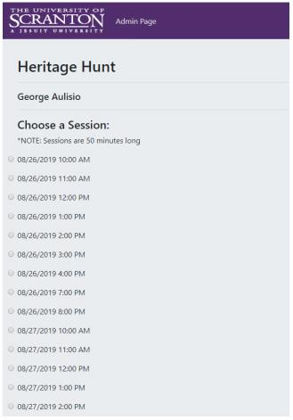
Collaboration with IT Departments
Campus IT
Build registration forms
Integrated registration system with campus Single Sign-On system
Resolve bugs; suggest and implement improvements
Library Systems
Prepare iPads
Create web pages
On-site availability
Screenshot of the Heritage Hunt registration system
Notes:
Collaboration between the library and our campus IT department has been a key part of the Heritage Hunt since it began in 2012. As mentioned, the IT department created a registration form for the first Heritage Hunt and made it available on our website. The first Heritage Hunt even had a web form for collecting responses to the questions on the Hunt, although this concept was later dropped to allow for more flexibility in answering questions.
Over the years, developers in the IT department have worked back and forth with library staff and faculty to refine and further automate the registration process, most recently configuring the system so that students could modify their own signup time instead of needing to call and have a librarian make the change for them. This removed a large burden from library faculty. The newest iteration of the registration system is also tied to our University-wide single sign on system and requires two-factor authentication, for greater security. The IT department has diligently worked to properly implement our suggested improvements, while offering access to the application on a development server so we can test it before any changes go live.
Our own library Systems department has also been an important partner in the success of the Heritage Hunt. Systems staff prepare the iPads for student use during the Heritage Hunt, making sure that the QR code reader app is installed and functioning, ensuring that the iPads connect seamlessly to the proper network, and setting up a secure system for charging the devices between sessions. In earlier iterations of the Heritage Hunt, Systems staff created web pages in our University CMS to display clues. And Systems staff are always available on-site to help with any problems that arise during the sessions.
Image credit: Screen shot of Heritage Hunt registration form

Slide 13
Heritage Hunt Evolution & Collaboration
Started as an information literacy session
Now involves whole library
Annual meetings for feedback
Make adjustments as needed
Run by committee of volunteers
Notes:
With the expansion of the orientation into the library itself, it has grown to be an event that involves staff and faculty on all levels and so we need to be very collaborative. Meetings are often held leading up to the Hunt in the summer to get input and feedback from the staff and faculty most directly involved- those at the service points involved in various tasks, library systems, and those who would teach the session introduction- and we frequently communicate throughout the week of the hunt to check in with departments. This has allowed for various adaptations to be made, especially if certain tasks for the hunt are causing pressure points within departments.
The Hunt is currently overseen by a small committee with volunteers from various departments. This group works with Library administration to offer the hunt each year, calls the meetings for those involved, and recommends changes to the administration and the faculty and staff of the library based on new technologies, the campus environment, and student, staff, and faculty feedback.
Image credit: Compass Rose # 506622 created by chiara ardenghi from the noun project

Slide 14
Heritage Hunt Overview
Approximately 40-45 sessions
50 minute sessions
24 students per session
6 groups of students
Teams A-F
Scheduled Monday - Friday
In 2019
Monday - Thursday: 10 am - 5 pm, 7 pm - 9 pm
Friday: 10 am - 2 pm
Notes:
So what does the Heritage Hunt look like? We typically schedule 40-45 sessions, depending on the size of the incoming class. Each session runs about 50 minutes, with the sessions starting on the hour. Each session allows 24 students to register, but we can override that if students ask to attend with their friends/roommates (which often happens). As Jen mentioned, we break students into 6 groups but sometimes have less depending on the number of registrants. We only run the hunt the first week of classes, so we schedule Monday through Friday. Most sessions are held during the day when we’re most robustly staffed, but we do schedule evening sessions to accommodate students who may have busy course schedules during the day. For example, in 2019 the Hunt ran from 10 am until 5 pm, with evening sessions at 7 and 8 pm. There would typically be 8-9 sessions a day, so staffing would prove difficult even in the best of times. On Fridays sessions end early due to conflicting scheduled campus events.
Image credit: Compass Rose # 506622 created by chiara ardenghi from the noun project

Slide 15
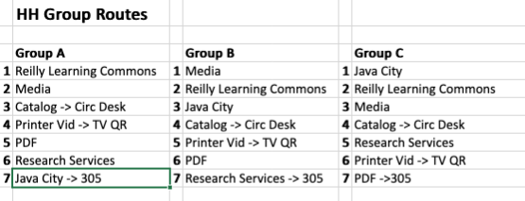
Heritage Hunt Routes - 2019
The students, using technology (a library-owned iPad) to scan QR codes, complete a series of tasks and submit a paper worksheet with their responses to the clues at the end of the session. 6 different routes cover 4 floors of the library. At each location students would scan a new QR code to get their next task. The students return to the classroom when they complete the hunt.
Notes:
As Jen previously discussed, up until 2019 we had different randomized routes for each group of students to complete and students would start in a room with an instructor to take attendance, provide some general knowledge about the library and call numbers, and give them basic directions to scan the QR codes for their assigned group with a library ipad to bring up their task. Each task would end with telling them how to get the next QR code. Students would write down answers to the various questions throughout on a provided worksheet.
For example, for the 2019 Heritage Hunt route A would start the students off in the Reilly Learning Commons on the first floor of the library, where they would identify three pieces of technology or locations, like the audio recording room, reservable group study rooms, and 3D printing.
They would then go to the third floor to the Media Department, where they would ask the staff for a DVD to watch in the viewing room which gave an overview of the library.
The Media staff would give them the next code that instructs them to do a search in the catalog on the ipad to look up a book and go upstairs to the 5th floor to take a picture of that book. They then go to the first floor of the library to show this book picture to the circulation staff member,
who would give them the next code directing them to go to the second floor of the library, where they would watch a video on how to print and
practice on the computer by locating a PDF to download in one of the library’s databases
The next clue would take them to the Research Services desk on the same floor, where they would hear from a librarian about the various ways to get research support and the librarian would give them the next clue.
Finally, they would go back to the first floor to visit the library’s cafe and learn more about sustainability. They finally would return to the room where they started on the third floor.

Slide 16
Staffing of the Heritage Hunt - 2019
In 2019 - 4 library staff/faculty were needed per session
Librarian or MLIS-holding library staff member to start the Hunt
Librarians or Library Staff at three service points to give the next code:
Circulation Desk
Reference Desk
Media Services
Notes:
So in the hunt as I described, at least four library faculty or staff members are needed for each session. We would need the faculty librarian or MLIS holding staff member to start off the hunt. Three of the tasks I described involved stopping at the service desks to complete a task and get the next code. This means the hunt requires that someone be available at the service point at all times during the 50 minutes the session was running since groups would move through the hunt at different paces and could show up at any time. Some of the required tasks were quick and could be handled by student workers if needed, but the students don’t always work the first week of classes since they are still coming back to campus and figuring out their course schedules.
So with COVID-19 beginning in March 2020 and the complications that came with it, the committee and library had to work together to adapt orientation options for students in light of our new circumstances.

Slide 17
Changing and challenging times
No Heritage Hunt Fall 2020
Classes remote and limited in-person
Masks required
Social distancing
Limited enrollment
Online Student Orientation
Library hosted a breakout room
Created online welcome video
Shared with incoming class via listserv
Notes:
In Spring 2020, the University moved online. Students went home for spring break and did not return for the rest of the semester for in-person instruction or services. The Library was staffed minimally in person to reduce chances of transmission- work from home was instituted and in-person services and tasks were performed with staggered shifts. While there was initial optimism that we would be able to return to campus in Fall of 2020, this ultimately did not happen and the University remained primarily remote for the next year. Some classes were offered in person, but they were restricted to a limited number of students per class to accommodate social distancing and masks were required.
With these restrictions, limitations, and the general burnout and emotional toll that came with COVID-19, it simply wasn’t feasible to offer the Heritage Hunt in 2020. To introduce students to library services, a group of librarians participated in an online student orientation exhibit hall in summer 2020 and 2021, hosting a breakout room for students and their families to chat and ask questions.
In 2020, a description of the library and an introduction video were added to an online orientation course module that was shared with the incoming students. Student government shared that students were feeling overwhelmed and recommended an email with details about the library and social media postings would be appropriate for an orientation replacement. The orientation video and description of library services was sent out via a listserv to the incoming students as well as posted to the library’s blog and social media channels.
Image: Heritage Hunt Logo behind a red box with a slash through it indicating no access

Slide 18
Returning to Campus
COVID-19 and Fall 2021
In-person classroom instruction returns
Masks required
based on local transmission rates
Vaccination requirement
medical/religious exemptions
New touchless printing system added
Loss of staff / frozen positions
less staff available at service points
Notes:
With the availability of COVID-19 vaccines, things were much more optimistic for Fall 2021. The University announced its intention to move back to primarily being in person, and so Marleen, Jen and I started planning to offer the Heritage Hunt once again. We did want to make some updates, as we still were not even close to being completely back to normal. While in-person classroom instruction returned, masks were still required. There also was a vaccine mandate in place, with exceptions for medical and religious reasons. This allowed for students to gather together, but we still wanted to be cautious and not unnecessarily expose staff and students to each other for long periods of time (and avoid a super spreader event). COVID-19 also brought in a new touchless printing system, which students would be using for the first time in Fall 2021.
Adding to this, we also had many staff and faculty positions frozen, particularly at certain service desks, which meant we would be harder pressed to provide some of the in-person aspects of the hunt since they were highly interactive.

Slide 19
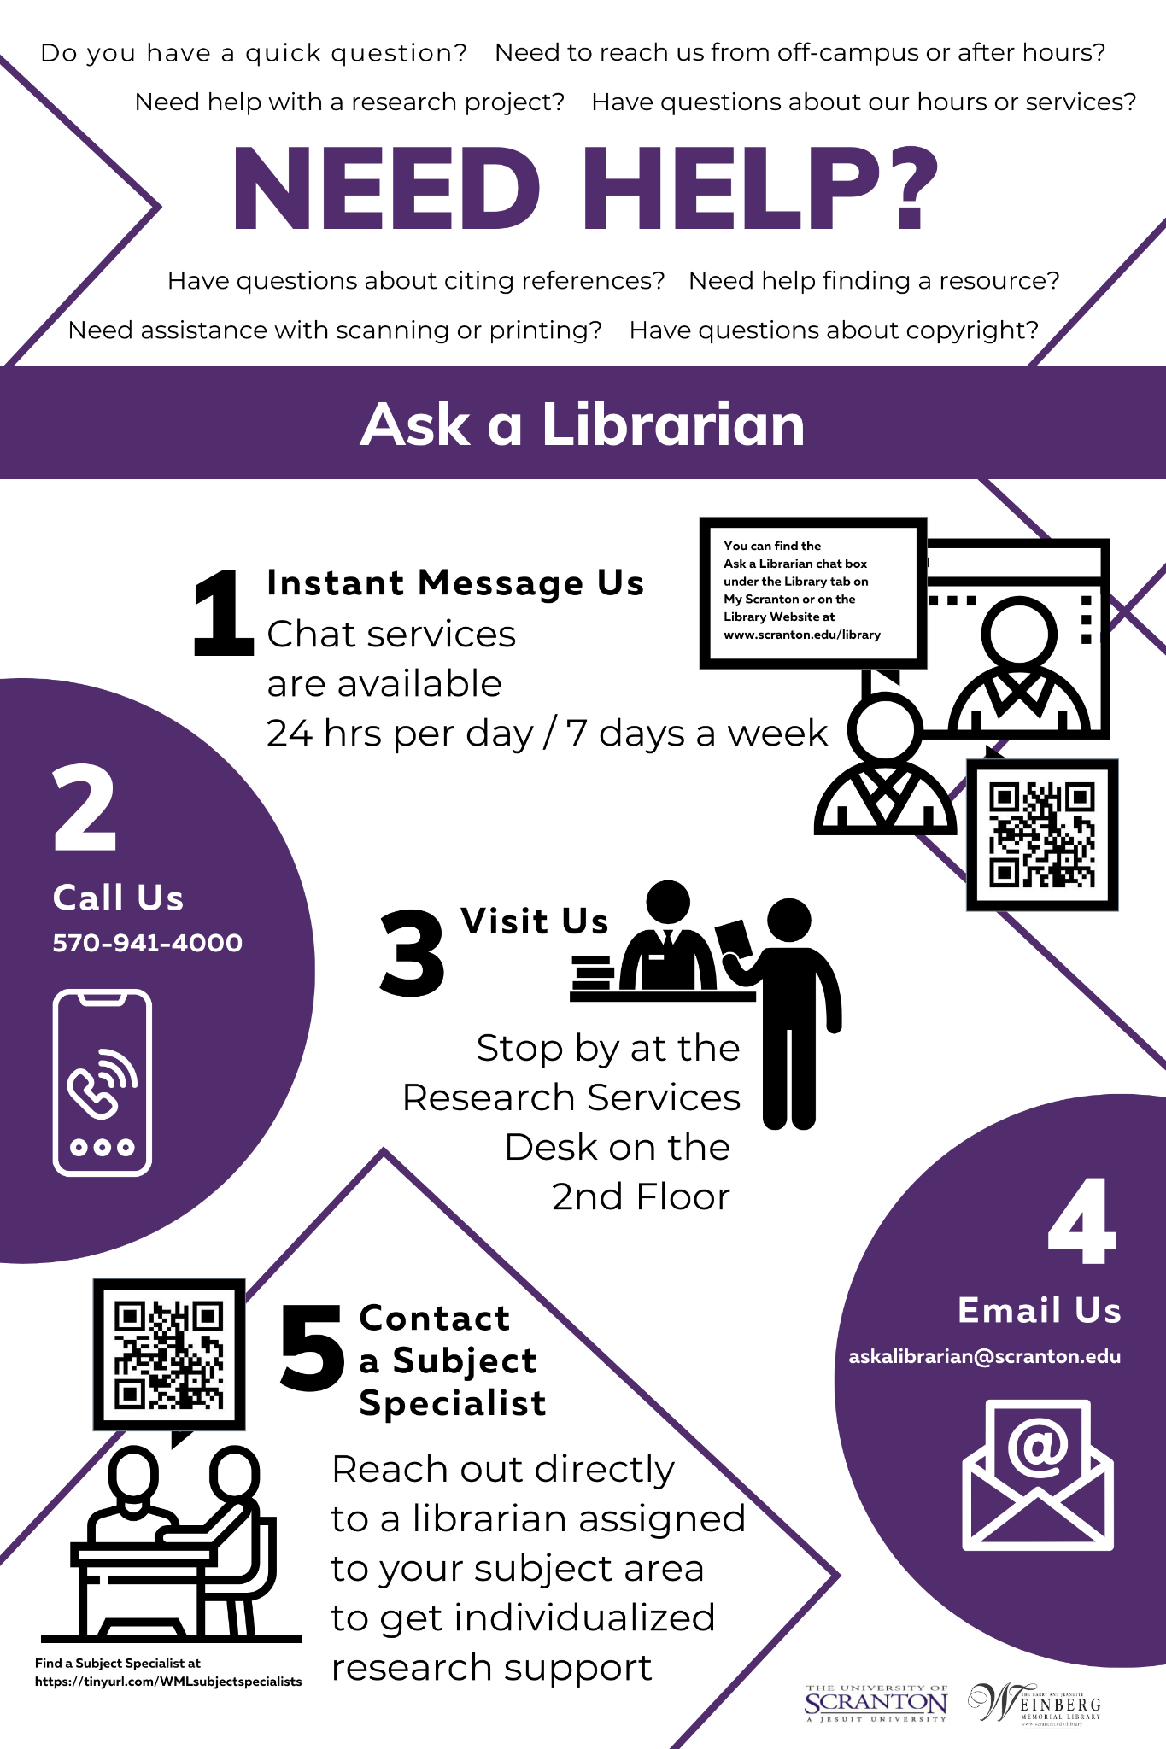
Changes needed for 2021
Revisions for 2021:
Shorter classroom introduction by embedding the content into the questions
Scripted talk at Research Services desk with librarian replaced with a “Need Help?” poster
Circulation Services and Media Services tasks modified to not require staff interaction
Notes:
One of the other big goals we made for 2021 was to reduce the amount of in-person contact during the Hunt. This was a trade off, as we wanted students to get to know the staff but also wanted to be mindful of people’s comfort levels and we were severely understaffed, particularly in Media Services.
First we decided to shorten the time spent in the classroom at the beginning of the Hunt. We wanted to embed some of that content in the tasks themselves as the students moved throughout the library. We still had a library faculty or staff member take attendance and introduce the hunt for some in-person interaction.
We also replaced the talk given by librarians at the Research Services desk with a poster listing all the ways to get help. Students had to locate the poster at the Research Services Desk, read it over, and identify how to contact a librarian 24/7. The poster is on the right side of the slide, and features QR codes they can scan to identify their library liaison and open up a chat box for the 24/7 service. If a librarian was at the desk, they could direct students to the poster and talk about it in more detail. This poster covers the same content that was in the 2-4 minute scripted speech, but it relieved the need for the librarian to be stationed at the desk, especially since this is a busy time when students often need printing support.
The need to speak to a circulation staff member was also replaced with content included in the Hunt, since they are often similarly pressed to assist students and may not be able to be at the desk at all times. Instead of having students retrieve a physical DVD from the Media department, they could watch the video introduction to the library embedded within the Hunt on the device they were using to complete the hunt. This was especially useful since there was not consistent staffing in media in the evenings.

Slide 20
Streamlining
Change the order of the routes
Students use their own device (iPads on standby)
Notes:
This led to a new set of routes for students to follow, which were also streamlined so they followed each other more sequentially than before. Previously the students had purposely been spread out more to alleviate pressure points on staffed points and discourage cheating. We wanted to avoid students having to crowd into elevators and stairwells so we made the routes more orderly than previously. Due to the renovation of the computer lab on the second floor, many of our activities had to take place on the first floor, so we grouped them together so students could do them sequentially. We also changed it so the questions were the same for each group so they could be replicated across the platform.
So for example, in route A students still visited the Reilly Learning Commons on the first floor to learn about the technologies and spaces,
but then stayed there using the computer lab to learn how to print, do catalog searches, and learn about the circulation desk and library databases.
They then went to the Pro Deo Room, also on the first floor, to learn about sustainability and watch the video with an overview of the library on their device.
They then went to the second floor to find the need help poster and see the research services desk.
They next went to Media Services on the third floor to look at a display of available movies to rent and learn more about the department.
Finally, the students went to the Heritage Room on the fifth floor to learn about the study spaces offered by the library, as well as the archives and special collections exhibits. They then return to the room on the third floor to check in with the session’s host and gather their things.
Overall these changes kept in all the previous content of the hunt, but would also make the Hunt a little shorter, which would reduce the amount of contact time the students had with each other. We were glad the students would have time to interact with each other, but also wanted to be as safe as possible.
Finally, one other major change we made was to eliminate the need to reuse communal devices. Previously students borrowed library ipads to scan the QR codes and get their clues, while another team member would use a pen and paper to write down their answers. Since we would want to sanitize the ipads between use, we wanted to encourage the students to use their own technology if they could. One thing that really took off with the pandemic was the use of QR codes, particularly at restaurants. Many phones no longer require a QR code reading app, too, and so students could just use their camera to scan. We did keep the ipads as backup in case at least one of the students in the group didn’t have a device that could scan the code or if they preferred to use our equipment. To eliminate the need for also writing down answers, which are hard to assess when each group turns in one, we decided to look for a platform that would allow the students to view the codes and answer the questions all in one place, which Jen will now discuss.

Slide 21
Choosing a platform
Factors to consider
Flexibility
Security
Cost/Budget
Statistics gathering
Notes:
When looking into platforms for automating a program like the Heritage Hunt, these are some factors to consider.
Flexibility: will the platform allow the types of content, questions, and tasks you want to use?
Security may be important, particularly if you will be gathering any type of personally identifiable information from the students.
Depending on your budget, the cost of the solutions you're researching will probably also be a factor. We found that platforms range from completely free to use, like Google Forms, to some rather expensive purpose-built options. Many platforms also offer price tiers, and you may be able to use one of the less expensive ones. Also, consider that your institution may already subscribe to some services that may work for you, like Microsoft Forms, Jotform, or SurveyMonkey.
Finally, consider what types of statistics you would like the platform to gather (for example: completion rates, time to complete, and number of questions skipped). It's likely that pretty much any platform you like using and have access to can be made to work in some way.
Image credits:
Flexibility 4463887 created by Tippawan Sookruay for the noun project
Security 1331552 created by DinosoftLab for the noun project
Budget 1856055 created by Vectors Market for the noun project
Statistics created by for the noun project

Slide 22
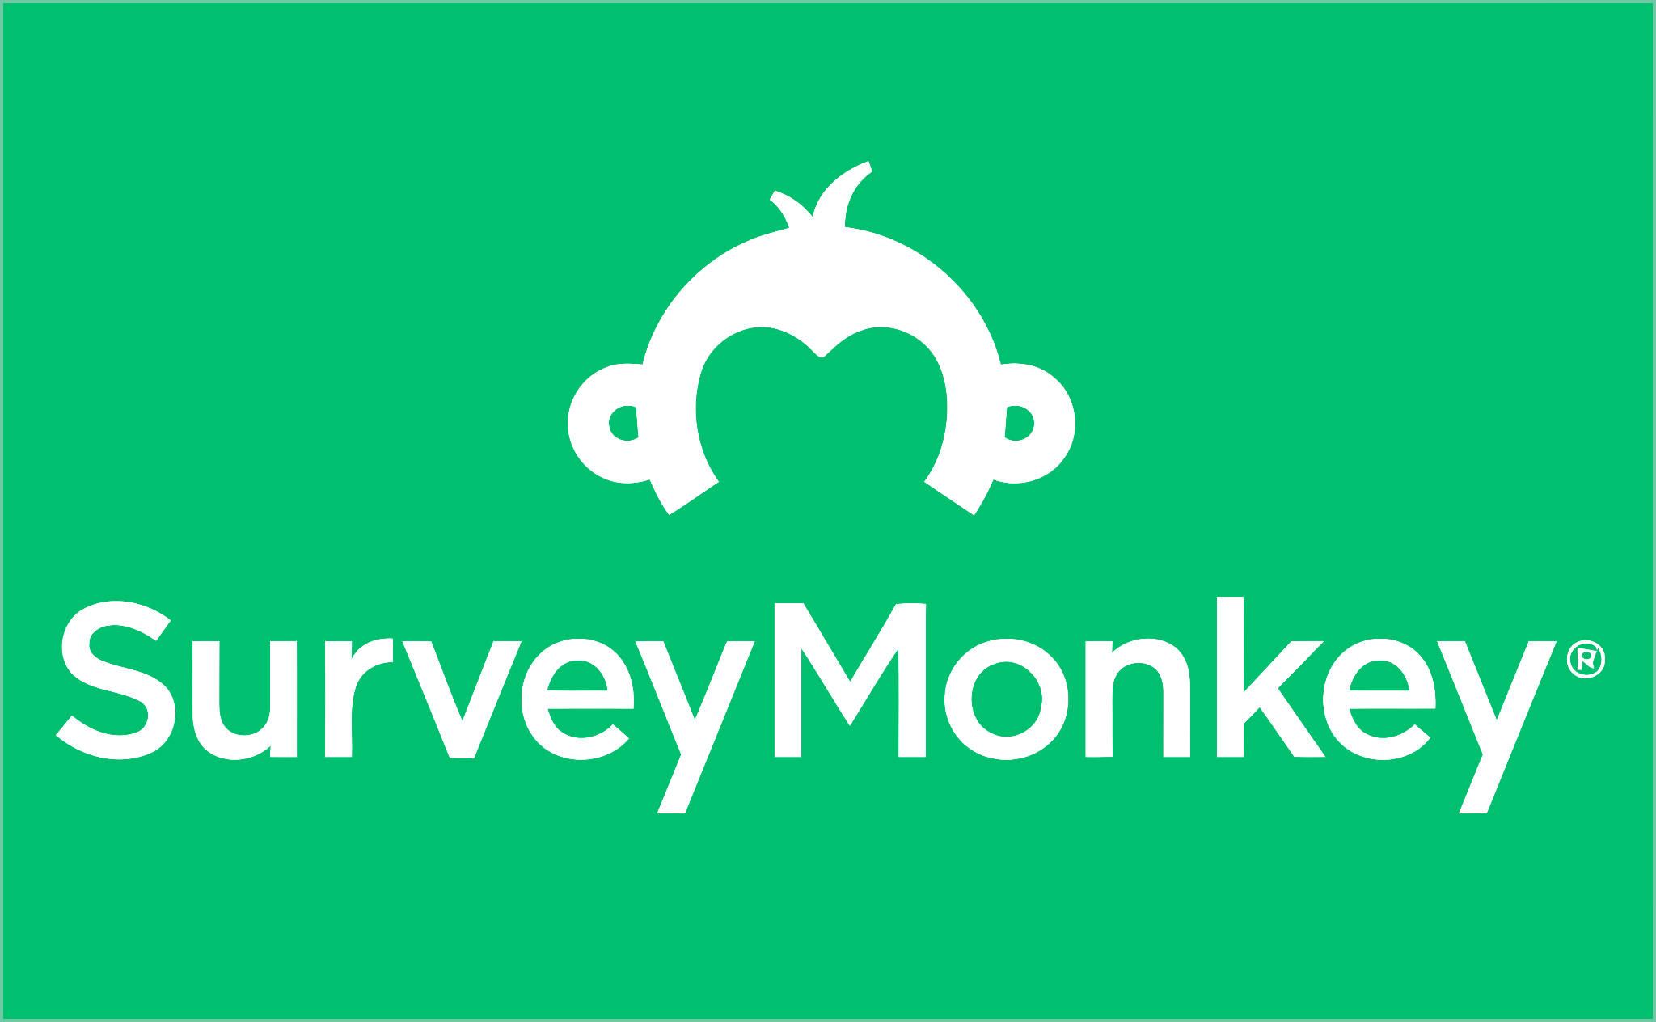
Identifying platforms and requirements
Our requirements
"Free" and simple
Embed videos and images
HTML/rich text formatting
"Card" or "quiz" form with one question per page
Give feedback to students about their answers
Collect statistics
Notes:
We briefly considered looking into a few platforms designed specifically for scavenger hunts, like GooseChase, but ultimately decided that we would prefer to keep things simple for everyone involved, and also try to reduce our costs as much as possible. This meant that the best platform would likely be a simple form creation system, preferably one that is free or that the library or university already pays for, for other purposes.
We identified four options: Google Forms, SurveyMonkey, Jotform, and Microsoft Forms. We also developed a list of what we would want the platform to allow us to do. For example, we needed to be able to embed videos and images as well as use HTML or rich text formatting, to use a "card" format that would make the students step through the questions one at a time, to give feedback to students about their answers, and to collect some basic statistics.
Each member of the Heritage Hunt committee evaluated one of the options by trying to mock up the questions we'd use in the Hunt, and it soon became clear that SurveyMonkey was the only platform that would fulfill all of our requirements. Although it is not a free platform like some of the others, the library already pays for a SurveyMonkey account that we would be able to use. Most of us were already familiar with how to use the platform and the data it collects, so that was another advantage. We decided to go ahead and build the 2021 Hunt in SurveyMonkey.

Slide 23
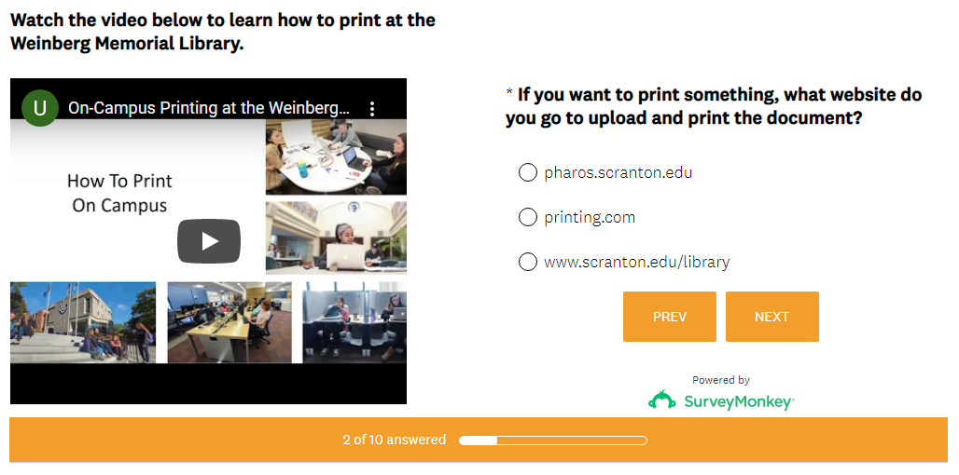
Sample question
Notes:
This sample question on the SurveyMonkey platform includes an embedded video. We developed several different types of questions ranging from multiple choice to short answer, and involving tasks from printing to searching the catalog to exploring the building to find the locations where different services are offered.
Image: Screenshot of sample question with embedded video on the SurveyMonkey platform

Slide 24
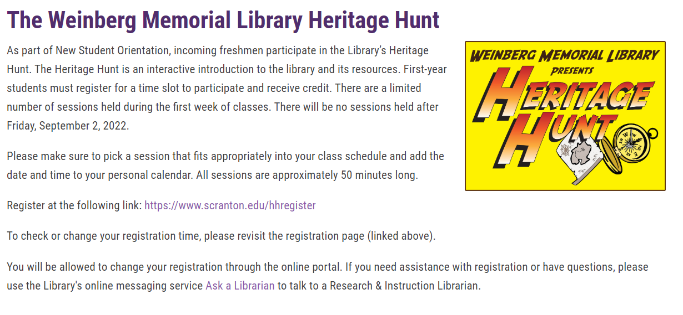
Marketing the Heritage Hunt
Collaboration with Dean of Students
Access to email listserv for incoming students
Advertise to faculty
Landing page on library website
First Year Seminar
First Year Writing Program
Notes:
Once the Heritage Hunt was created we needed to market the sessions. Throughout the history of the Hunt, we’ve employed various strategies to reach out to the students and get them to register. The one consistent marketing strategy that has worked really well is working with the Dean of Students to use a listserv for incoming students. -each summer we check dates with her in order to send out the registration emails to see if there are any conflicts with other emails going out since we don’t want to overwhelm them. We send the emails from our askalibrarian@scranton.edu email account, so if they have any questions they can get in touch with the department and not just one person- this also hopefully encourages them to add us to their contacts or at least lets them know we have an email address they can always reach out to.
We also created a landing page for the Heritage Hunt on our website that could easily be shared with faculty who are willing to help us advertise the event. As the Research & Instruction Librarian for Student Success, I presented to the faculty teaching first-year seminars during their spring workshop event in 2019. This was to introduce or remind the faculty as to the library’s services, particularly for incoming students, and let them know about the Heritage Hunt, since we weren’t really sure just how aware faculty were of the event. Faculty responded positively to this information, and I also sent a follow up reminder email with the registration link. Through a survey to the faculty and informal comments from the students, we know that many faculty advertised the event to their students and even offered extra credit for attending. Due to the pandemic and subsequent transitions in coordinator responsibilities, this hasn’t been repeated yet but will be investigated for the future. I also utilized other opportunities where I was involved in faculty meetings, such as an annual workshop with the First-Year writing program instructors to advertise the Hunt in Fall 2021.
Image: Screenshot of Heritage Hunt Website

Slide 25
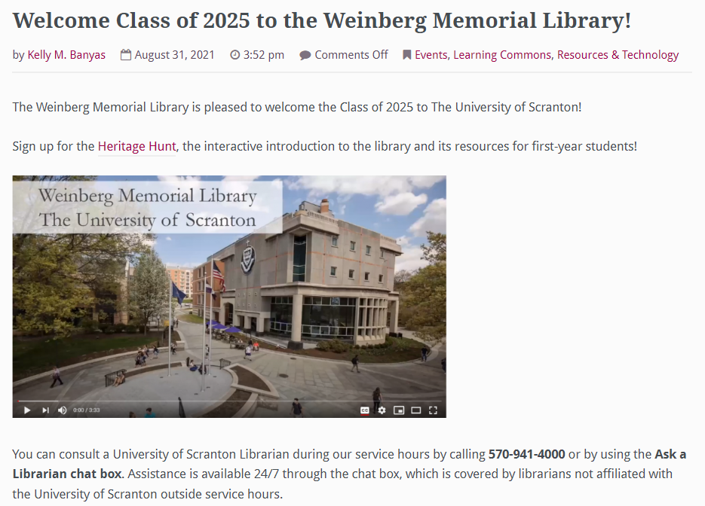
Marketing Post-COVID
Table at New Students Resource Fair
Display QR code to register
Raffle Starbucks gift card
Give away bookmarks and pens
Advertising
Post to library blog
Use social media channels
Notes:
In 2021, we had an additional marketing opportunity that had not been available before- The Center for Student Engagement held an in-person tabling event the first week of classes since they did not host an in-person exhibit hall during orientation. Due to our previous collaborations with the virtual exhibit hall in 2020 and 2021 for the online summer orientation, the library was invited to participate. The Digital Services Librarian and I staffed a table at the event, which featured a QR code that would send students directly to the Heritage Hunt registration page if they indicated they hadn’t registered or attended yet. We also handed out bookmarks adapted from the Need Help poster and pens. We also did a raffle for Starbucks giftcards, which proved very popular in drawing students to our table. These were leftover from another library event and so were of no extra cost for us.
Finally, since registrations were a little down from previous years, we also used social media and the library’s blog to advertise the hunt. We had started the practice of doing welcome blog posts in Fall 2020 when we didn’t host the hunt, and we decided it would still be a good opportunity to engage the students and reach those who might not have seen or read our email. A snapshot of the first part of the blog post is on the slide, which has the video introduction to the library and the link to register. This blog also posts to our facebook and twitter pages- a separate instagram post was made.
Image: Screenshot of Welcome Blog with link to Welcome Video

Slide 26
Attendance
2021 - 640 registrations, 587 participants out of 824 students (71.24%)
—
2019 - 910 registrations, 873 participants out of 1005 students (86.9%)
2018 - 888 registrations, 854 participants out of 978 students (87.3%)
2017 - 823 registrations, 776 participants out of 911 students (85.2%)
Notes:
Our registration was a little bit lower than previous years, but we still met the established goal of reaching over 70% of the incoming class. We had 640 registrations, 587 attendees (those marked present by the session hosts), which amounts to 71.24% of the incoming class of 824. In the three previous iterations of the hunt, 2017-2019, we were between 85-87%. Even though we did more marketing than ever, there were many factors that contributed to a smaller number of participants. These past few years have been very difficult, and students may be overwhelmed by communications and getting back to being in-person, and also might not be willing or comfortably able to attend in-person events. We were still very happy with our numbers and the engagement that we had with the students.
Marleen will now talk about how we measure our success from the student perspective and how the adaptations we made have led to more ideas for reaching and welcoming students and others to our campus.

Slide 27
Assessment of the program
At the end of the Heritage Hunt, students that participated are asked via email to fill out an anonymous survey to help the Library internally assess and improve the program.
Email serves as confirmation of program completion.
This information is highly valued by the committee and seriously considered as we review the previous year and develop new ideas to improve the Heritage Hunt.
We try to keep the survey to 5 questions. Shorter is better.
Check with your institution for how you can use the survey data and if you need IRB approval.
Notes:
At the end of the Heritage Hunt, students that participated receive a confirmation email that asks them to fill out an anonymous survey to help the Library internally assess and improve the program. This information is highly valued by the committee and seriously considered as we review the previous year and develop new ideas to improve the Heritage Hunt. We try to keep the survey short in the hopes of getting a good number of responses, currently we ask 5 questions. Something to keep in mind. You may want to apply for Institutional Review Board approval if you are looking to publish or share the data collected from your surveys externally. This is something the committee is pursuing now but had not done consistently in the past because we were only using our data collected internally. Check with your institution for how you can use the data and if you need IRB approval.
Image credit: Evaluation #4965672 created by Eko Purnomo from the noun project

Slide 28
Student Survey Questions
The students were are asked:
Was the Heritage Hunt activity fun and enjoyable?
Name one service offered by the Weinberg Memorial Library that you found out about by participating in the Heritage Hunt activity.
Do you feel comfortable asking a Library staff member a question after participating in the Heritage Hunt?
How valuable was the Heritage Hunt activity in orienting you to the physical layout of the Weinberg Memorial Library?
How do you think the Heritage Hunt activity could be improved?
Notes:
We ask five questions to the students.
Questions number 1 & 3 are yes/no questions with a not sure option.
Question #1 asks the student if the activity is enjoyable. Where as question #3 indicates if students feel more comfortable using the library and asking for help after attending the Heritage Hunt. Question #3 quantifies one of the primary goals for the programming, which was to reduce library anxiety.
Question #4 uses a likert scale identifying value. Most responses that have come back to us indicated that the program was either “very valuable” or “somewhat valuable”.
Questions #2 and 5 are open-ended questions. It is interesting to see what students pick up on and actually care about. An open ended question like question #2 about Library services often varies wildly from year to year. Often new technologies added to the library are often mentioned here.
We review responses to Question #5 before the next Hunt to incorporate any student ideas or changes that would improve the Heritage Hunt experience.

Slide 29
Analyzing student data
WML analyzes student survey data internally each year to make improvements to the Heritage Hunt. We take our student feedback into account when planning for the next year.
At the end of the sessions we gather the attendance data and survey results into a “wrap up” that we share internally and track year to year
Responses to the survey questions are used to help
Generate new questions
Edit existing questions
Adjust timing or routing
Identify areas where students are not understanding content
Notes:
The committee analyzes student survey data internally each year to make improvements to the Heritage Hunt. We take our student feedback into account when planning for the next year. At the end of the sessions we gather the attendance data and survey results into a “wrap up” that we share internally and track year to year.

Slide 30
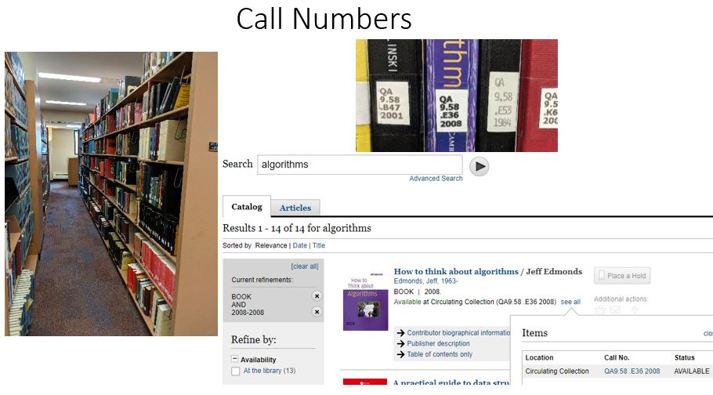
Evidence of Student Participation
Initially student participation and results from the Heritage Hunt were tracked on paper slips that were handed in at the end of a session. Seeing the responses helped to guide us to make changes.
Example: Students were writing down ISBN and Barcode Numbers instead of Call Numbers for one of our questions. In response we created a quick call number tutorial in PowerPoint that instructors presented the next year before sending the students out.
Notes:
We initially tracked student participation from the worksheets they handed in at the end of their session. Seeing responses helped guide us to make changes. One example is the evolution of a call number tutorial. One question required students to write down a call number of a book they located. What we discovered as we reviewed the worksheets was that Students were writing down ISBN and barcode numbers instead of call numbers. Realizing that more students are coming to college without ever experiencing finding a book in the library, the committee developed a call number tutorial in PowerPoint that the instructors would present to the students before they leave the room to head out on the Hunt. When we revised the Heritage Hunt in 2021 we combined the call number information into the actual question.
Image: Screenshot of Call Number Tutorial

Slide 31
Statistics collection
Moving to the Survey Monkey platform now allowed us to track completion rates and responses more efficiently
Notes:
One of the benefits of moving to the Survey Monkey platform is that Survey Monkey tracks completion rates. This provides a quicker snapshot of the results without us needing to review or count worksheets making statistics collection less labor intensive.
SurveyMonkey provides a wide variety of statistics about each group's journey through the Heritage Hunt. At a glance, we are now able to view the number of responses for the Heritage Hunt in any given year, the completion rate, and the amount of time spent by students. These statistics help guide our decisions about modifying the program to improve it for the future.
Images: Screenshots of SurveyMonkey Analytics

Slide 32
Adaptive Reuse
Videos developed for the Heritage Hunt were utilized broadly
WML recorded the videos using Zoom then added music post recording
Videos were posted on YouTube with a transcript and captioning for accessibility
The Welcome video continues to be utilized for Orientation, the Heritage Hunt, and blog posts welcoming students at the beginning of the semesters
The printing video is shared through our Libguides
The printing video is also shared via QR Codes on paper handouts posted near the printers and with copies for distribution at all the service desks
Videos need to be revisited yearly to ensure they stay current with changes within the building and with printing services
Notes:
A number of elements from the 2021 Heritage Hunt have been reused, with some evolving through further adaptation, or were expanded upon to be used in other Library marketing and programming efforts. As we mentioned earlier the videos created have been utilized broadly for orientation and are also included within our Libguides and shared via blog posts welcoming students to campus.
We recorded the videos using Zoom and then added music post recording. We host the videos on our YouTube channel and provide a transcript and captioning for accessibility. Something to keep in mind, just like the tasks themselves, the videos will need to be updated over time as spaces and user needs change.
Image: YouTube Logo

Slide 33
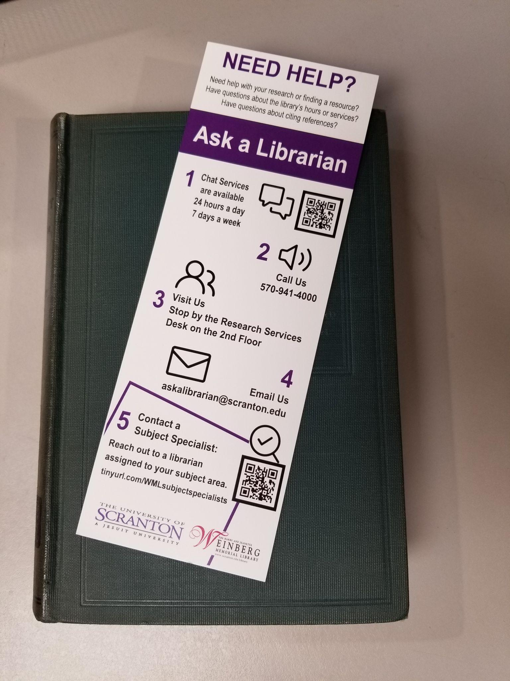
Evolving uses for the Need Help Poster
Need Help Poster expansion
Expanded within the building (on every floor)
Expanded to campus buildings outside of the library
Need Help Bookmarks
Based off of the Need Help Posters
Developed as a take-away for orientation
Currently used as a take-away at information literacy sessions
Will be used as a take-away at the 2022 Heritage Hunt
Notes:
The Need Help poster developed for the Heritage Hunt and created using Canva was a hit and became a marketing tool for the Library. Additional copies were printed and hung throughout the building and in other locations around campus. Bookmarks of the same content were developed and are offered as a take-away at Information Literacy Sessions and at Orientation tabling events. Just like the videos, graphics created for programming should be checked yearly to ensure the content is still correct and the QR Codes are going to the correct virtual destinations.
Image: Photo of Need Help Bookmark

Slide 34
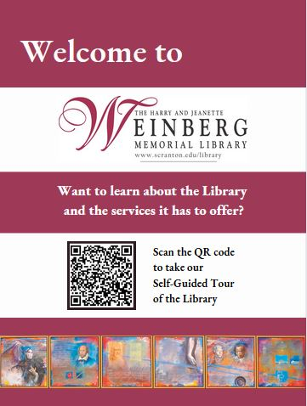
Adaptation - Self-Guided Library Tour
The self-guided tour takes visitors on a tour of the building, describing library spaces and services. Visitors scan the QR Code on posters displayed at the Library’s entry to begin the tour.
Elements created for the Heritage Hunt and Orientation were repurposed or adapted to create the self-guided tour including:
Utilizing the Survey Monkey platform & QR Code Technology
Content descriptions created for the Heritage Hunt and the Library website were repurposed into the descriptions for the tour
Utilizing the Library Welcome Video
Users were given the choice to take the tour or just watch the library video
Notes:
One of the adaptations that came out of the Heritage Hunt revision included the development of a self-guided library tour. Again we utilized QR Code technology and the SurveyMonkey platform to provide visitors a way to tour the building and learn about library spaces and services. Placed on easels adjacent to the entry to our library, visitors scan the QR Code on the poster with their phone or portable device (iPad or Chromebook) to begin their tour. The tour utilizes the Library Welcome video previously mentioned and the content descriptions for the tour were modified from the Heritage Hunt and our Library website. Visitors are given the option to to take the full tour or to just view the video.
Image caption: Image of WML self-guided tour poster

Slide 35
Possible future directions
Email reminders of session times
Offering access to the Heritage Hunt beyond the Fall Semester
Inclusion of additional students
Transfer students
Students who missed the Heritage Hunt due to campus closure/restrictions in 2020
Graduate students
Follow-up document sent to students after completing the Heritage Hunt (identified through comments from HH 2021)
Adding more tasks and elements to discover
Rewards for completion
Notes:
Based on our informal student surveys, survey results collected through MISO, and talking to the Library faculty and staff, we have identified some areas for future consideration.
The first is setting up eMail reminders for students. Having a message sent to remind students about their chosen date and time for their session would be helpful especially if they have changed their session. We hope to make this change in the near future.
Expanding access to the Heritage Hunt is another consideration. While the Library sees the largest influx of first-year students in the Fall Semester, some students begin their studies at the University during other semesters and would not have access to the program. By offering the Heritage Hunt beyond the Fall semester, it may be possible to reach students we would typically miss. With the Heritage Hunt now being less staff dependent this may be a possibility. In the meantime while we figure out the logistics of making this change we can offer up the self-guided tour as an alternative.
The Library would also like to offer the program to transfer students, graduate students, and students who missed the Heritage Hunt during the campus closure in 2020.
Student comments from the 2021 surveys indicated that they would like to receive a follow-up document after completing the Heritage Hunt with the correct responses that the students can refer to, highlighting what they learned and including some general information about the Library and its services. They also asked for more tasks and elements to discover.
We are also reconsidering rewards for completion. While the Heritage Hunt was not necessarily designed as a competitive activity, the students have often asked about rewards for finishing.
Image credit: Map # 38593 created by Alen Krummenacher from the noun project

Slide 36
Thank you
If you have additional questions or would like more information contact:
Kelly Banyas
kbanyas3@washcol.edu
Marleen Cloutier
marleen.cloutier@scranton.edu
Jennifer Galas
jennifer.galas@scranton.edu
Notes:
This concludes our presentation today. We hope this session has been informative and you have discovered some tools and strategies to help you to create a similar orientation session at your institution. If you have additional questions or would like more information please reach out to us. Thank you!
Image credit: Compass Rose # 506622 created by chiara ardenghi from the noun project

Slide 37
References
Aulisio, G.J. (2013). The Heritage Hunt: From start to update. Pennsylvania Libraries: Research & Practice, 1(1), 35-52. https://doi.org/10.5195/palrap.2013.3
Eshbach, B.E. (2020). Supporting and engaging students through academic library programming. The Journal of Academic Librarianship, 46(3), 1-11. https://doi.org/10.1016/j.acalib.2020.102129
Goldman, C. et al. (2016). Creating an engaging library orientation: First year experience courses at UC San Diego, Communications in Information Literacy, 10(1), 81-98. https://files.eric.ed.gov/fulltext/EJ1103401.pdf
Notes:
References
Aulisio, G.J. (2013). The Heritage Hunt: From start to update. Pennsylvania Libraries: Research & Practice, 1(1), 35-52. https://doi.org/10.5195/palrap.2013.3
Eshbach, B.E. (2020). Supporting and engaging students through academic library programming. The Journal of Academic Librarianship, 46(3), 1-11. https://doi.org/10.1016/j.acalib.2020.102129
Goldman, C. et al. (2016). Creating an engaging library orientation: First year experience courses at UC San Diego, Communications in Information Literacy, 10(1), 81-98. https://files.eric.ed.gov/fulltext/EJ1103401.pdf

