Slide 1
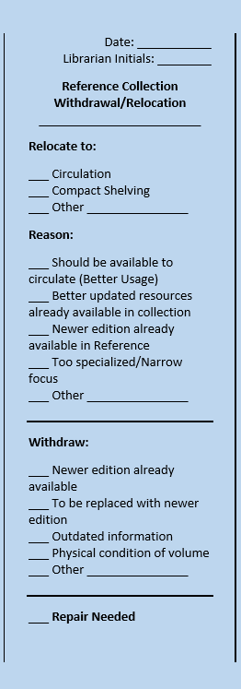
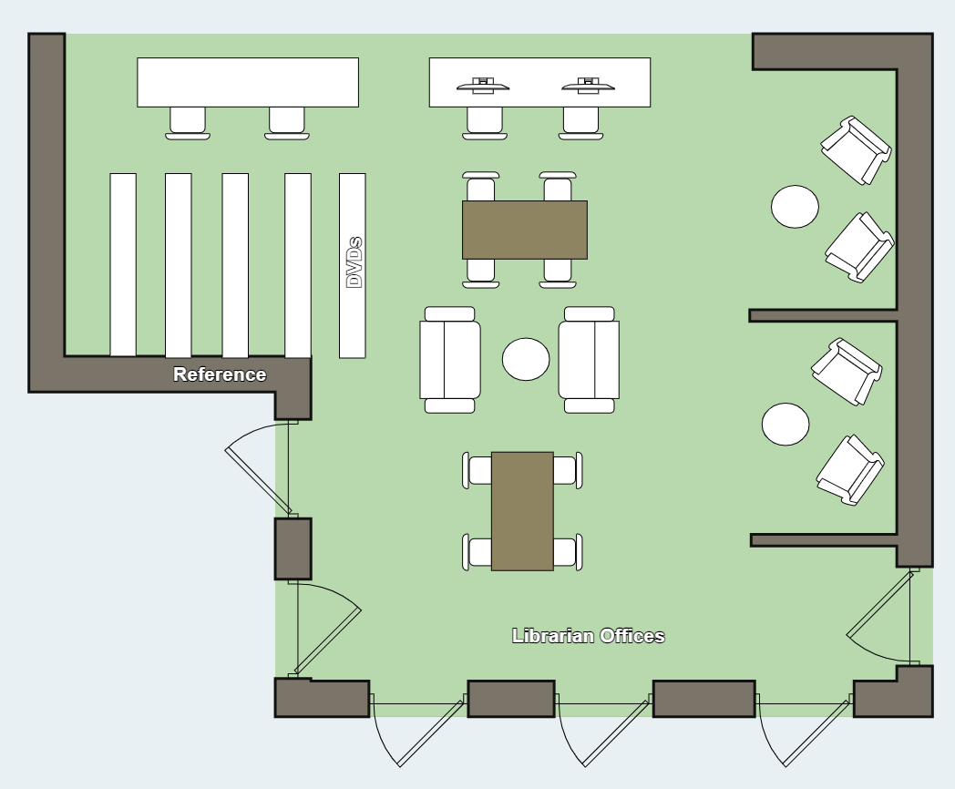
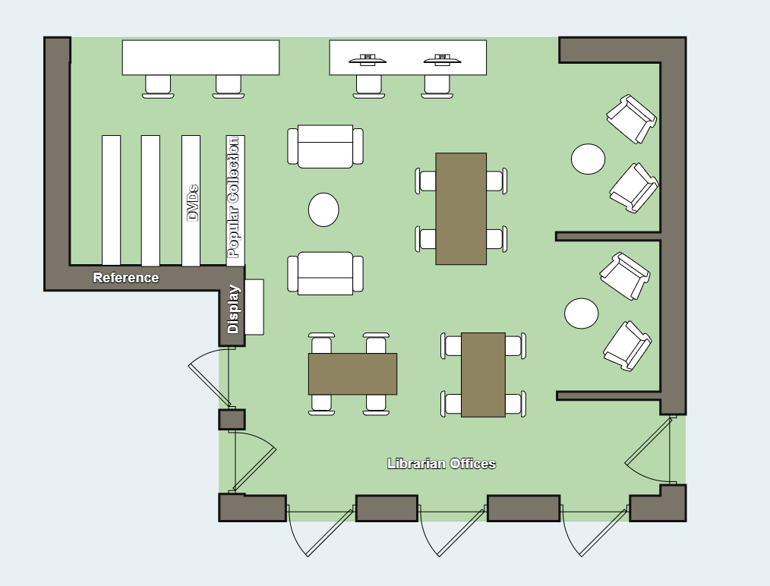
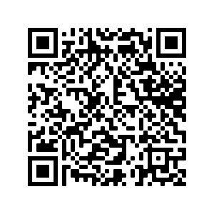
Rolling Back the Stacks: A Reference Overhaul
Elizabeth Davidson, Associate Director & Head of Public Services Hoover Library, McDaniel College
In 2021, librarians at McDaniel College's Hoover Library undertook the project of overhauling the reference collection, which took up significant space on our first and most communal floor.
These new standards were transformed into a weeding/relocation/repair slip. Each librarian was assigned a set of the slips in a different color, specific to their subject liaison areas, to indicate that they were the decision maker for a specific volume. **
**This ensured that if there was a question about the decision made regarding the volume, the team would know to whom to direct it.
The lead up to the project included:
Assessing the In-House Usage statistics of the Reference Collection
Developing a set of standards for how the collection would be assessed for withdrawal, relocation, or retention in the same collection
Establishing a timeline for project completion and the transition the of work from the librarians to our Technical Services team for cataloging and relocation
Once the collection was fully flagged, Technical Services set to work. Texts were respectively:
Transitioned to the Circulation collection to increase usage,
Transitioned to Compact Shelving for more efficient storage,
Withdrawn, OR
Retained in the Reference Section if their statistics reflected high usage by the community.
Though the original slip was designed for the reference collection, it can and will be reused when assessing, shifting, and weeding other collections.
Results:
Removal of one full range of shelves and increased spacing for improved ADA navigability
12% increase in seating area for communal workspace
Approximately 600 volumes made available for circulation in the community
Approximately 250 volumes withdrawn due to outdated information
400% increase in shelf space for Popular collection
Before
In Summary:
A more easily navigable collection and more accessible space!
To access the script for this poster and to see photos of the rearranged space, please follow this QR code.
After

