Slide 1
You Didn't Learn This.
in Library School:.
Closing Knowledge Gaps in Management & Teaching.
Kaitlyn May, Hood College.
Emily Hampton Haynes, Carroll Community College.
Notes:
In this presentation, we will share some of what we learned as early career librarians in our current areas of specialization: teaching and management.
Kaitlyn: Emily and I used to work together, and so often one of us would come to the other and say something like, “Don’t laugh, but what is EZ-Proxy?” or “Do you know how to update LibCal?” I used to feel like a perpetual idiot, but the reality is that there are so many paths you can take in a library career, and so much to know, that it’s impossible as a young professional to NOT have some knowledge gaps.
There’s the apocryphal quotation, ascribed to Abraham Lincoln, “Better to remain silent and be thought a fool than to speak and to remove all doubt” --- that WILL NOT apply here.

Slide 2
A little about us
Notes:
Emily: Although I studied archives in library school, job availability steered the course of my career for years, bouncing around library jobs, until I finally found permanent work teaching info lit in an academic library. Over the past 4 years, I learned how to teach by on-the-job trial and error, which always felt like sneaking in through a back door. Thinking of the teachers I know, who went through a curriculum of education theory and supervised student teaching, I felt totally unprepared in comparison.
Kaitlyn: I didn’t have a professional pathway or concentration while I was in library school; I took electives in different areas (something I didn’t do in my undergrad and regretted). I found several things I wasn’t interested in, including law librarianship. I even went back to school after I completed my Master’s to get a school media certification, completed 6 of the 12 credits I needed for that, and then realized I’d made a huge mistake during my fieldwork and quit two days in.
While all of this was going on, I was working in an academic library part-time, and then full-time, still wanting to explore. I knew I didn’t want to teach, and I didn’t think that I wanted to manage, either. Meanwhile, I worked my way up through positions with steadily increasing managerial responsibilities, each time thinking, “Okay, I might be in over my head, but I can probably figure this out. I just won’t go any higher.” That’s not to brag --- that’s to try to impress upon you how underqualified and unprepared I felt, and how little that ended up mattering.

Slide 3
Did you receive teacher training
during your LIS education?
Notes:
Emily: Did you receive teacher training during your LIS education?
If, like me, you don’t feel like library school prepared you for the reality of the classroom, you’re not alone.

Slide 4
“There is a severe mismatch between the ways our library schools prepare graduate students for the classroom and [...] librarians don’t receive much, if any, on-the-ground training for learning how to teach.”
Merinda Kaye Hensley, ACRL 2015
Notes:
Merinda Kaye Hensley, who evaluated 10 syllabi of LIS courses that cover library instruction in this study, concluded that “…there is a severe mismatch between the ways our library schools prepare graduate students for the classroom and that librarians don’t receive much, if any, on-the-ground training for learning how to teach.”
Hensley’s study also found that teaching is increasingly a skill that library directors and deans expect in library hires, and that whether you’re in front of a classroom, at the reference desk, or training other library staff, it’s clear that “Teaching is inescapable for the academic librarian.”

Slide 5
How about management
and leadership training?
Notes:
What about management and leadership training?
All MLIS programs offer a management or administration course, and for many (but not all) it’s part of the core curriculum. I had one, and every colleague I talked to about this presentation had one --- and most mentioned that they felt it to be inadequate preparation. In 2018, Against the Grain asked their 2017 Up & Comer award recipients what they wish they had learned in library school and along with “more about cataloging” and “how to fundraise,” over half wanted more management and organizational training, wanting more instruction in: “how to manage people,” “how to deal with conflict,” and (I love this one) “human interaction.”

Slide 6
ALA’s Core Competencies
7. Continuing Education and Lifelong Learning
7C. Learning theories, instructional methods, and achievement measures; and their application in libraries and other information agencies.
7D. The principles related to the teaching and learning of concepts, processes and skills used in seeking, evaluating, and using recorded knowledge and information
Notes:
Kaitlyn: Library school programs certainly intend a prioritization of these topics, among others.
In January 2009, the ALA approved and adopted as policy “ALA’s Core Competencies of Librarianship.” There are eight core areas and a total of 41 competencies that a person graduating from an ALA-accredited master’s program in library science should possess.
Emily: Section 7 is “Continuing Education and Lifelong Learning,” with sub-areas including: “Learning theories, instructional methods, and achievement measures; and their application in libraries and other information agencies” as well as “The principles related to the teaching and learning of concepts, processes and skills used in seeking, evaluating, and using recorded knowledge and information.”
MLIS programs are varied, and many of them are flexible. There are so many directions you can take in this field, and specialized areas of study are constantly evolving. All of this to say --- if there are gaps between the expectations of the Core Competencies and any one librarian’s personal experience of library school, it isn’t an indictment of the system.
Kaitlyn: We can’t go any further without acknowledging what I would argue is the most critical of the competencies, also in section 7 ---

Slide 7
ALA’s Core Competencies
7A. The necessity of continuing professional development of practitioners in libraries and other information agencies.
Notes:
“The necessity of continuing professional development of practitioners in libraries and other information agencies.” Obviously, no one needs to be sold on this argument; by listening to this presentation, you’re actively engaging in professional development.

Slide 8
Tacit Knowledge:
Information that you learn from experience, that’s hard to put into words
aka “things your boss will expect you to know already”
Notes:
But it’s also true that we’re all experiencing a gap between our book-learnin and our professional know-how.
The concept of “tacit knowledge” helped me feel a lot better about my level of preparedness -- there’s some information people take for granted if they’ve been in a field for a while. Like when you’re at a new job and they use an acronym you don’t know.
We have to watch this impulse at the desk all the time -- assuming a student knows what “periodicals” or “databases” are.
We’re hoping this presentation can make some concepts go from tacit to explicit.
We’re also hoping to inspire non-judgment in honest conversations about how to bridge knowledge gaps. If you still feel like you don’t understand something, and all of your individual research and studying has left you with more questions than answers, reach out to someone.
Because asking questions helps promote a culture where it’s ok not to know things.

Slide 9
You’re not a failure.
You’re a beginner.
Notes:
Because no one is born knowing what WorldCat is, or how to make a worksheet that actually assesses what you’re trying to teach. An important moment in my teaching journey was when I allowed myself to release the feelings of being a failure and embrace the term “beginner” instead. You’re not a failure. You’re a beginner.
Even if you’ve been in the field for 20 years, you can still wander down a new path with a beginner’s mind.

Slide 10
A few teaching terms:
Pedagogy
Rubric
Learning objectives
Scaffolding
Active learning
Universal Design for Learning (UDL)
Flipped classroom
One-shot
Assessment
Notes:
In the next slides I’ll go over some teaching concepts I had to learn the hard way: by pretending I knew what my boss was talking about until she left my office, and I could Google it. We can start with some basic terms in education that teaching librarians use a lot.
Pedagogy: the art and science of teaching, especially putting a theory into practice.
Rubric: A grading system where you state what an A paper looks like, what a B paper looks like, etc. You may remember rubrics from when you were a student.
Learning objectives: Brief statements that describe what a student should be able to do by the time they’re done with the lesson, or assignment. Learning objectives are an important part of lesson planning as well as assessment.
Scaffolding: I think of it as meeting a student where they are, either by starting with the familiar, then transitioning to new concepts, or spreading the skills they need across the course of a semester or series of sessions. A paper where over the course of the semester, you write an outline, then a bibliography, then a first and final draft of a paper, this would be a scaffolded research assignment.
Active learning: practicing what you’re learning in a hands-on activity during the class
UDL: a way of thinking about teaching and learning that is inclusive to all students. It involves designing activities to engage different learning styles, and is especially important for students with learning and attention issues
Flipped classroom: where students learn a concept ahead of class, then use class time for an activity that would normally be homework. This gives the student access to the teacher for questions, and the chance to work with others while they practice the concept. Flipped classrooms are a popular model for library instruction because you’re often limited in time.
One-shot: This is where the librarian teaches how to do research in one class period of a semester-long course. A lot of library instruction works on a one-shot model, as opposed to working with the same students for an entire semester.
Assessment: the variety of ways educators evaluate and measure learning objectives in students. Administrators care a lot about assessment, but it’s also a big catchall term that I found ambiguous for the first few years of teaching.

Slide 11
A little more on assessment:
A little goes a long way
Think of data in terms of good, better, and best
Use student learning outcomes
Assessment should make your job easier
Don’t let perfect be the enemy of the good
Notes:
A little more on assessment. If your school already has things in place, great! If not, and you're expected to develop that in your area, here are tips I've found useful:
A little goes a long way. Especially if you haven't formally assessed instruction at all before.
Think of the good, better, and best type of data you could have to assess instruction. For example -- student survey is good, faculty feedback is better, and maybe seeing the finished assignment is best evidence.
This helps you think through what information you need, how you could get it, and who you need to collaborate with to make it happen
Use your student learning outcomes to form your assessment. This is why it’s worth taking the time to write good learning outcomes for a lesson plan -- because then as you begin to assess how it went, you can start with a simple “Ok, here’s what I said they’d be able to do at the end of this. So, can they do it?”
Assessment should ultimately make your job easier, and make your instruction more rewarding for everyone
Don't let the perfect be the enemy of the good: I think that’s where a lot of library teams get stuck, because the thought of formal assessment programs feels so overwhelming. Just try a little, and grow from there.

Slide 12
A few assessment ideas:
Index cards, Poll Everywhere, Google Forms
3 Things I Learned
Muddiest Point
One-minute Paper
Seek faculty feedback
Collect student work samples
Notes:
Online polls or surveys with Poll Everywhere, Survey Monkey, or Google Forms. (Poll Everywhere is the one I have experience with)
Three Things You Learned: At the end of the session, have students write down three things they learned.
Muddiest Point: Have students write down one thing they are still confused about. You can use this for follow-up instruction.
One-minute Paper: Give students one minute to write down everything they learned at the end of the session
Seek faculty feedback: Ask faculty, either face to face or through a survey, to reflect and share on observed gains and gaps in student learning.
Review student work samples: If it’s already happening at your institution, take part in evaluating student assignments.

Slide 13
Emily’s Tips™
Learn how to write learning outcomes:
“Students will be able to [Verb] + “in order to” + [why statement].
On asking questions in class:
Be patient
Work up to open-ended questions
Ask someone to observe you in the classroom
Keep a teaching log
Seek a “constellation of mentors”
Write a teaching philosophy
Notes:
Learn how to write learning outcomes. It’s basically the second half of the statement, “After this [class/activity], students will be able to…” Verb/action phrase + "in order to" + why statement = learning outcome
So an example could be: “Use Noodlebib in order to organize research and citations, so that they avoid plagiarism.”
Asking questions:
Be patient. The recommended amount of wait time after asking a question is ten seconds. This will seem like an uncomfortable eternity, but it is important processing time for students. Try counting silently to yourself, before offering a hint or rephrasing the question.
Asking questions pt 2:
Move from closed to open-ended questions. Starting with simple yes or no questions, like how many of us use an iPhone, can help students become comfortable and more willing to take a risk on a deeper question later in the class. If students are reluctant to speak, you can ask for a show of hands as response, or let them pair up and discuss answers before sharing in front of everyone.
Ask someone to observe you in the classroom:
You might be thinking “oh no, then they’ll know i’m an idiot who can’t teach,” but this is a chance to get valuable feedback from someone who knows what to look for.
You can also talk ahead of time about the specific kinds of feedback you want, so that you avoid getting feedback like “you touch your hair a lot, or your jokes aren’t that funny,”...there are also worksheets for classroom observation that make this process feel less murky and subjective.
keeping a teaching log, where you take the time to reflect on what’s working, and what you’d like to improve in the future.
Constellation of mentors:
I learned about this at ACRL 2017 and it’s better than trying to find your one special mentor who will be perfect in meeting all your needs. Instead, the presenters talked about different types of mentors in different areas of life, like a cheerleader, confidant, advocate, and role model. https://s4.goeshow.com/acrl/national/2017/conference_schedule.cfm
Kaitlyn is a perfect example of a cheerleader and confidant in my life!
MILEX, the Maryland Information Literacy Exchange, is a great membership with periodic workshops on teaching information literacy. They’re some of the most supportive folks in a professional membership that I’ve ever talked with.
Write a teaching philosophy. https://cei.umn.edu/writing-your-teaching-philosophy Even if you don't need one yet, it's a living document you can update as you learn and helps you put your priorities into words.

Slide 14
My teaching philosophy:
My teaching philosophy is learner-centered, interactive, and inclusive. I center student experience and show faith in their capacity to succeed. I have a humorous, personal style that is meant to make students feel comfortable coming to me for advice on research or other parts of college success. I am not afraid of failure, whether it’s my student’s mistake or mine. I endeavor to foster curiosity and confidence in every student I meet.
Notes:
Here’s a short paragraph I wrote last year, summarizing my teaching philosophy. This is definitely a work in progress, and I can already think of things I wish I could add. It does not need to be written in teacher jargon, and there are great resources out there to help you get started. I’ve linked one in the slide notes, from the University of Minnesota, that I found helpful.
Taking the time to identify the values I want to support – curiosity, persistence, failure as a part of learning – has influenced the way I design class activities and how I interact with students. Having my teaching philosophy fresh in my mind as I walk into the classroom has helped me be a more thoughtful teacher.
Now I’m going to turn it over to Kaitlyn to talk about management.

Slide 15
ALA’s Core Competencies
Foundations of the Profession
1J. Effective communication techniques (verbal and written).
8. Administration and Management
8B. The principles of effective personnel practices and human resource development.
8E. The concepts behind, issues relating to, and methods for, principled, transformational leadership.
Notes:
Back to the ALA’s Core Competencies, this time as they relate to management and leadership. Once again, when I spoke to colleagues and told them about the topic of this presentation, almost everyone without exception said, “Oh, but I did have a class about library management in library school,” immediately followed by, “But I didn’t really learn any practical skills.” Again, this isn’t an indictment of library school, but rather a call to remember that earlier competency regarding continuing development and to find what works for you as a manager. These are a couple things I’ve picked up over the years that I think will help anyone, though.

Slide 16
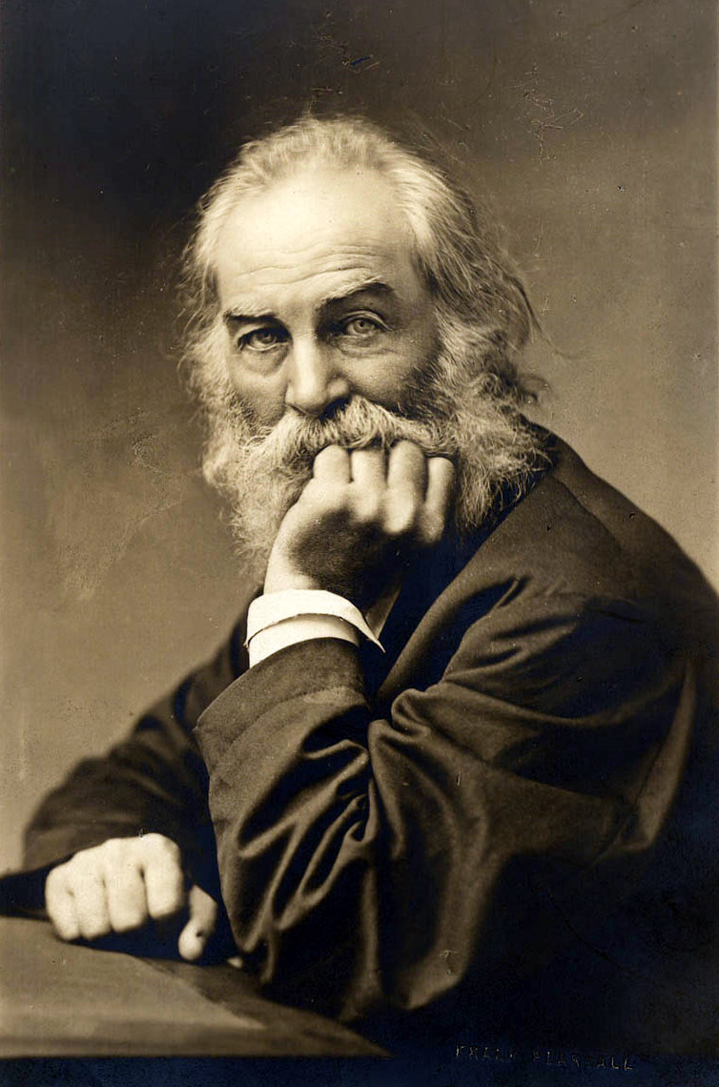
First, think about yourself...
Do I contradict myself?
Very well then I contradict myself,
(I am large, I contain multitudes)
Notes:
Last year I attended an excellent professional development experience, maybe some of you watching today were able to attend as well --- the Library Management Skills Institute, put on by DeEtta Jones and Associates and designed in partnership with Association of Research Libraries and National Training Laboratory.
One of the most informative pieces of that experience was the self-discovery element.
What do you know about your own communication preferences? Your behavior style? Could you sum up both in a couple of sentences? It’s important to understand the people you’re working with and managing but the other critical part of those relationships is you.
Self-reflection and self-awareness are absolutely essential to being an effective leader. How do you get there? There aren’t short-cuts, but if this is a new area for you, and you’re looking to learn the vocabulary and how your personality influences what happens in the workplace, I recommend both the DiSC and the Influence Strategies Exercise.

Slide 17
Logical Persuasion: using logical reasons, expertise or data to convince and persuade other
Bargaining: gaining support by negotiating a mutually satisfactory outcome, exchanging favors
Empowerment: making others feel valued by involving them in decision-making, and giving them recognition
Interpersonal Awareness: (identifying other people’s concerns and positioning one’s ideas to address these concerns
Notes:
The DiSC looks at four different aspects of your natural behavior and the ISE tells you what influencing strategies you tend to use, what that looks like in working with others, and how you can become a more effective influencer --- basically, how you can become a more effective leader.
For instance, when I took the ISE, the top strategies I scored in were empowerment (making others feel valued by involving them in decision-making, and giving them recognition) and interpersonal awareness (identifying other people’s concerns and positioning one’s ideas to address these concerns), both of which rang very true to my natural tendency to avoid conflict and try to please people.
I scored low in logical persuasion (using logical reasons, expertise or data to convince and persuade others) and bargaining (gaining support by negotiating a mutually satisfactory outcome, exchanging favors).
There are nine strategies, and you need them at different points --- for example, logical persuasion is most effective when you’re dealing with people who rely on logic and reason. The instrument gives you ideas for when each strategy is most effective, how to increase your effectiveness in using it, and also troubleshooting questions if you find it’s just not working.

Slide 18
(Self)-Knowledge is Power
Increase your self-knowledge: how you respond to conflict, what motivates you, what causes you stress, and how you solve problems
Improve working relationships by recognizing the communication needs of team members
Facilitate better teamwork and teach productive conflict
Develop stronger service skills by identifying and responding to others’ styles
Manage more effectively by understanding the dispositions and priorities of employees and team members
DiSC Profile - What is DiSC®? The DiSC personality test and profile explained. (n.d.). Retrieved July 26, 2020, from https://www.discprofile.com/what-is-disc/overview/
Notes:
A little bit of self-reflection and self-awareness can go a long way. I’ve personally found that when I have the vocabulary to describe the behavior I see in others, and the self-knowledge of my own patterns, I’m able to see things with less judgment, take things less personally, and make better, evidence-based choices in managing.
These benefits come from the DiSC personality website, and I think they’re representative of any time you take the time to reflect on human nature, including your own. You can increase your self-knowledge, how you respond to conflict, what motivates you, what causes you stress, and how you solve problems. And you may find that you can facilitate better teamwork and teach productive conflict.

Slide 19
In other people we see the behavior; in ourselves we see the intent.
Notes:
Of course, other people are tricky to understand.
Maybe we understand ourselves, we understand what we’re trying to accomplish and what we’re trying to say. I love this quotation --- in other people we see the behavior; in ourselves we see the intent.
It’s easy to understand our own intentions for doing things, or for what we say. There may be certain contexts in which intent doesn’t matter or matters less in life --- it’s not about intent, it’s about the impact, but I don’t think we can skip the intent stage when we’re trying to understand others and work with others.

Slide 20
Confirmation Bias: the tendency to interpret new evidence as confirmation of one's existing beliefs or theories
Notes:
This brings us to confirmation bias --- the tendency to interpret new evidence as confirmation of one's existing beliefs or theories, which is harmful because you are assuming. In dealing with people, we want to do a lot less assuming than is natural. Our brains are automatic processors, we’re going to try to find shortcuts, but we need to fight it and have a conversation.

Slide 21
First:
What are other possible explanations?
Am I making an interpretative leap?
Am I aware of prejudices/biases I have about this issue?
Then:
Share your thinking – “I’m hearing this, is that right?”
Seek more data, observable behaviors
Stay curious
Notes:
So if there’s a problem situation, how can you combat confirmation bias and get to better understanding?
This is where having a planned conversation with someone as opposed to an off-the-cuff conversation has its benefits.
But even in the moment, just mirroring back to the person you’re talking to, saying, “I’m hearing this --- is that right?” leads to more clarity.
Another thing to think about: when you ask a question of someone in the context of a problem situation, the first response is usually not the answer (or at least not the full answer). Ask people to “say more about that.” I know when I was younger, my natural impulse was to say whatever would end an uncomfortable conversation quickest, as opposed to being completely forthcoming.
Speaking as a naturally shy, non-confrontational person, it’s easy to want to go into a discussion with a team member having formed some conclusions because it’s uncomfortable to sit with the unknown, or to go into a conversation wide-open to where it could go.
I will add that anytime I hear myself saying “always” or “never” in my head, it’s usually an indicator that my emotions have gotten involved, and I need to step back and think about some of these questions, especially “Am I making an interpretive leap?”
An example from my Fall semester being, “This student worker is never on time,” I’m frustrated, I’m watching the clock knowing this person is going to be late.
Then I checked myself. Before I sat down and looked at our new time clock’s data, I made a guess as to how many shifts this person had been late for, because I wanted to check my bias. And I guessed higher than the actual number. That gave me pause, because I’m on the students’ side. I’m not out to catch them.
All this to say it’s difficult but essential to cue in to when you are taking mental shortcuts, because you’re cheating yourself out of a better understanding of what’s going on.

Slide 22
We need to talk...
Behavior – JUST FACTS
What is the impact on…users?
What is the impact on….colleagues?
What is the impact on…project/the work?
What is the impact on…me?
Then, script a presenting statement, focused on facts.
Notes:
If there’s a problem behavior that needs to be addressed, though, it’s helpful to work through problem behavior analysis. Think through these questions surrounding the impact of the behavior you’re looking to discuss: what are the impacts on users, on colleagues, on the project or the work, and on me. Then, think out what you can say based on that, focused only on facts. Now, this model doesn’t work for every conversation --- it’s more for single issue, focused problems.
Let’s say we had a meeting yesterday, and Emily left in the middle of it without any explanation, and slammed the door shut as she left. When I talk to her about it, I’m going to mention the behavior, focused only on facts (not how much it hurt my feelings), and then if there were any impacts on the groups mentioned here, I’ll mention those --- but they HAVE to be OBSERVED by ME.
I’m not going to future-forecast and say, “If you did that in a meeting with faculty, it would damage our working relationship.”
I’m not going to give feedback based on third person information, where someone tells me they were in this meeting where this happened but I wasn’t; in a situation like that, it’s better to inquire rather than assume because all I have is hearsay, and that’s not fair to build a case on.
So with my previous example, I might say, “Emily, yesterday during our meeting when I started to talk about building updates, you picked up your notebook and left the room and didn’t come back. You missed the rest of the information in the meeting. I’d like to know what happened.”
In that opening statement which starts our conversation, I’m not trying to FIX the behavior, I’m not telling her what I want from her, or telling her what went wrong; I’m not editorializing the interaction in any way. I’m coming to this conversation with facts but also questions, open to hear whatever she has to say and then work together on a solution.

Slide 23
Coaching and feedback are ideally given at a 6:1 (positive:negative) ratio, and a minimum 3:1.
Good feedback is:
–Timely
–Specific
–Focused
–Non-evaluative
–Purposeful
–Future-oriented
Coaching 101
Notes:
I started with more difficult conversations, but of course, there should be many more positive conversations than just those brought on by a problem behavior. Ideally, coaching and feedback should be given at a 6:1 ratio of positive interactions to negative, but a minimum ratio of 3:1.
Good feedback is:
Specific – observable behavior, never something like, “You seem sad.” That’s not feedback.
Focused – SINGLE issue conversation
Non-evaluative – don’t make assumptions, or ascribe intentions…come to the conversation as much a blank slate as possible
Purposeful – gives the person useful, actionable info. and deals with a BEHAVIOR that CAN and NEEDS to be changed
Future-oriented – leaves opportunity for growth/change
You’ve probably heard of the compliment sandwich --- a critique given between two pieces of positive feedback. The compliment sandwich is bogus --- it is a disservice to the person receiving feedback; the positive feedback seems less sincere and it really only serves to make the person delivering it feel better.

Slide 24
Reward Power – ability to give others something they want
Legitimate Power – sanctioned authority to act based on position
Expert Power – ability to influence based on perceived knowledge/skills
Referent Power – interpersonal; people like, admire, or want to please this person
Coercive Power – influence through ability to threaten/punish – good for short term compliance
Informational Power – control sources/flow of information – can be accidental or deliberate
Power⚡
Notes:
The last topic I want to talk about is power. Power in this context is really just the ability to influence the behavior of others, to overcome resistance, in order to achieve an objective. When I started researching power dynamics, I didn’t really see how it fit into the library workplace --- it seems more like a topic for the corporate world, right? Libraries are egalitarian by nature, and to talk about power feels a little weird, at least to me, but this isn’t power to rule over someone --- it’s more about recognizing relationship dynamics.
Everyone has access to these types of power in different contexts in their lives. To further explain one type I use a lot: referent power is interpersonal, it’s based on others liking or wanting to please a person who doesn’t necessarily have a recognized, legitimate power in the relationship. For example --- if you have a faculty emeritus who no longer has any formal relationship with the college, but everyone adores him --- he’s going to be able to leverage that power to get access to things that would normally be cut off for him, maybe like interlibrary loan.

Slide 25
Leading others: different techniques work in different situations/with different people
What sort of power do you have in a situation?
What sort of power do other people have in a situation?
What strategies are most effective in individual situations?
What’s the Point?
Notes:
What’s the point of knowing about these different forms of power? Well, they inform how you as a manager or leader work with people. If you understand what type of power you have in a situation, or what type of power others have, it informs what strategies you can leverage to work most effectively.
And just because I have a type of power doesn’t mean I want to use it in a given situation. I may have coercive power over my student workers, because I can threaten or punish them. And coercive power is good for short-term compliance --- if I had a one-off problem, like someone bringing a friend behind the desk, maybe I want to use coercive power and say to them as part of a larger conversation, “You can’t have friends behind the circulation desk; next time I’m going to need to write you up.” If I know from the context of a different conversation with the student that their friend is just visiting with the person’s parents for the weekend, this may strategy may work because it should be an isolated incident. But I can’t wield coercive power willy-nilly, because it dilutes over time and affects the dynamics of the relationship.
A helpful way to get started thinking about this, and using this information, is to think about relationships you have with people and what sort of power structures exist in those relationships.

Slide 26
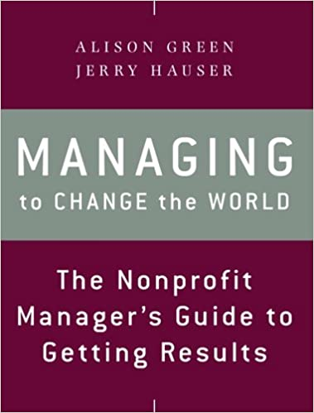
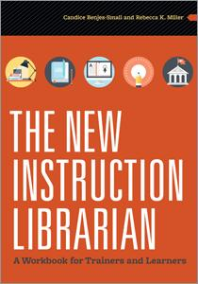
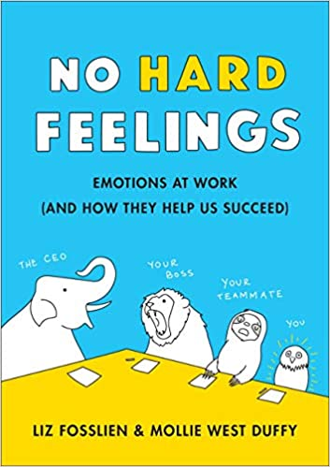
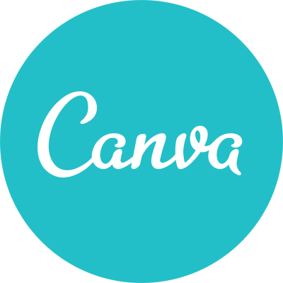
Recommended resources
Notes:
We have some resources to recommend! No Hard Feelings is a great book for anyone who over-thinks their work life and gets lost in the bog of human relationships in the workplace. Managing to Change the World is an excellent, practical book with really actionable advice; it’s written by the creator of “Ask a Manager,” and if you are not familiar with that blog, please check it out. It’s good for a laugh, but beyond that it’s an excellent forum for thinking through workplace questions --- it is one website where I would recommend that you read the comments because it’s so thought-provoking to see different people’s takes on issues.
As for teaching resources, I highly recommend The New Instruction Librarian, which is an ALA book. It’s organized by the different “hats” an instruction librarian has to wear, like project manager, coordinator, and advocate. And has some excellent worksheets for designing learning objectives and classroom observations in the back.
I’d also recommend library blogs! ACRLog is the ACRL official blog (full disclosure I write for them) -- I’ve found their posts knowledgeable and compassionate about all kinds of topics in academic librarianship, not just teaching.
The ACRL Sandbox is another cool resource, where you can browse learning activities, worksheets, assignments, and lesson plans, tagged by the ACRL Framework for Information Literacy frames. That’s something I love about education, and library educators in particular, is this willingness to share classroom resources and inclination toward open access and Creative Commons.
Some other tools we like are:
Trello, a project management website
Unsplash, a repository of high-quality, freely-usable stock photos (all the photos in this presentation are from Unsplash!)
Canva

Slide 27
What do YOU wish you’d learned in library school?
https://bit.ly/TCALknowledgegaps
Notes:
I’m always personally curious to hear what people wish they’d learned in library school and also to hear about how they filled their own knowledge gaps.
I love to hear about the tools other people are using to continue their learning. Please feel free to contribute your thoughts on our Google form here.

Slide 28
Conclusion
When you are lost in the woods, ask for help!
Notes:
In conclusion, when you’re lost in the woods, ask for help! Even if your workplace doesn’t feel psychologically safe enough to admit your ignorance, if you can find one friend to confide in and compare notes with, I think you’ll find an easier time. It might feel like the lost leading the lost, but there’s something to be said for peer-learning. We’ve jokingly referred to each other as “dumb-question friends,” even though of course there is no such thing as a dumb question!

Slide 29
Contact us:
Emily Hampton Haynes
ehamptonhaynes@carrollcc.edu
Kaitlyn May
may@hood.edu

