Slide 1
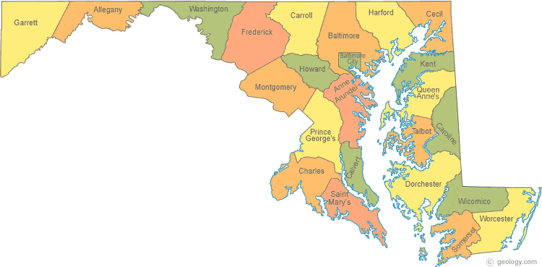
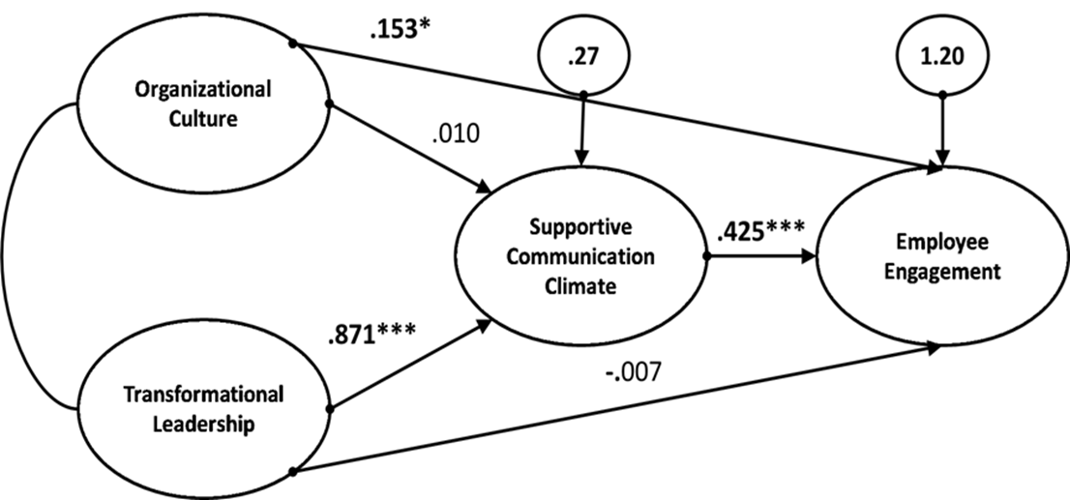
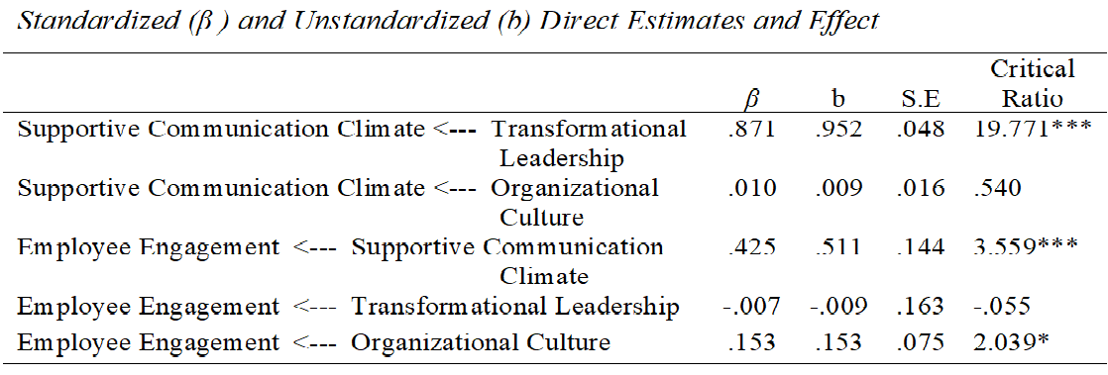
The Effects of Leadership Behavior and Organizational Culture on Library Employee Engagement:
The Mediating Role of Communication Climate
Fanuel Chirombo, Ph.D. Acquisitions, Serials & E-Resources Librarian • Bryan Fuller, Bryan Fuller, Reference and Government Documents Librarian
Richardson Library, Morgan State Library, Baltimore
BACKGROUND
DATA AND METHODS
Data Source
Study population–library employees from 16 four-year public universities, 3 public graduate institutions,16 two-year community colleges, and 22 private universities and colleges in Maryland.
Initial sample size: 299; Final sample for data analysis: 286 (96% response rate)
Criteria for subject selection: library employees.
Based on 95% confidence level with a 5% margin of error recommended in most research (De Vaus, 2001).
RESULTS
ANOVA Results
FINDINGS AND IMPLICATIONS
Expected Finding: Supportive communication climate was expected to partially mediate the relationship between leadership behavior and employee engagement
Actual Finding: Supportive communication climate fully mediated the relationship between leadership behavior and employee engagement.
Theoretical Implications
Added new knowledge to the understanding and explanation of the predictive nature of transformational leadership theory.
Introduced supportive communication climate as a strong mediator of the predictive relationship between leadership behavior and employee engagement.
Practical Implications
Library leaders need to invest in their own leadership development.
Empower employees to gain leadership skills through attending leadership workshops and conferences.
Create communication policies that enable all employees to freely participate in organizational communication.
Create cross-functional teams to encourage cross-fertilization of ideas.
Encourage informal communication among employees through parallel structures such as social groups and service committees.
Enable use of new information communication technology by encouraging and at times, enforcing its use.
Design intensive orientation programs for new employees and establish mentorship programs.
Be aware of the fact that organizational cultural change is constant in all organizations.
Don’t wait and react to cultural change, instead initiate the change process.
Invest in employees’ learning and innovation opportunities.
Consider employees’ health and well-being by offering programs such as tele-working and flextime.
Purpose of Study
Examined the effects of leadership behavior and organizational culture on employee engagement through the mediation of supportive communication climate among academic library employees in Maryland.
Independent Variables | Transformational Leadership | Organizational Culture | Supportive Communication Climate | Employee Engagement
Gender | No Significant Difference | No Significant Difference | No Significant Difference | No Significant Difference
Type of University/Colleges | No Significant Difference | No Significant Difference | No Significant Difference | No Significant Difference
Service Area | No Significant Difference | Significant Difference (p = .026) p < .05 | Significant Difference (p = .021) p < .05 | No Significant Difference
Technical Services |  |  | Higher than those with public and other services
Other Services |  | Higher than those with technical and public services
Years Working at Current Library | No Significant Difference | No Significant Difference |  | No Significant Difference
Years Working with Current Supervisor | No Significant Difference | No Significant Difference | Significant Difference (p = .020) p < .05
1 to 5 years |  |  | Higher than those with 6 to 10 and >20 years
6 to 10 years |  |  | Higher than those with 11 to 15 and >20 years
Current Supervision Experience | No Significant Difference | No Significant Difference |  | Significant Difference (p = .013) p < .05
Yes |  |  |  | Higher than those with no supervision experience
Sample Demographic Characteristics
Academic Libraries in Maryland
Gender: Male – 24% Female – 74% Other – 2%
Type of University: Private – 23% Public – 77%
Service Area: Technical Services – 36% Public Services – 51% Other – 13%
Supervision Experience: No – 58% Yes- - 42%
Length of Current Service:
1-5yrs. -42%, 16-10yrs, -16%, 11-15yrs -10%, 16-20yrs. – 13&, 20+ yrs. – 19%
Length of Experience under current supervisor
1-5 yrs. – 68%, 6-10yrs. – 19%, 11-15yrs. – 10%, 16-20. – 13%, 20+ yrs. – 2%
Sixteen four-year public universities
Three public graduate institutions
Sixteen two-year public community colleges
Twenty-two private universities and colleges
Confirmatory Factor Analysis
Model | χ ² | df | ∆ χ ² | ∆df | p | AIC | RMSEA | TLI | CFI | SRMR
Initial Measurement | 451.816 | 113 |  |  | .000 | 531.816 | .103 | .919 | .932 | .0603
Alternate Measurement 2 with MI | 200.153 | 95 | 251.663 | 18 | .000 | 318.153 | .062 | .970 | .979 | .0396
Instruments
Theoretical Model
Variable | Description | Items | Cronbach a
Leadership behavior | Inspirational motivation, intellectual stimulation, individualized consideration, idealized influence (charisma) | 20 | .968
Organizational culture | Clan, adhocracy, market, and hierarchy | 24 | .904
Climate Communication | Supportive:- Problem orientation, empathy, equality, description, provisionalism, and spontaneity | 15 | .970
Employee engagement | Vigor, dedication, and absorption | 9 | .932
Path Analysis Summarized Results
Data Analysis
Main Research Question and Hypothesis
To what extent does supportive communication climate mediate the relationship between leadership behavior and employee engagement?
• H₁: There will be a statistically significant indirect effect of transformational leadership behavior on employee engagement via supportive communication climate.
IBM Statistical Package for Social Sciences (SPSS)
Descriptive Statistics
Correlations
Analysis of Moment Structures for Structural Equation Modelling (AMOS)
Reliability Analysis
Model Measurement Analysis
Model Evaluation/Fit: Chi-Square, CFI, RMSEA, SRMR
Path Analysis
Alpha level of .05 to determine significance for all statistical test.
Mediation Results
Parameter | Employee Engagement
 | Total Effects (with Mediator) | Direct Effects (without Mediator ) | Indirect Effects (Mediator only) | Mediation Results
Transformational Leadership | .486*** ( c₁ ) | .000 ( c₁’) | .486*** ( a₁ ) | Full
Organizational Culture | .165 ( c₂ ) | .165*** ( c₂’) | .000 ( a₂) | None
REFERENCE
De Vaus, D. A. (2001). Research design in social research. SAGE.

