Slide 1
Chronicling America and the
Historic Maryland Newspapers Project
Pamela A. McClanahan
Digital Projects Librarian
University of Maryland Libraries
August 12, 2020
Towson Conference for Academic Libraries
Notes:
Hi, I’m Pamela McClanahan, the Digital Projects Librarian at University of Maryland Libraries and Project Manager for the Historic Maryland Newspapers Project. Through this project, we digitize Maryland newspapers and make them freely accessible on the Chronicling America website as a part of the National Digital Newspaper Program.
[Image: Presentation title - Chronicling America and the Historic Maryland Newspapers Project. Background image of overlapping front pages of digitized Maryland newspapers. University of Maryland Libraries logo.]

Slide 2
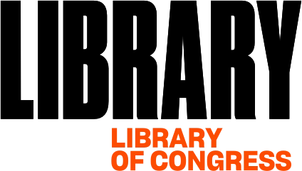
National Digital Newspaper Program
Notes:
The Historic Maryland Newspapers Project at University of Maryland Libraries is the Maryland state awardee of the National Digital Newspaper Program, or NDNP, which is a partnership between National Endowment for the Humanities and Library of Congress. Each state has one awardee to the program that receives a two-year grant to coordinate newspaper title submissions for the state and submit approximately 100,000 digitized newspaper pages to be included in the Chronicling America website.
[Image: National Endowment for the Humanities logo. Library of Congress logo.]

Slide 3
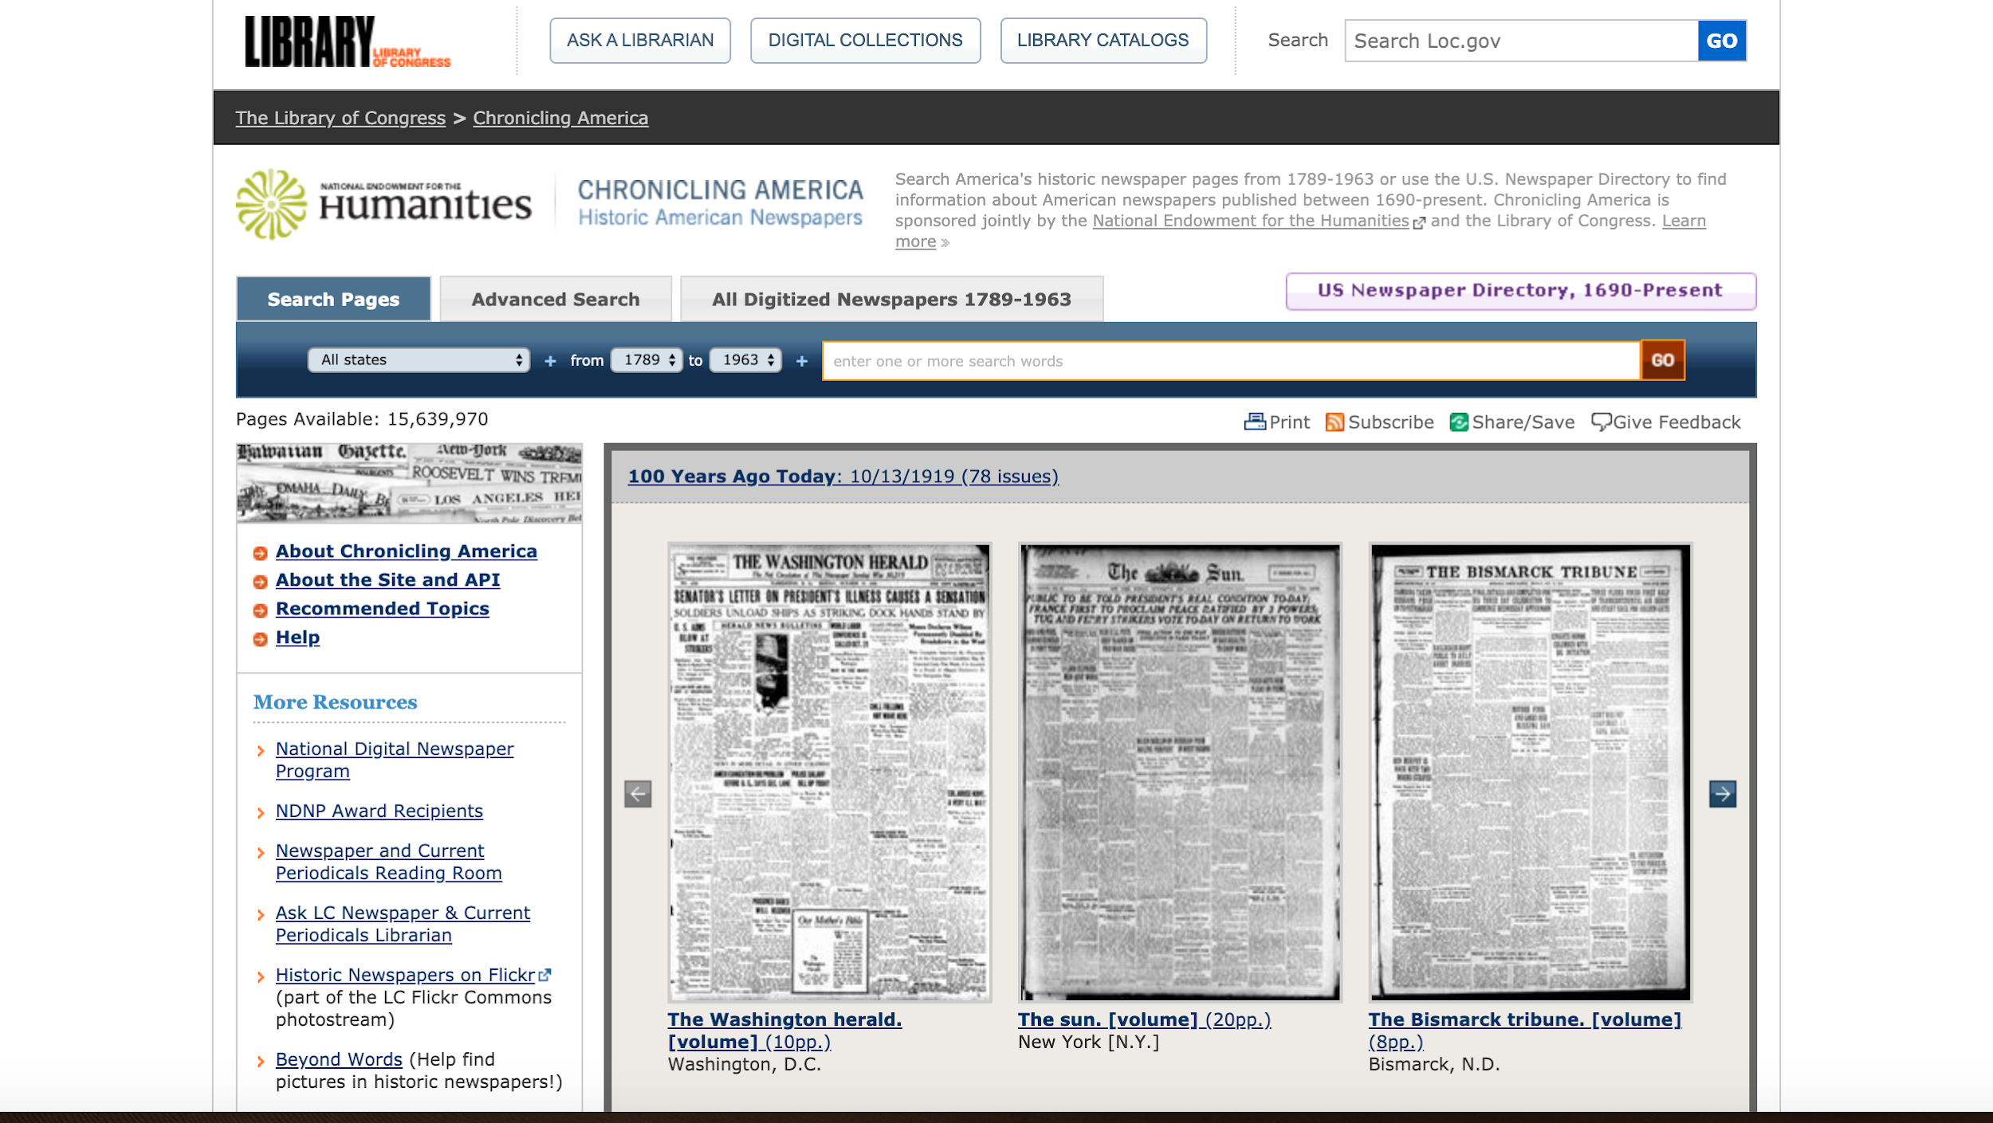
Chronicling America
https://chroniclingamerica.loc.gov/
Notes:
The Chronicling America website is used by researchers of all kinds including students, educators, historians, academic researchers, genealogists, and the general public. Newspapers include a wealth of information providing insight into the day to day life in a specific time and place. Chronicling America allows you to do a simple keyword search or an advanced search by state, newspaper title, date range, language, or phrase.
[Image: Screenshot of Chronicling America homepage. Link to site: https://chroniclingamerica.loc.gov/.]

Slide 4
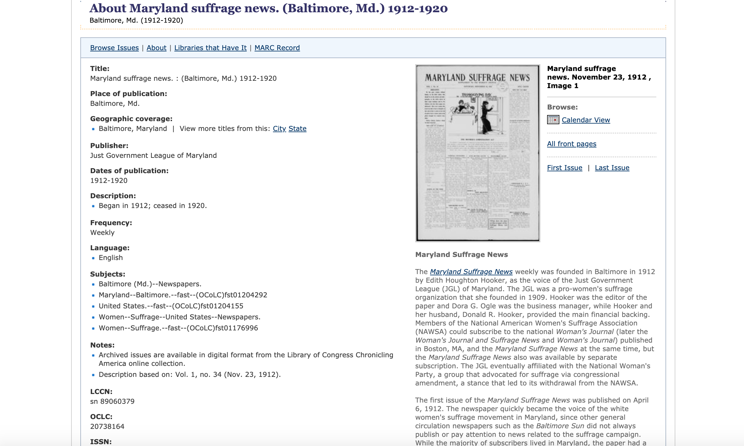
Chronicling America - Title View
https://chroniclingamerica.loc.gov/lccn/sn89060379/
Notes:
The Chronicling America website also hosts the US Newspaper directory which provides detailed bibliographic information about newspaper titles. This is a title view for the Maryland Suffrage News. If the title has been digitized like this one, on the right you will see an image of the first page, a link to a calendar view of digitized issues, as well as other viewing options for the digitized papers and a title essay. Title essays are prepared by the state awardees for the titles they digitize and provide background historical information about the title and its significance.
[Image: Screenshot of Chronicling America newspaper title view of Maryland Suffrage News. Link to site: https://chroniclingamerica.loc.gov/lccn/sn89060379/.]

Slide 5
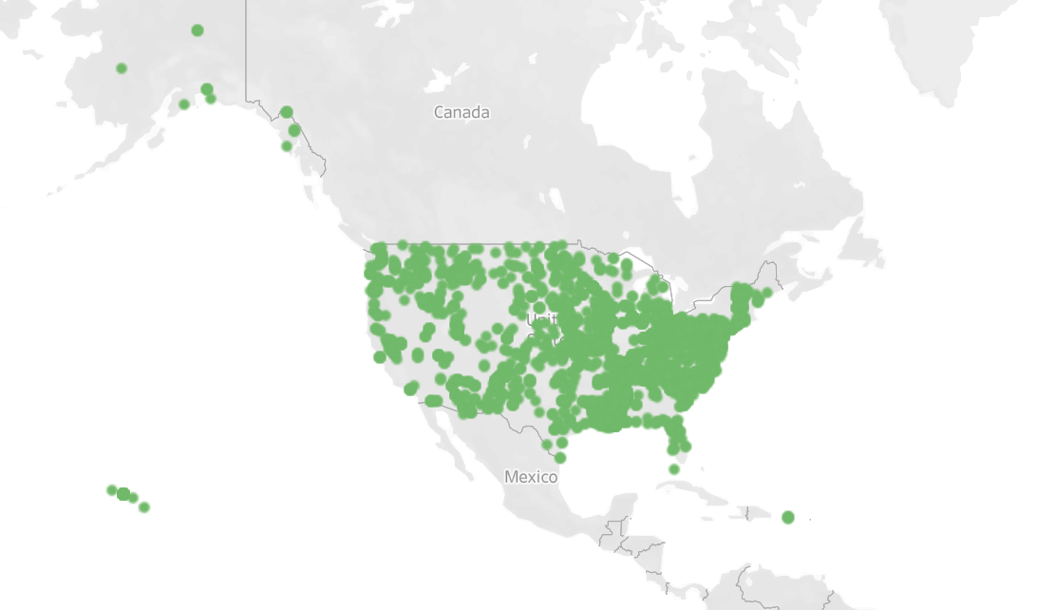
Courtesy of Library of Congress, https://www.loc.gov/ndnp/data-visualizations
Notes:
NDNP began in 2005 with only a few states initially participating. There are now 48 states and 2 territories represented in the program, which altogether have contributed over 16 million newspaper pages to Chronicling America. This map shows the location for all titles included in the project. You can see a concentration on the East Coast and especially around larger cities.
[Image: Data Visualization courtesy of Library of Congress. Map of United States with dots for each newspaper title in Chronicling America.]
Data used in this visualization is from https://chroniclingamerica.loc.gov as of 5/14/2019. Map locations based on system generated longitude and latitude values. More info at: https://www.loc.gov/ndnp/data-visualizations.

Slide 6
Maryland Content in Chronicling America
Historic Maryland
Newspapers Project
Years participating: 2012 - present
Total MD News pages: 316,168
Total MD issues: 58,664
Total MD titles: 46
Languages: 3 (English, German, and Polish)
Notes:
Maryland received their first NDNP grant in 2012 and we’re currently on our 4th grant phase. In the first three grant phases, 316,168 Maryland newspaper pages representing 58,664 issues from 46 titles were added to Chronicling America. In addition to English, German and Polish titles are also included. By the end of this current 4th grant phase, we expect to add another 110,000 pages and also will add a title in Czech and one in Italian.
[Image: Background image of overlapping front pages of digitized Maryland newspapers. University of Maryland Libraries logo.]

Slide 7
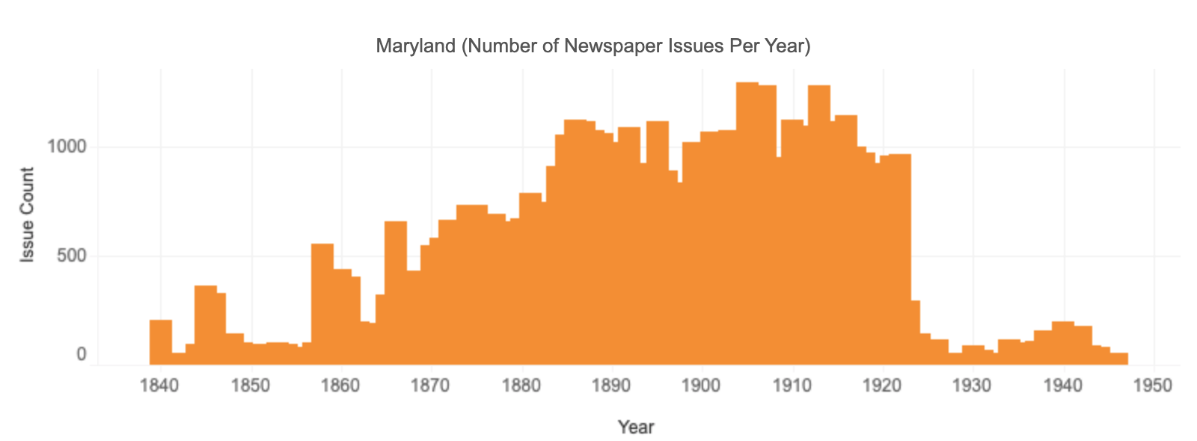
Courtesy of Library of Congress, https://www.loc.gov/ndnp/data-visualizations
Notes:
The Program did not initially accept newspapers from all years and has slowly expanded to now covering newspaper titles from 1690-1963. This graph shows temporal coverage of Maryland titles in Chronicling America. Maryland currently has titles from 1840 to 1946 with the majority of content between 1885 and 1922. In this current phase, we’ll be expanding on this and adding titles all the way to 1963.
[Image: Data Visualization courtesy of Library of Congress. Bar graph depicting number of issues of Maryland newspapers in Chronicling America by year.]
Data used in this visualization is from https://chroniclingamerica.loc.gov as of 9/4/2019. More info at: https://www.loc.gov/ndnp/data-visualizations.

Slide 8
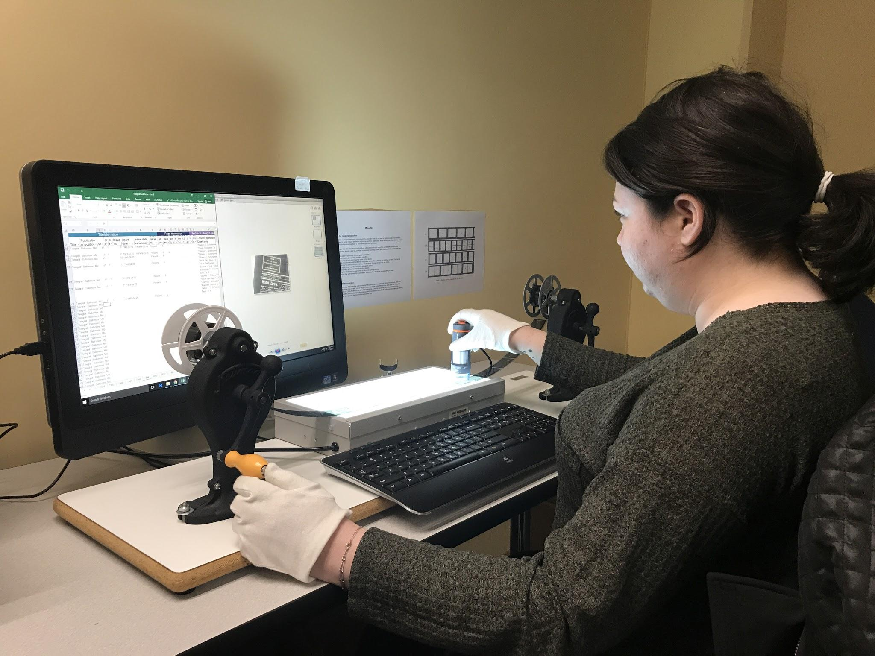
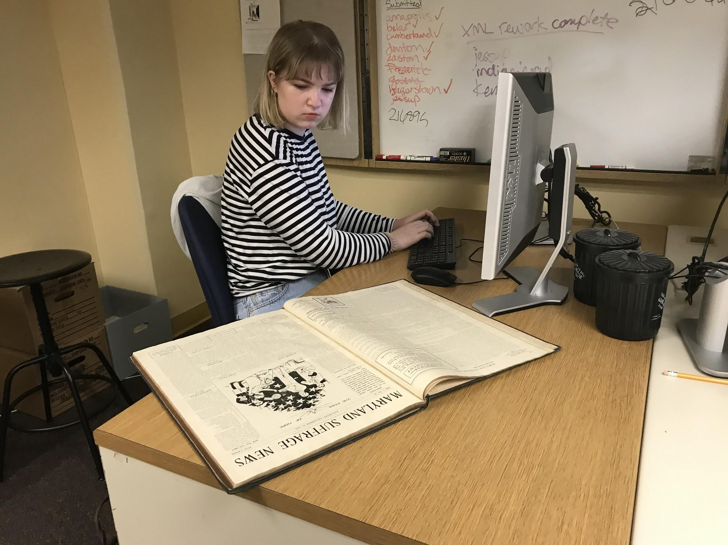
HMNP Phase 4 Staff
Co-Directors:
Douglas McElrath
Robin C. Pike
Project Manager:
Pamela A. McClanahan
2019-2020 Student Assistants:
Bryanna Bauer
Sarah McKenna
Mark Parkhurst
2018-2019 Student Assistants:
Sydney Schneider
Jane Sonneman
Notes:
The staff working on the Maryland project include myself as the day to day Project Manager. We have co-directors, our Director of Special Collections and our Digitization Department manager. We also have student assistants primarily from the University’s ischool helping with metadata collation and quality review of digital images. These photos show two of our students working on metadata collation in 2019 - one working from duplicated master microfilm and the other from a bound print volume.
[Image: Top - Photo of student sitting at desk with lightbox wearing white cotton gloves viewing newspaper images on a microfilm reel with an electronic microscope connected to a computer screen. Bottom - Photo of student sitting at a desk viewing a bound volume of newsprint typing on a computer keyboard to input metadata.]

Slide 9
Project
Workflow
Finalize title selection
Obtain original content
Send microfilm for duplication
Complete metadata collation
Send duplicated microfilm reels for imaging along with metadata to be embedded in images
Conduct quality review on digital files
Submit approved files to LC for inclusion in Chronicling America
Notes:
We work with many partners to select and digitize Maryland Newspapers. We have an advisory board made up of archivists, librarians, educators, and historians from throughout the state who help with the title selection based on their expertise. Then we work with content partners who hold titles, primarily on second generation master microfilm to have that duplicated. Imaging is done from the duplicated microfilm and metadata is added in post-processing. After quality review, we submit the images and metadata files to the Library of Congress for inclusion in Chronicling America.
[Image: Workflow chart with arrows.]

Slide 10
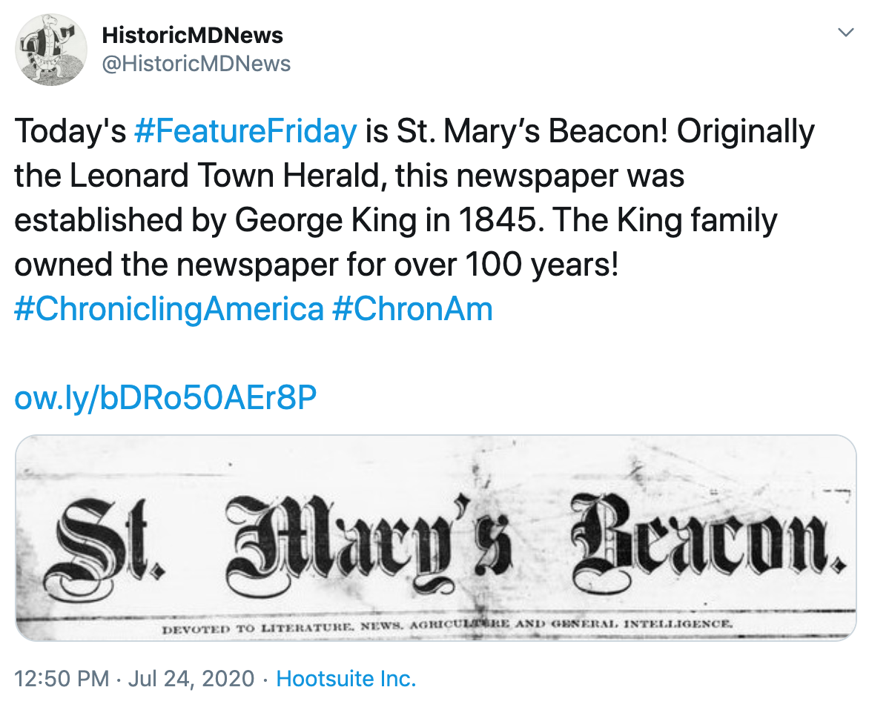
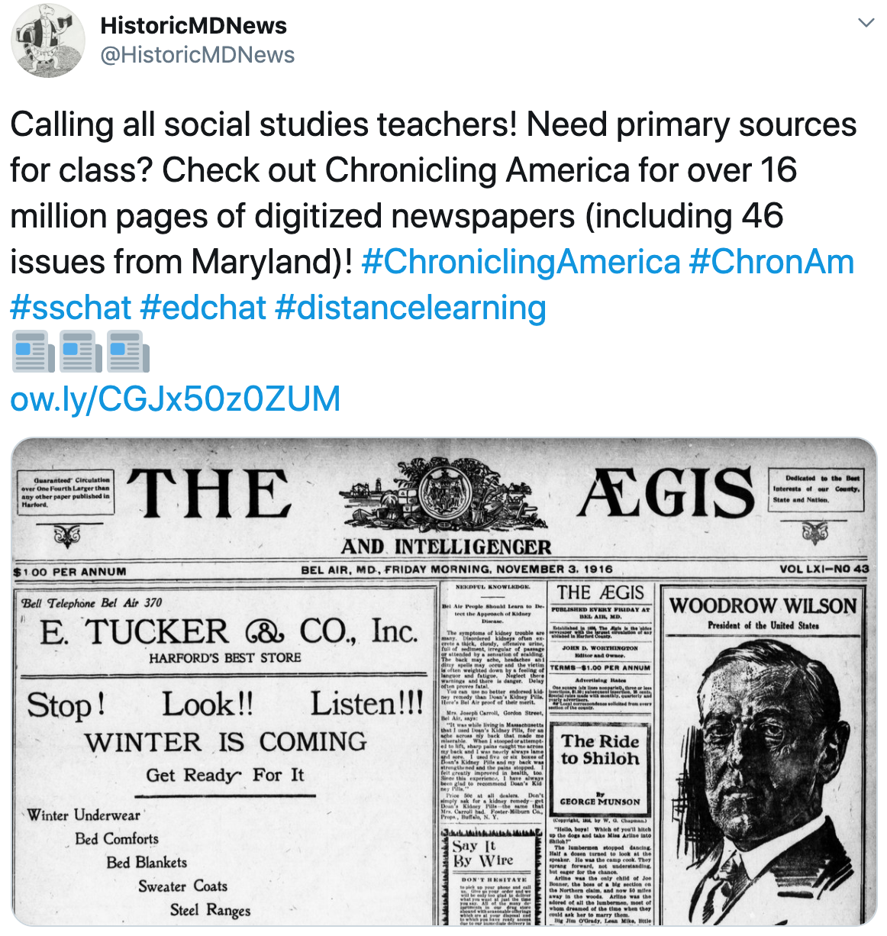
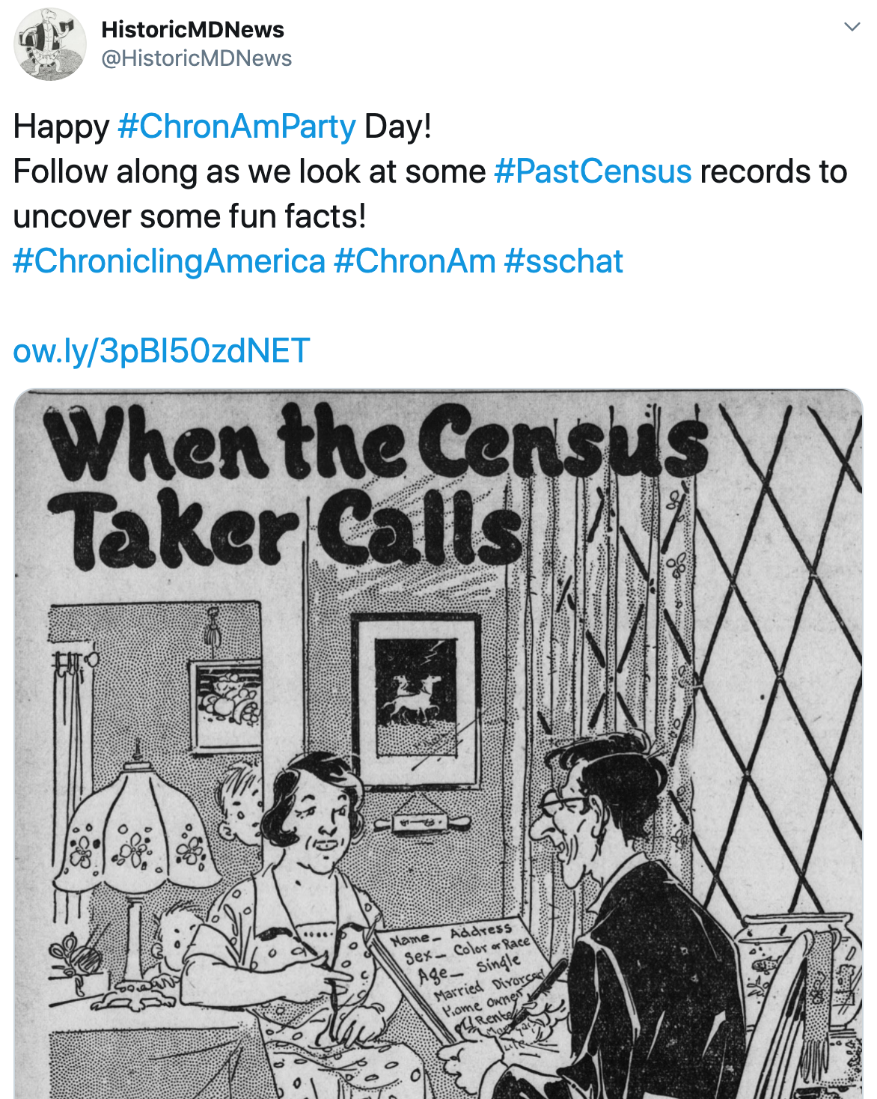
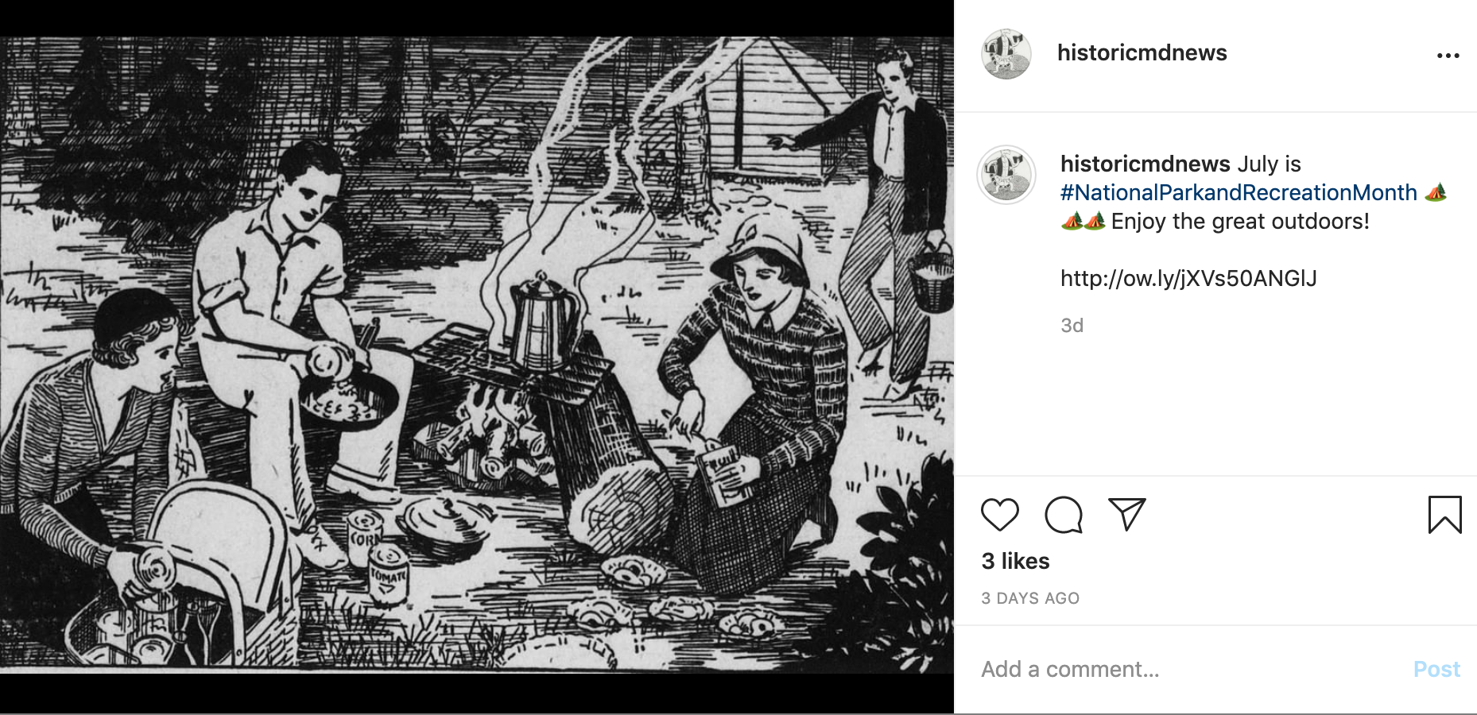
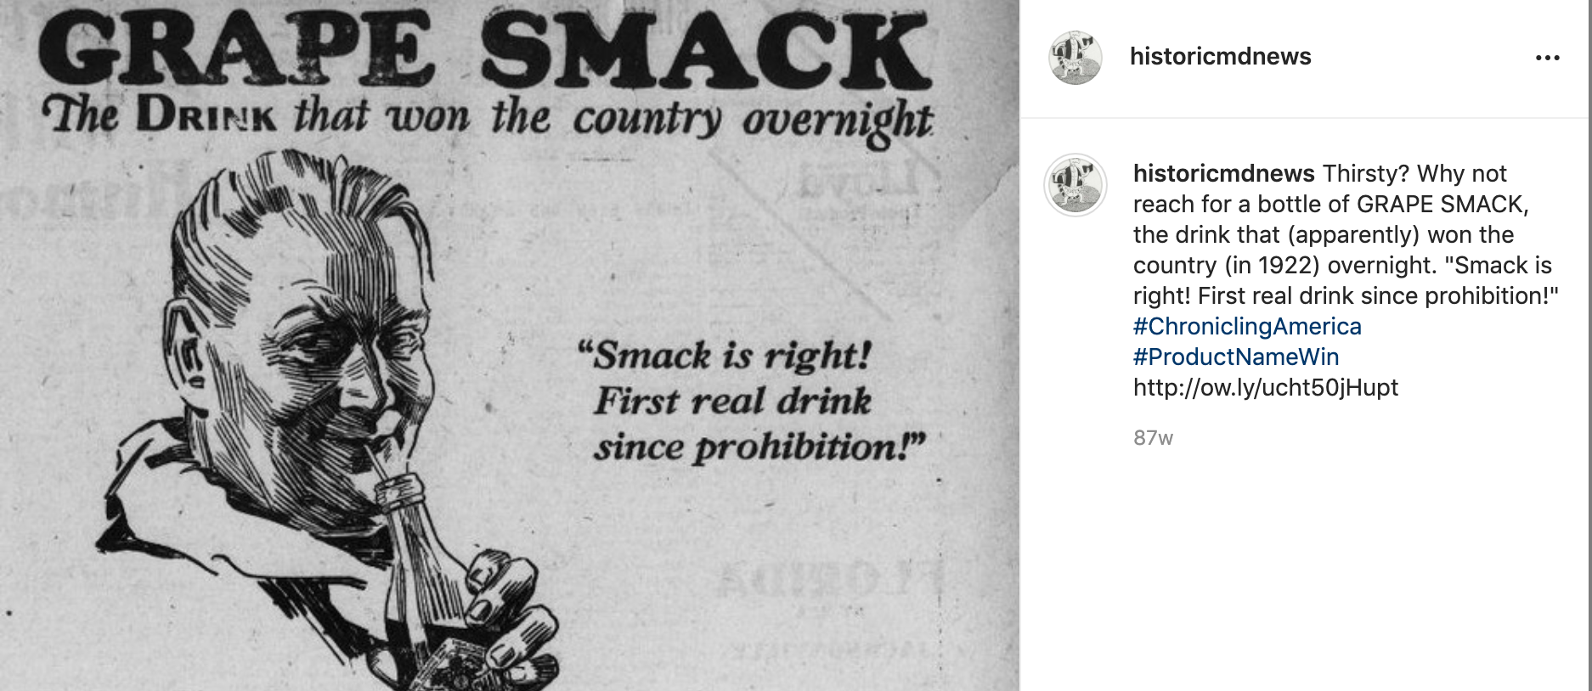
Outreach: Social Media - @HistoricMDNews
Notes:
One of the ways we do outreach for the project is through social media on our @HistoricMDNews account on Twitter, Facebook, and Instagram. We take the opportunity to feature specific Maryland titles and interesting articles as well as eye catching illustrations and advertisements. We participate in a monthly hashtag event on Twitter called #ChronAmParty with the other state newspaper projects posting content from our state titles around a particular topic. During this time of distance learning due to the pandemic, we also engaged the education community to share Chronicling America as a great place to find primary sources through twitter hashtags.
[Image: Five screenshots of social media posts. Screenshot 1 - Image of masthead of the St. Mary’s Beacon newspaper. Screenshot 2 - Image of newspaper illustration of a group of young adults in the 1930’s at a campground sitting around a fire cooking a meal. Screenshot 3 - Image of a newspaper illustration titled “When the Census Taker Calls” with a man and a woman sitting in a room with the man writing notes and two children are peeking around a wall behind the woman. Screenshot 4 - Image of the top half of the front page from an issue of The Aegis newspaper. Screenshot 5 - Image of a newspaper advertisement for a beverage called “Grape Smack” with a man drinking from a bottle.]

Slide 11
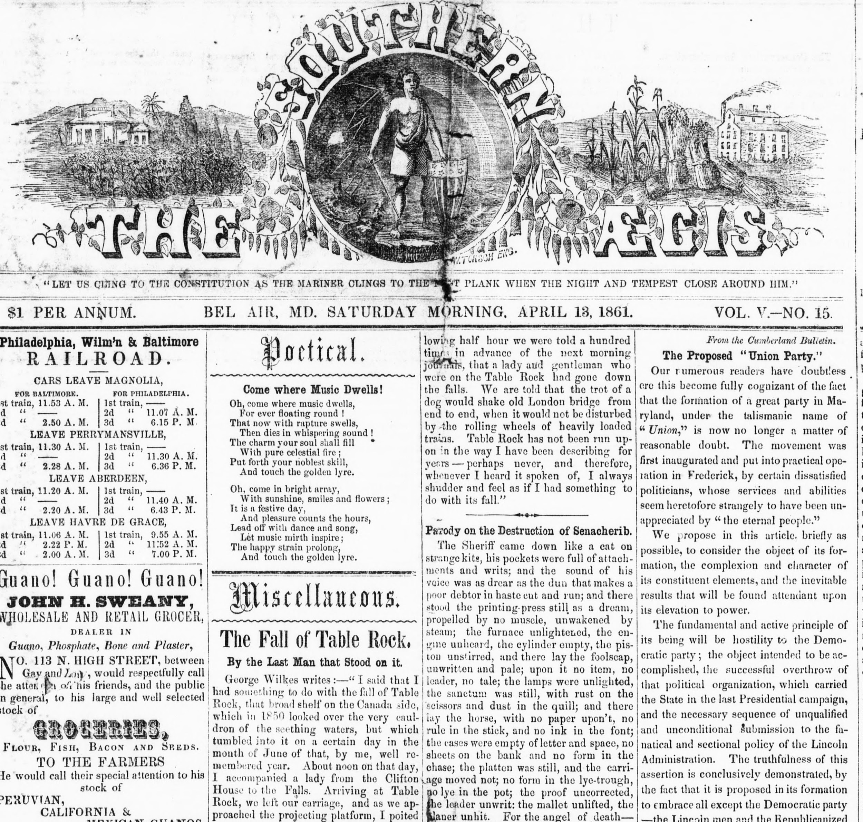
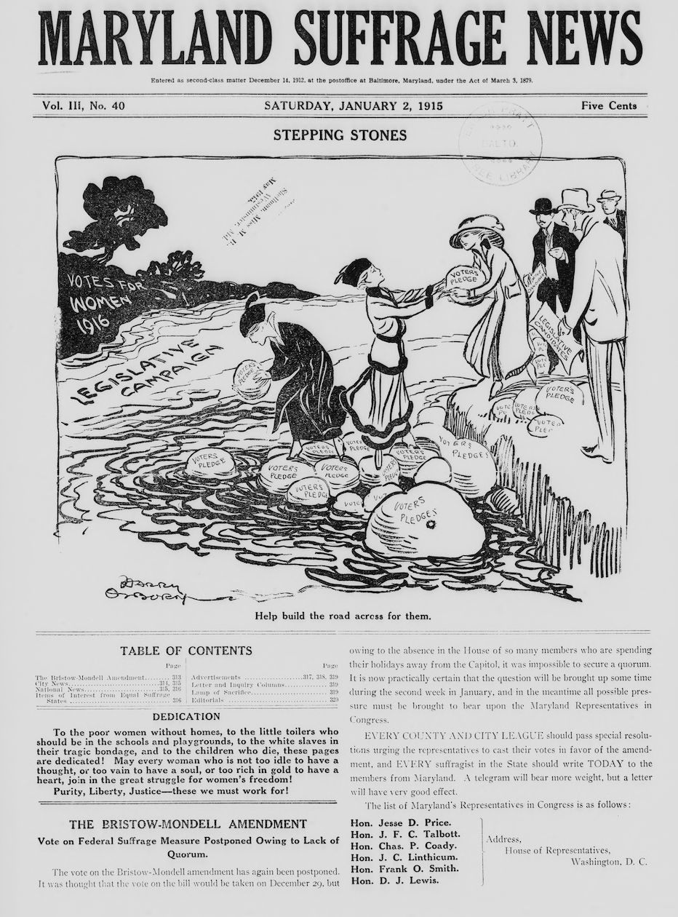
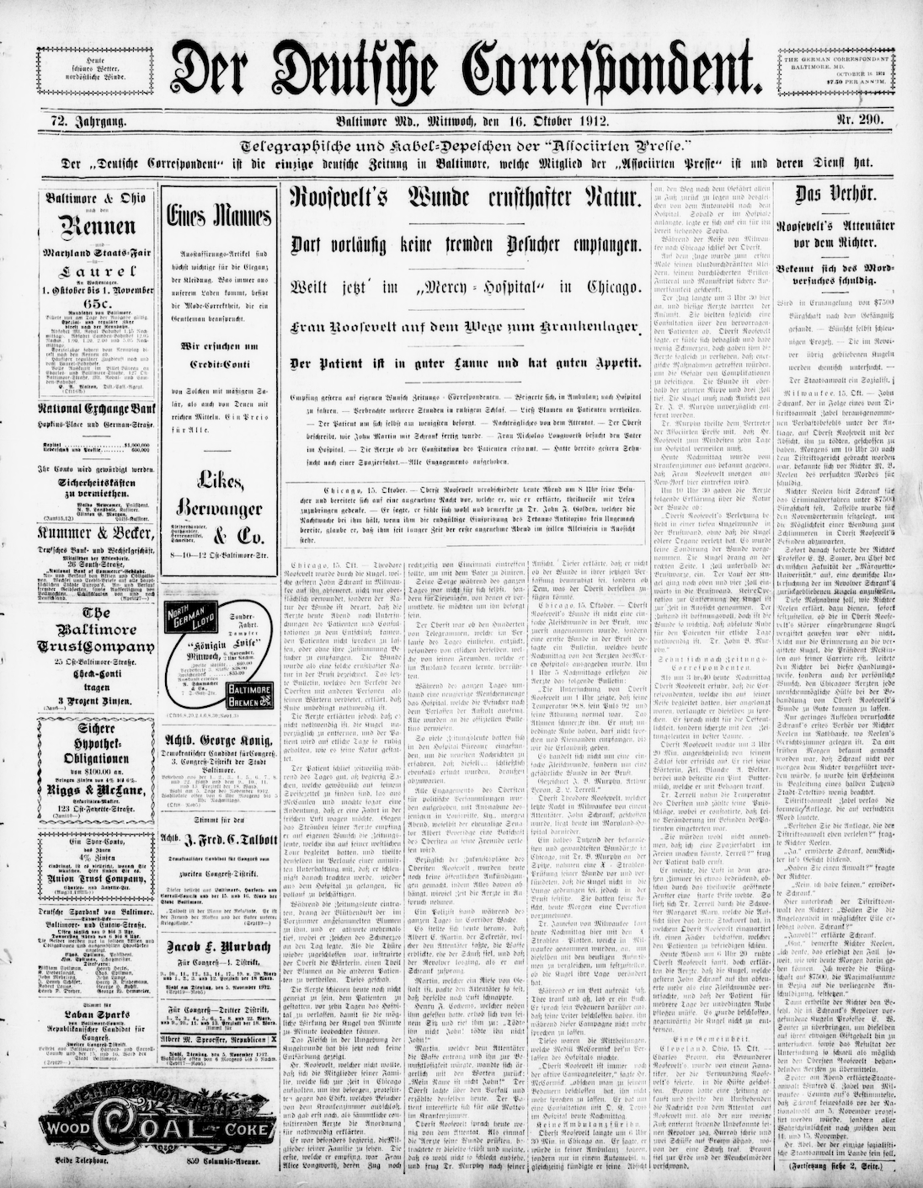
Data Analysis Project
Notes:
Now that I’ve given an overview of the program, I’d like to discuss a data analysis project that I have recently started, but would like to continue to delve into further. With the goal being to better understand the Maryland newspaper collection in Chronicling America to make future digitization selection decisions and to share this information with researchers and archives, libraries, and other cultural heritage institutions throughout the state.
[Image: Front pages of digitized newspaper issues from three newspapers: the Maryland Suffrage News, The Southern Aegis, and Der Deutsche Correspondent.]

Slide 12
Title
Selection
Criteria
Current NDNP selection criteria include:
content must be published in state between 1690-1963 and be in the public domain;
with significant research value (papers of record for the state and good geographic, temporal, social, and political coverage of the state, as well as prioritizing content from diverse and underrepresented groups);
good image quality, preferably from the master negative microfilm (but can consider positive microfilm and print);
with as complete a run as possible - long runs, continuity, few to no gaps; and
has not already been digitized elsewhere.
https://www.loc.gov/ndnp/guidelines/selection.html
Notes:
NDNP has selection criteria requirements that must be met as listed here including research significance and microfilm quality. Additionally, UMD Libraries and our advisory board have prioritized titles from communities traditionally underrepresented in archival records including immigrant communities, women, political minority groups, and labor groups. Newspapers are often one of the only primary sources for these communities’ activities as they are not always otherwise well-documented in the historical record.

Slide 13
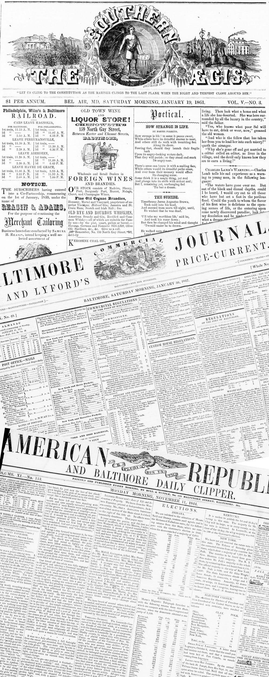
HMNP Title Selection Phases 1-4
Phase 1: primarily German-language Baltimore newspaper, Der Deutsche Correspondent, a few English titles from Baltimore, Cumberland, and Hagerstown
Phase 2: increased English pages, geographic representation, and temporal coverage, particularly Civil War years and beyond
Phase 3: continued to increase geographic and temporal representation of Maryland newspapers, expanded into papers of communities less represented including one Polish paper and two labor papers; also papers of contrasting political perspectives and one paper of record from Annapolis
Phase 4: documenting underrepresented groups including papers of immigrant communities (German, Czech, and Italian) and a woman’s paper, adding post-1922 content (1923-1963), and completing titles previously selected
Notes:
Each phase has had a slightly different focus as noted here, but has remained committed to digitizing papers from underrepresented groups, providing temporal and geographic diversity for the state, and emphasizing papers of high research value. We have just recently found out we have been awarded a Phase 5 grant. With that in mind, this project will provide an in-depth analysis of the Maryland papers to share with our advisory board to kick-off the title selection process this fall.
[Image: Overlapping front pages of three digitized Maryland newspapers.]

Slide 14
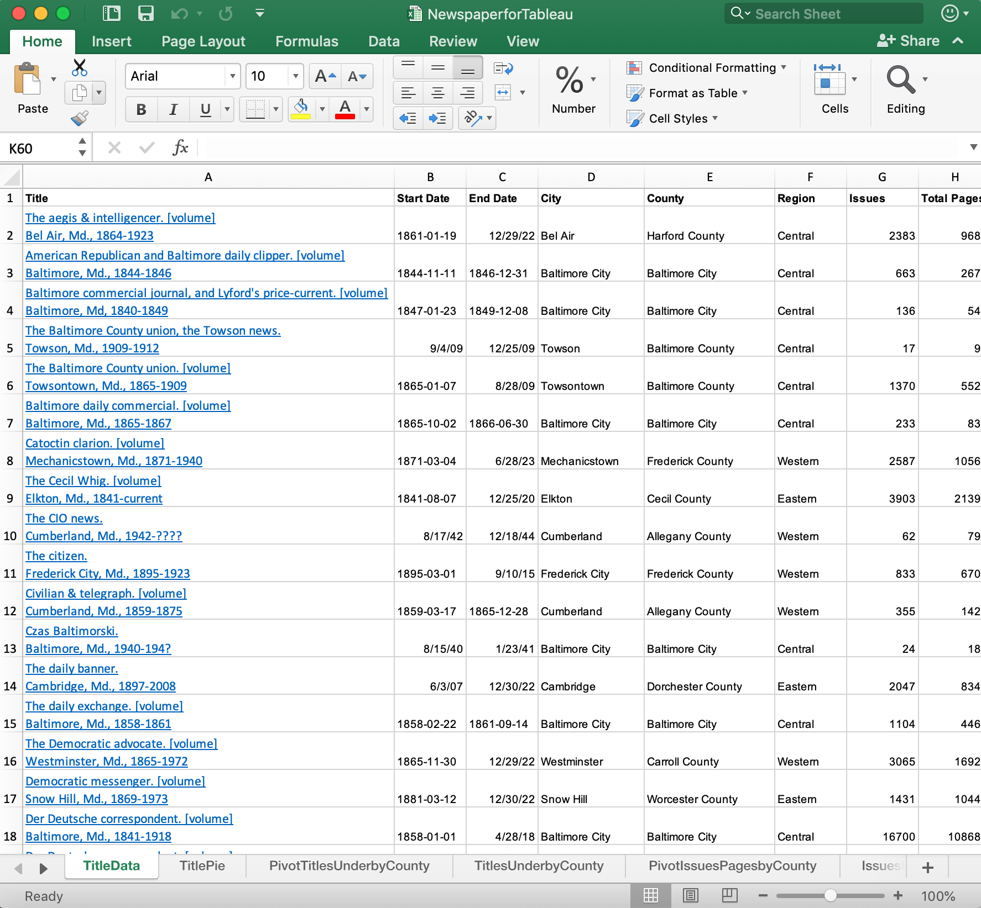
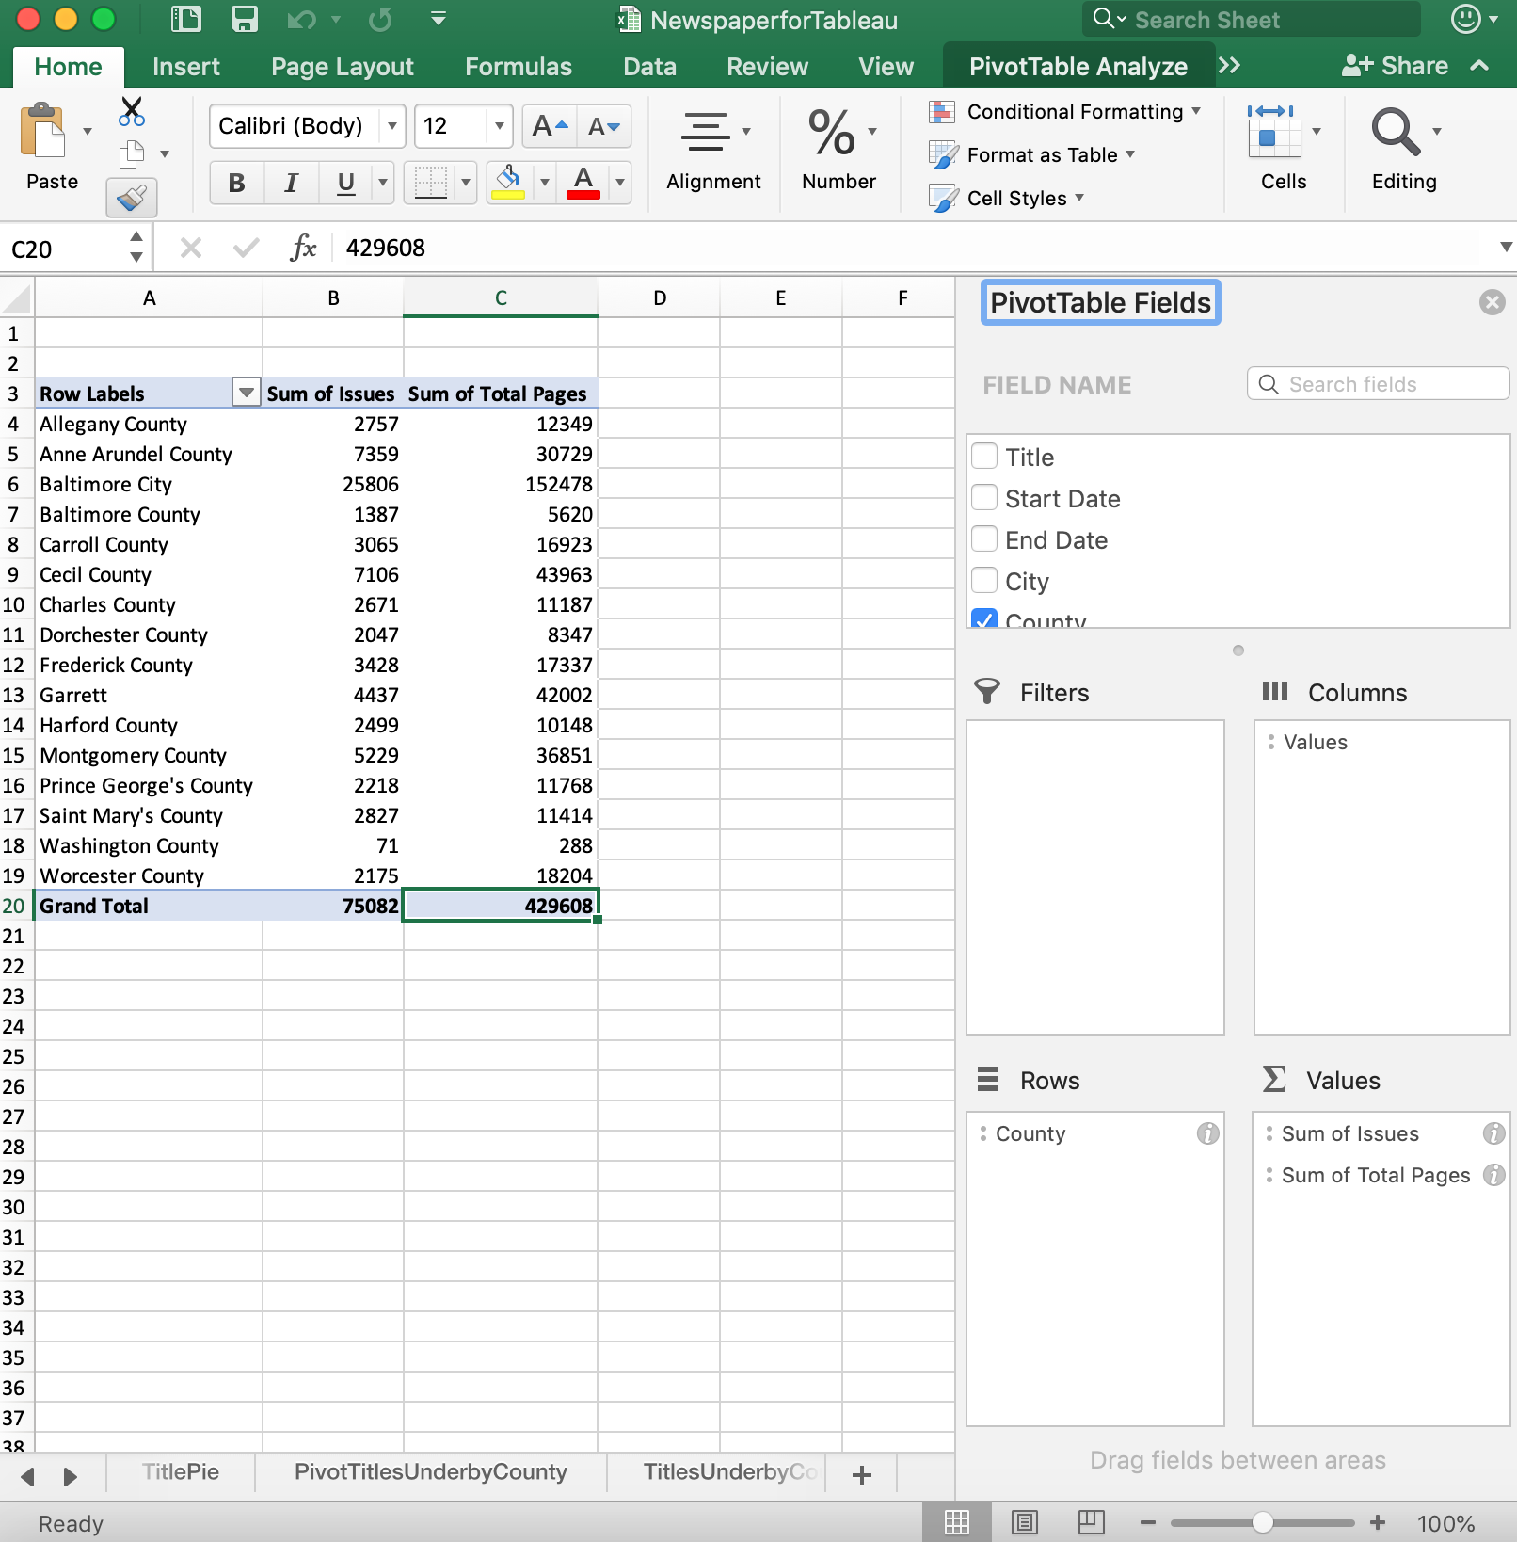
Data Collection
Notes:
While we have had excellent recommendations from our advisory board for title selection, as we’re moving into our 5th phase, I thought it was a good time to look more closely at the data and let that help guide our decisions. This process started with data collection from Chronicling America and our metadata collation records being input into an Excel spreadsheet and then using Excel pivot tables to sum data. I had to use estimates for some of these numbers based on what we intend to submit during this current phase.
[Image: Left- screenshot of title data in rows in Excel spreadsheet. Right- screenshot of sums of data in Excel pivot table spreadsheet.]

Slide 15
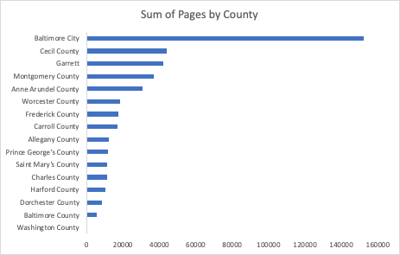
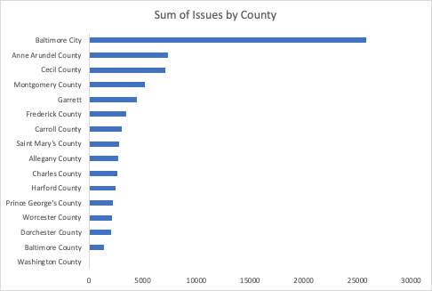
Data Analysis
Notes:
I wanted to see the number of titles, issues, and pages per county and region of the state. There are families of newspapers where a newspaper may have changed names or merged with other newspapers. While these may be listed separately in the newspaper directory, they are essentially one title. Also with newspapers ranging from daily to weekly and issues having anywhere from four to 32 plus pages, all three of those measures are important to review. I used Excel to create some simple graphs from the pivot table sums to quickly show this data.
[Image: Left - Excel chart of data showing sum of pages by county. Right - Excel chart of data showing sum of issues by county.]

Slide 16
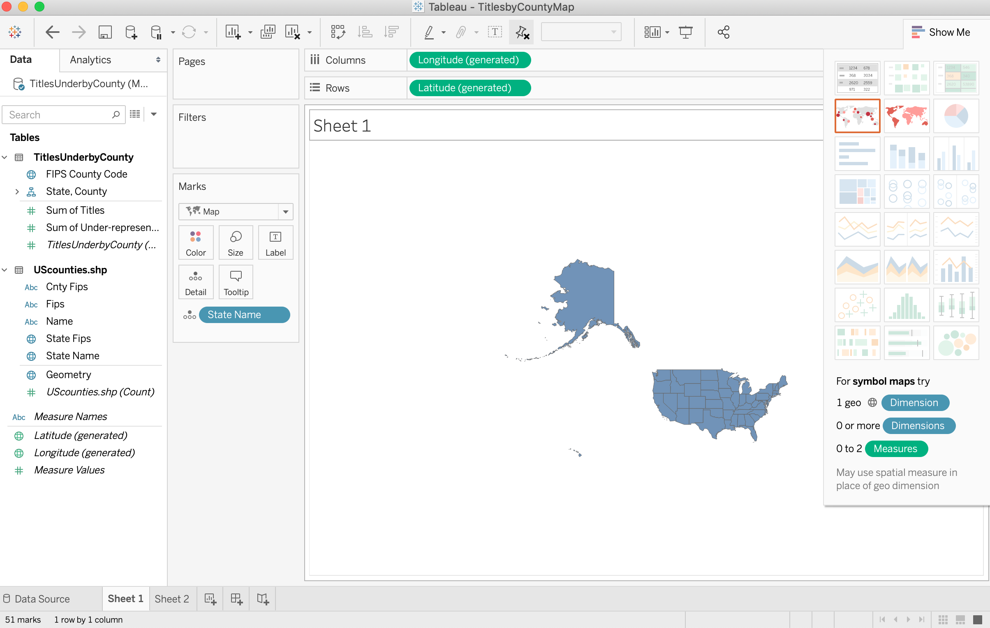
Tableau
Notes:
I wanted this data to be more visually appealing though and see if looking at it in a different format could help us learn more about the collection. I decided to try inputting the data into Tableau. Tableau has a free public version or as an academic researcher or instructor you can request a free one year license to Tableau Desktop Professional Edition, which is what I have used here. This is a powerful data analytics tool that provides many visualization options. I decided to try working with the map feature.
[Image: screenshot of Tableau Desktop Professional application worksheet view with map feature.]

Slide 17
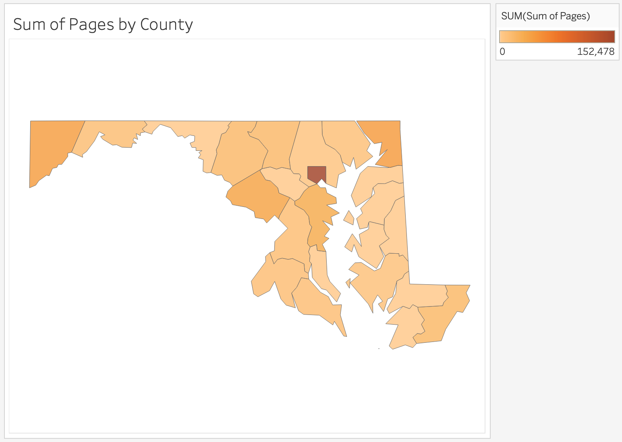
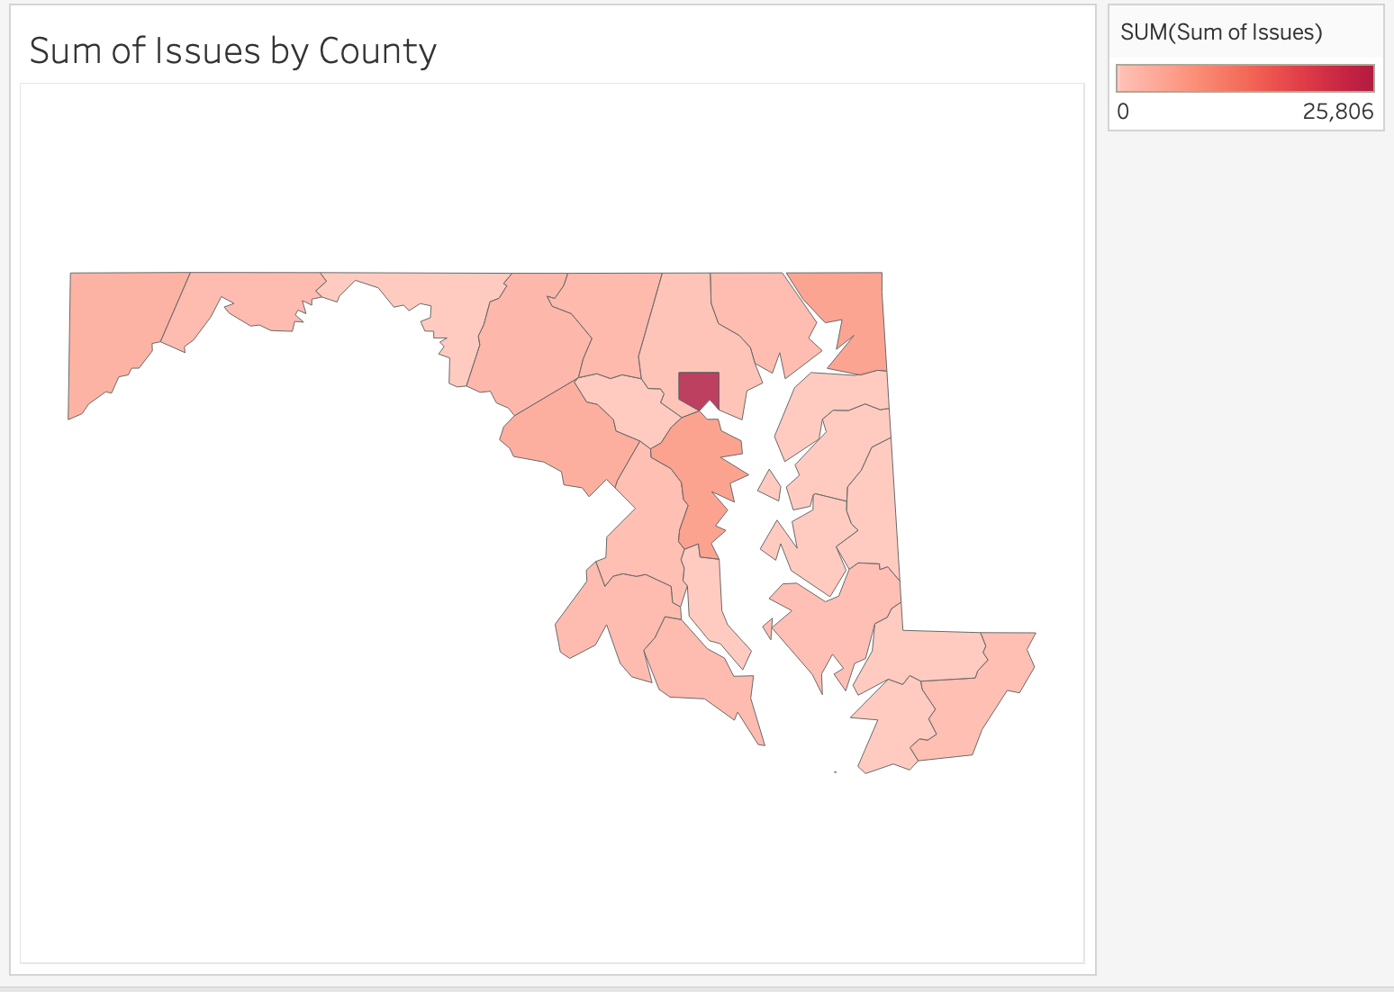
Density Measure Maps
Notes:
After looking up some tutorials online, I was able to add the required geographic data and display a Maryland state map with counties and assign the newspaper title data to the counties on the map. Then I used the density measure option to color the counties - a lower number has a lighter color and higher number has a darker color. These two density maps show the same information as the two charts - sum of pages by county and sum of issues by county.
[Image: Left- Density Map visualization created in Tableau showing sum of pages by county. Right- Density map visualization created in Tableau showing sum of issues by county.]

Slide 18
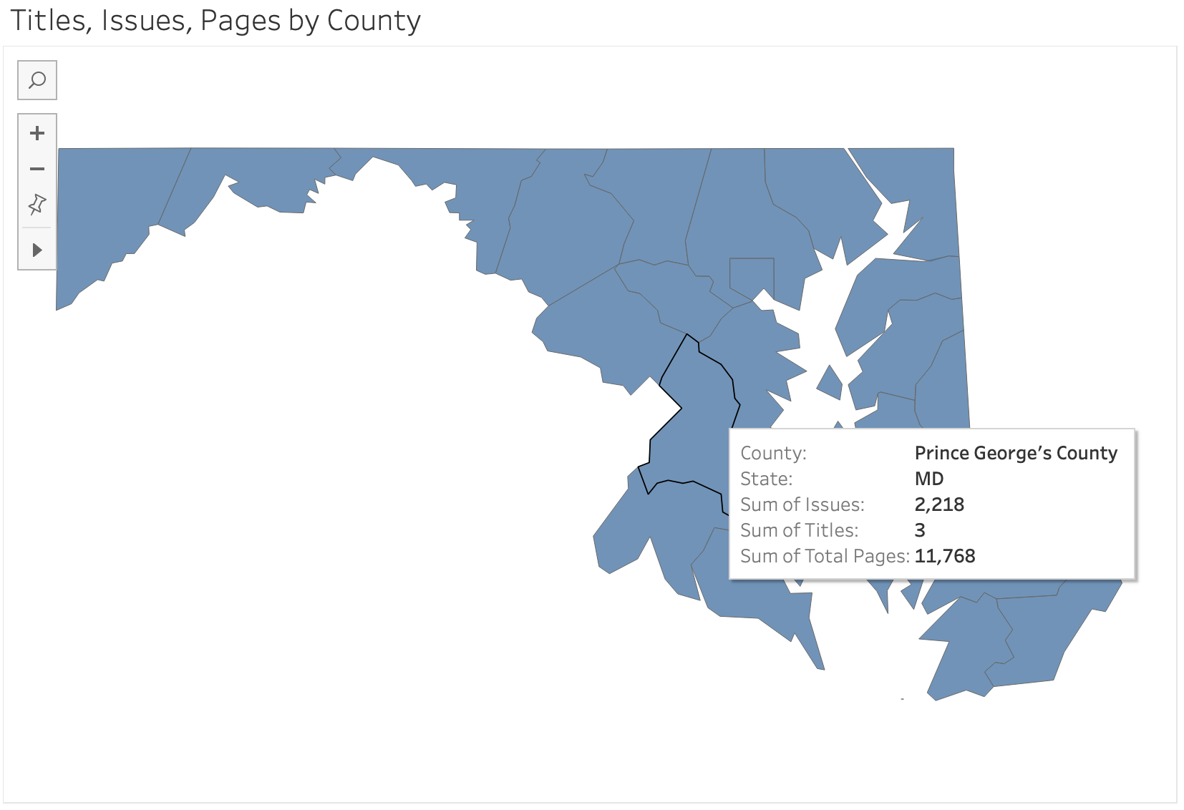
Interactive Map
Notes:
I also created an interactive map that I hope to display on our webpage. When you hover over a county, a pop up (as seen on the screenshot here) shows the county name, and the different sums of title, issues, and pages for the county.
[Image: Screenshot from Tableau of interactive Maryland state map with Prince George’s County highlighted with a circle around it and an arrow pointing to the pop up screen that displays the County, State, Sum of Issues, Sum of Titles, and Sum of Total Pages.]

Slide 19
Further Research
Next steps include:
Considering other ways to compare and visualize the data and diversity of titles
Reviewing families of titles and including temporal data
Sharing research with advisory board and utilizing it in finalizing the title selection decisions for the next grant phase
Working with the advisory board to share this information with researchers and other institutions
Notes:
I’ve just started looking at this data and would like to continue to do further research into the best ways to analyze and visualize the newspaper project data to help understand the collection and inform title selection decisions and also share about our project with others. For example, I want to think more about families of titles and how to demonstrate that in the numbers, as well as how to best visualize the diversity of the titles. I’d also like to determine the best way to incorporate temporal data with these other measures.

Slide 20
Thank you!
Historic Maryland Newspapers Project
https://www.lib.umd.edu/digital/newspapers/home
lib-newspapers@umd.edu
@HistoricMDNews
Pamela A. McClanahan
301-405-1798
pmcclana@umd.edu
@Pam_McClanahan
Notes:
Thank you for listening to my talk on the Historic Maryland Newspapers Project! I’ve listed the project website and social media handle below as well as my contact information. If you have any questions, would like more information, or would be interested in collaborating, please feel free to reach out anytime! Thanks!

