Slide 1
It’s who you know
Teaming up to help faculty
use library materials
in courses
TCAL 2019

Slide 2
Who we are...
Elizabeth De Coster, Research & Instruction Librarian
Miriam DesHarnais, Research & Instruction Librarian
Rob Pleshar, Library Associate for Electronic Resources
Kyla O’Hara, Library Services Specialist for ILL Borrowing

Slide 3
Course materials adoption matters
Forward facing & mission critical
Good target for improvement:
Distributed responsibility problem
Aspects are resolvable through better communication
Cyclical/perennial

Slide 4
What we’re doing today
Examining scenarios for opportunities & challenges in faculty course materials adoption
Hearing examples of relevant cross-departmental knowledge
Locating “pain points” in the communication around these processes
Laying out a suggested process & toolkit for improvement

Slide 6
Crisitunities
Read the scenario on your closest flip chart
Discuss and identify opportunities/challenges, pros/cons, advantages/disadvantages
Don’t need to solve the problem
Report back

Slide 7
Scenario 1:
A faculty member doesn’t use any library resources at all in his courses
Opportunities? Challenges?

Slide 8
Scenario 2:
A faculty member does use some library resources in her courses but has no contact with the library
Opportunities? Challenges?

Slide 9
Scenario 3:
A faculty member wants to update an inherited course with newer readings, but is totally confused about how. They do contact their liaison.
Opportunities? Challenges?

Slide 10
First steps in the process
Determine:
… type of material needed
… if the library has access to it
… how students can get to resource
… if access is stable / guaranteed for class duration

Slide 11
Further steps
Identify titles or volumes of journals that have permanent access
Explain suitable use for ILL vs. e-Reserves.
Communicate pathway to faculty for when we don’t own/have stable access
Return available data on use to faculty

Slide 12
Questions e-resource experts can answer:
Ebooks
Are there simultaneous user limits?
Use restrictions in the license?
Is it part of a leased collection that could change?
How often/when could change?
Would we be notified?

Slide 13
Questions e-resources experts can answer
Journals
Do we subscribe to the journal?
Do we own the article through subscription (i.e. post-cancellation access)?
Is it part of an aggregator?

Slide 14
Questions e-resources experts can answer
Videos
What are the restrictions and license terms for the platform?
Many streaming platforms are leases for a specific period, will our current lease cover the class?
Is it part of a package subscription?

Slide 15
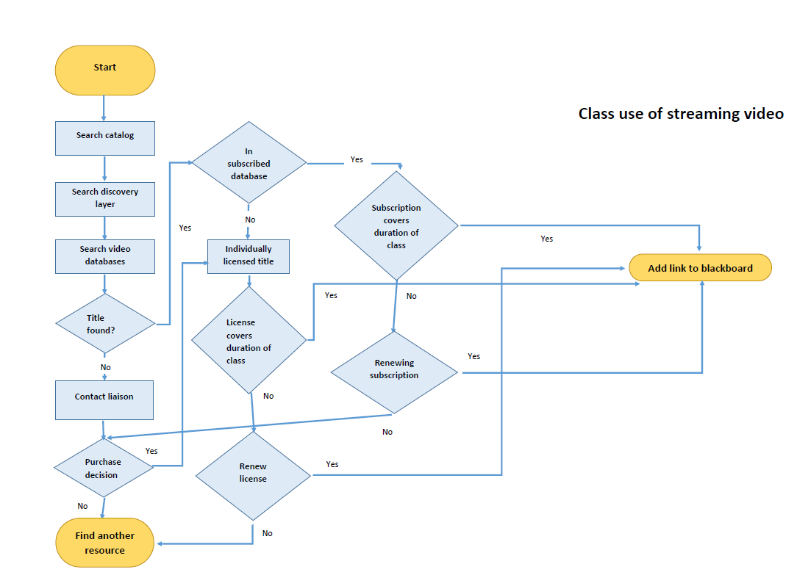
Sample flowchart by course material type
Rob’s flowchart here

Slide 16
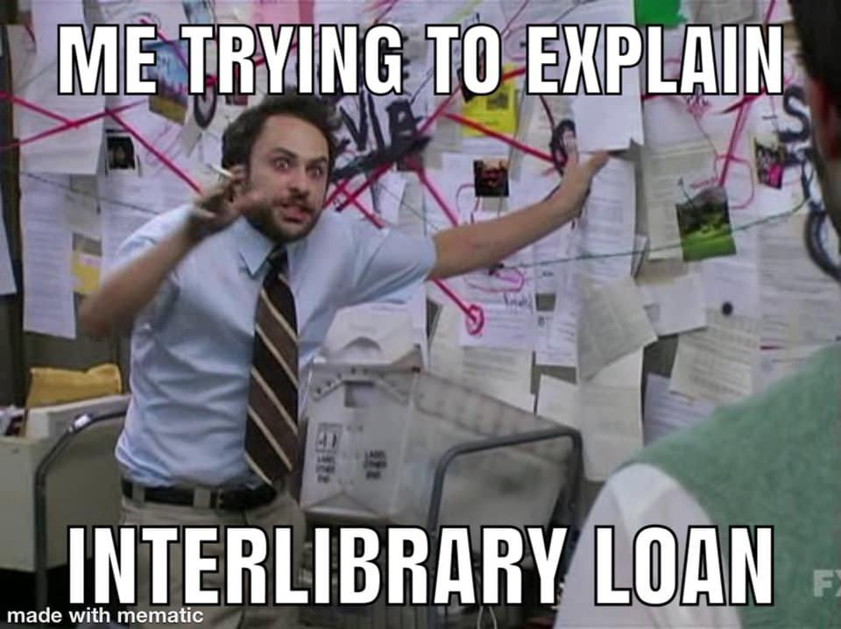
How does ILL work, exactly...?
Policies
Services
Data

Slide 17
Workflow | Patrons | Materials | Other Services
Staffing Turnaround Time Hours/Days Registering New Users (automatic vs. manual) Unmediated Requests Lender Choice Copyright | Who can use ILL? Alumni Retired Faculty/Staff Visiting Researchers Special Borrowers | Newly Published Textbooks Ebooks International ILL Audio/Video Microform Video Games Music Scores Theses/Dissertations Conference Papers Maps Technical Standards Archives & Special Collections | Document Delivery (scanning from local collection) Purchase on Demand Accessible PDFs Data/Statistics
 | Distance Education Students
 | Policies Based on Patron Status
 | Fees & Fines

Slide 18
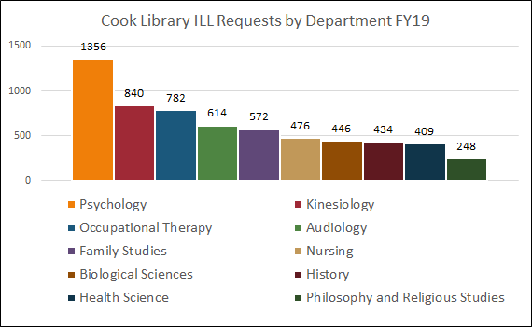
Questions your interlibrary loan expert can answer
Statistics by Department
Who: Faculty / Students
What: Materials / Topics
When: Date of Publication
Where: Cited In
Why: Low Use/ High Use
How: Data on Demand

Slide 19
Process
Naming the problems
Mapping processes
Identifying knowledge gaps & pain points
Getting answers
Re-mapping
Strategic Communication
Cyclical assessment

Slide 20
Communication pain points
For the scenario, please note all the points where communication is:
Missing
Difficult
Potentially confusing
Can include time before and after the scenario itself

Slide 21
Communication pain points
What communication would be required to improve or fix each “pain point?”
Note: You can add communication that should have taken place before the scenario opens, as well as communication that should happen after the scenario’s close.

Slide 22
Course materials adoption toolkit
Job summaries: “I can help with/I know”
Glossary of specialized terms
Written policies (in accessible location)
Process maps by material type
External communication templates
Checklist/new employee training documents
Assessment plan for process improvements

Slide 23
Assessment
Library data faculty could use to assess courses
Circulation data for reserves, e-reserves
ILL statistics for course-related materials
Click-through rates on course readings, LibGuides, etc.
It’s important for the library, too!

Slide 24
Thanks!
Any questions?

Slide 25
Contact us
Elizabeth De Coster, edecoster@towson.edu
Miriam DesHarnais, mdesharnais@towson.edu
Rob Pleshar, rpleshar@towson.edu
Kyla O’Hara, kohara@towson.edu

