Slide 1
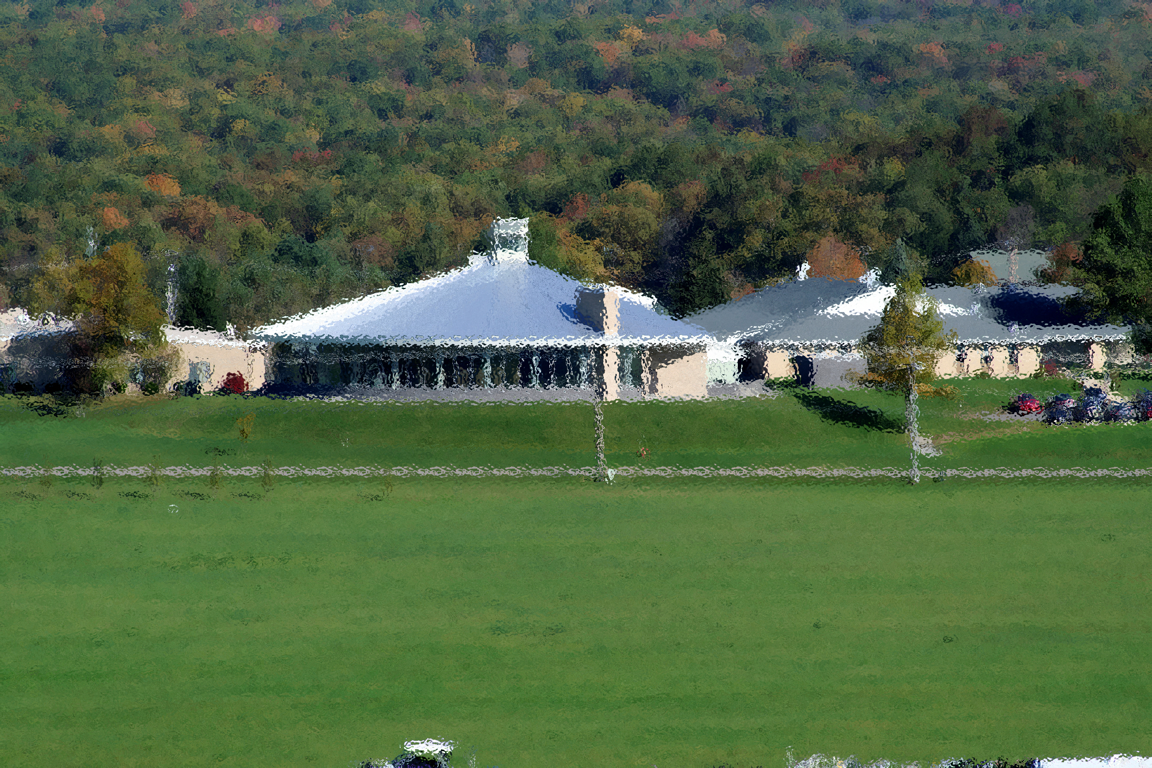
To the Window, to the Wall: Reimagined Spaces in One Short Year
Ashley Ruby Director of Advising & Academic Success Jenny Meslener Interim Director of the Learning Commons
Notes:
This is the story of how one small campus library reinvented the themselves into a vibrant learning commons, literally cutting the bookshelves in half to reveal the floor to ceiling windows and opportunities to support student learning.

Slide 2
Notes:
Poll Title: What is your morning beverage of choice? https://www.polleverywhere.com/free_text_polls/k9G0bs57jdtRkI0b2SUYg

Slide 3
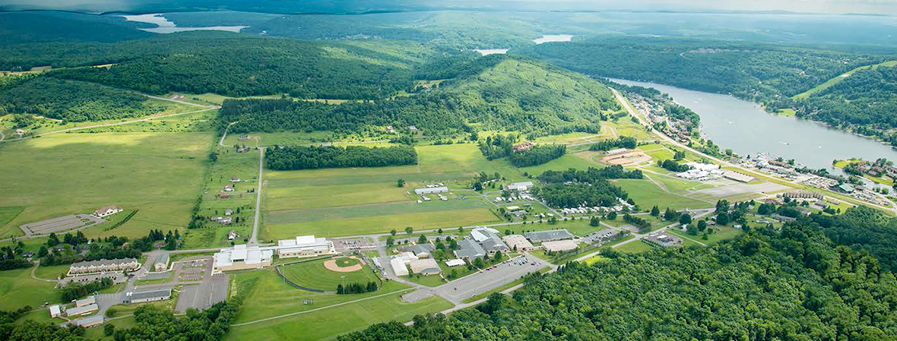
Basic Info
Small, public community college
Located in rural western Maryland
Credit enrollment 650
Associate Degrees and Certificates
Residence halls

Slide 4
Notes:
Poll Title: What does student success mean to you? https://www.polleverywhere.com/free_text_polls/JyuEVyuzQungSC62ZA9NB

Slide 5
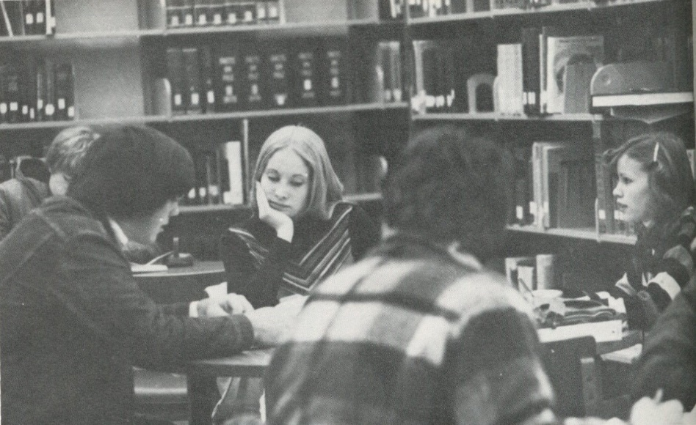
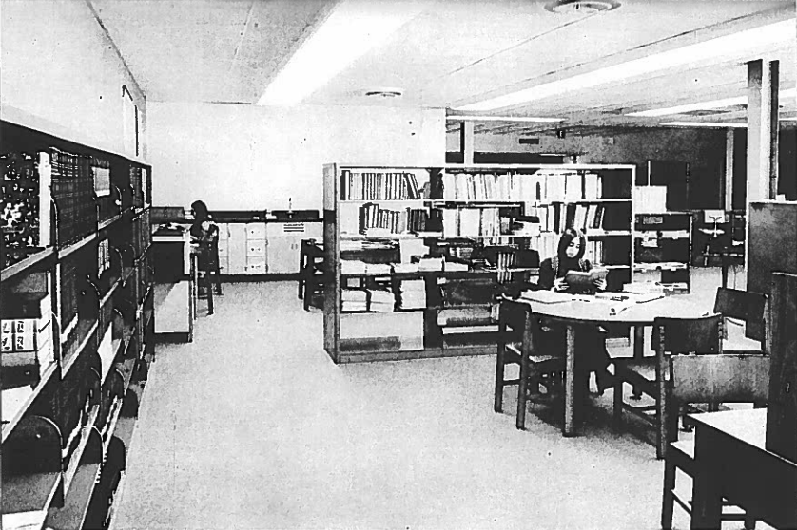
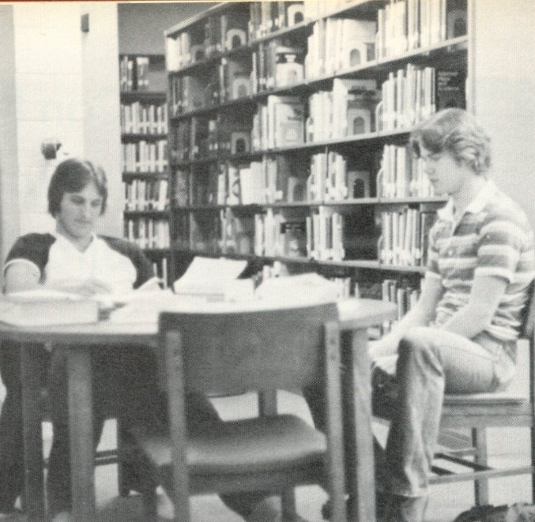
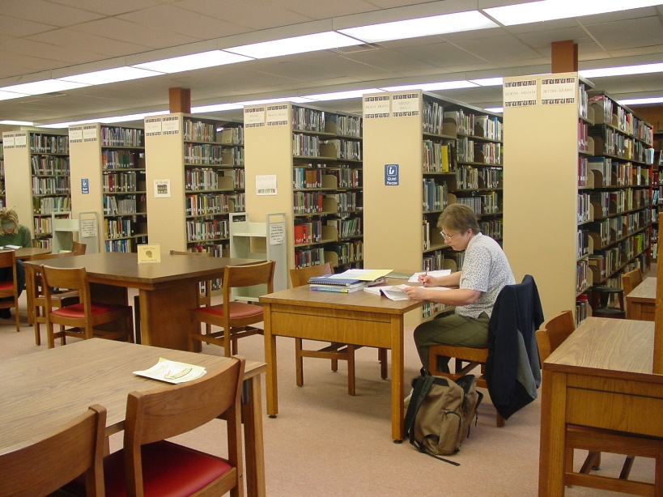
History
Former location

Slide 6
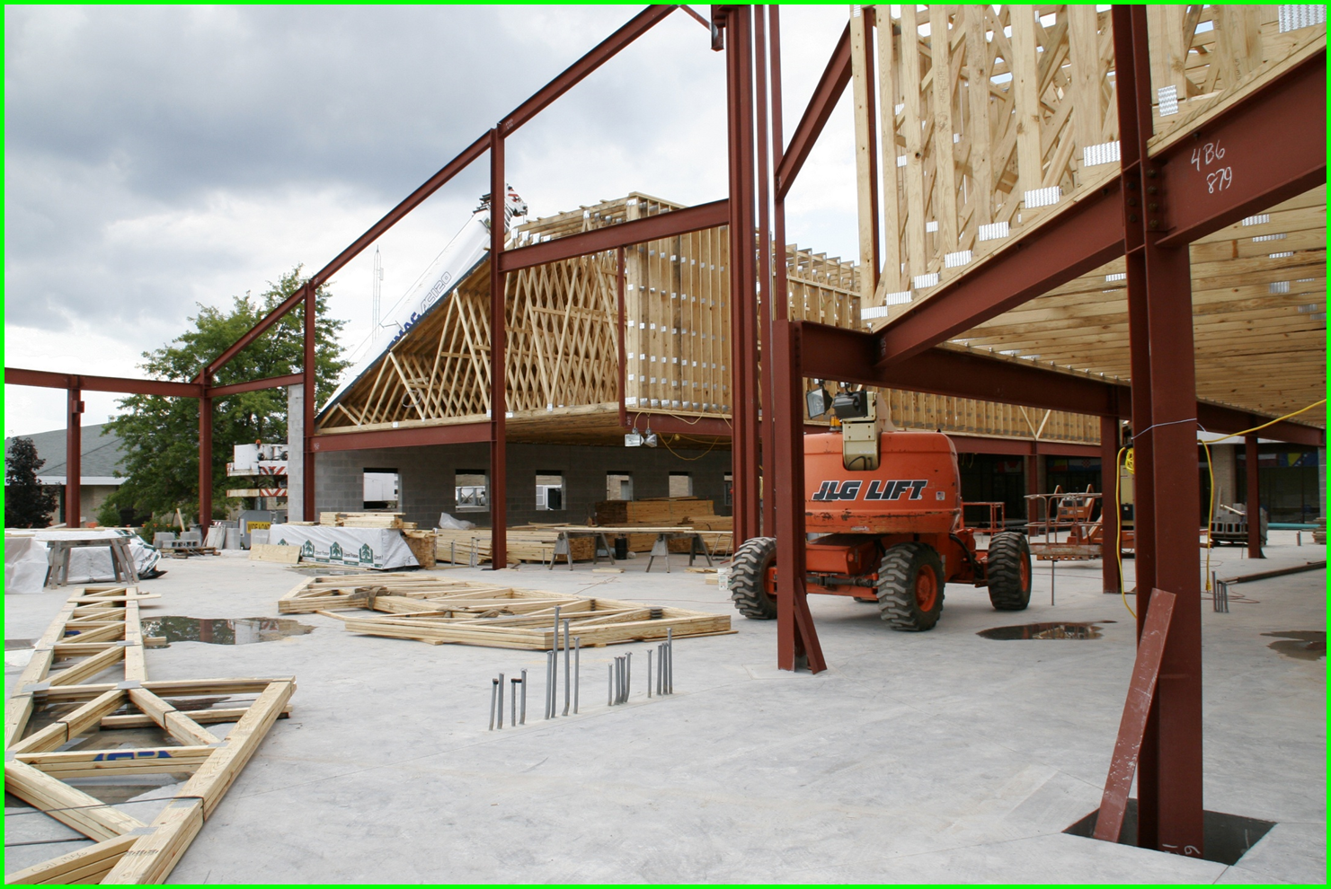
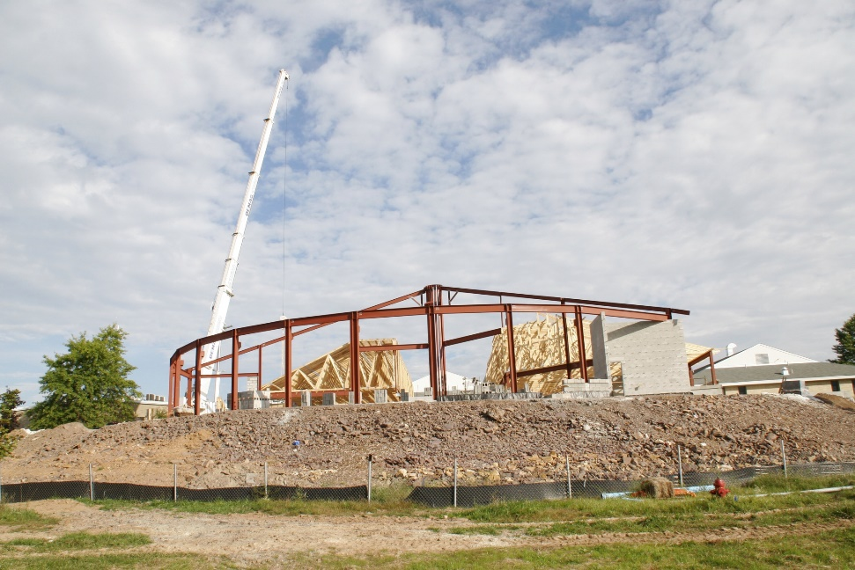
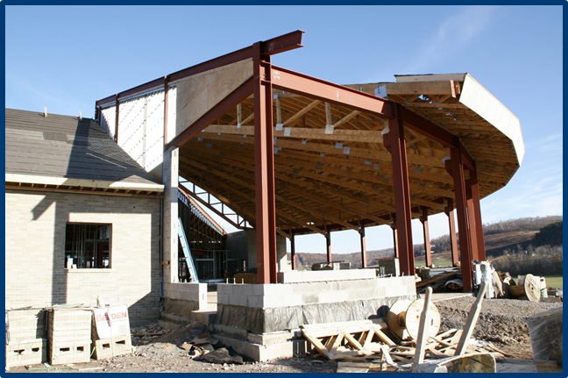
History
New location
Opened 2010

Slide 7
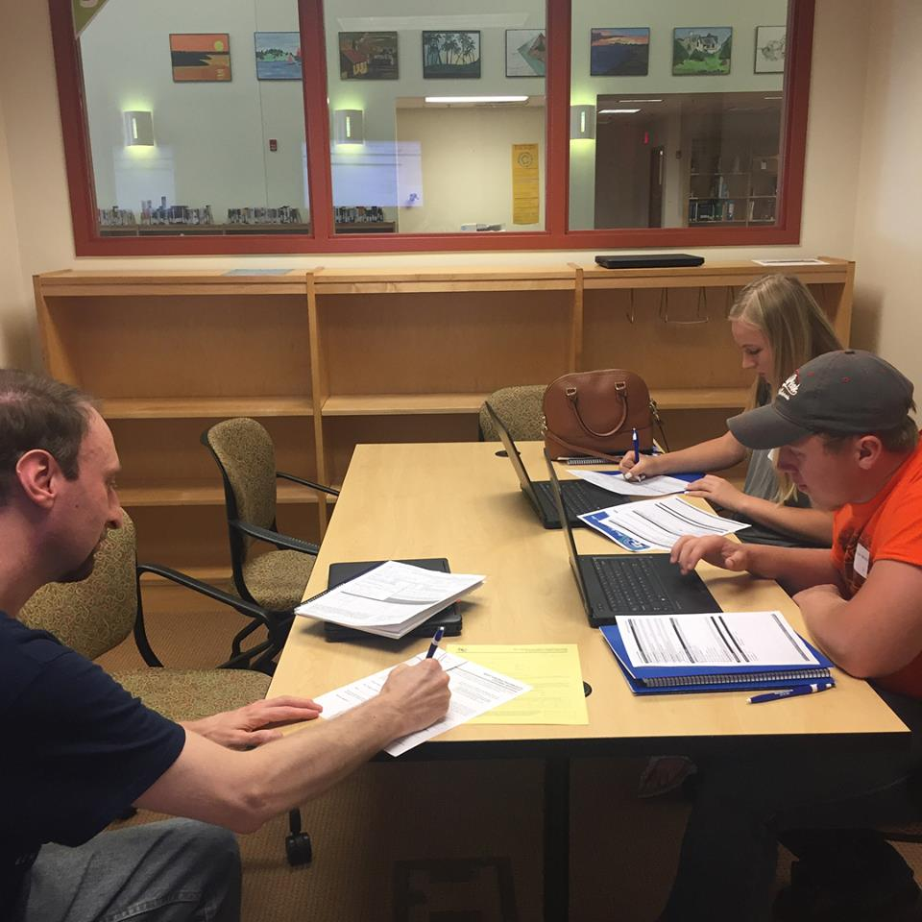
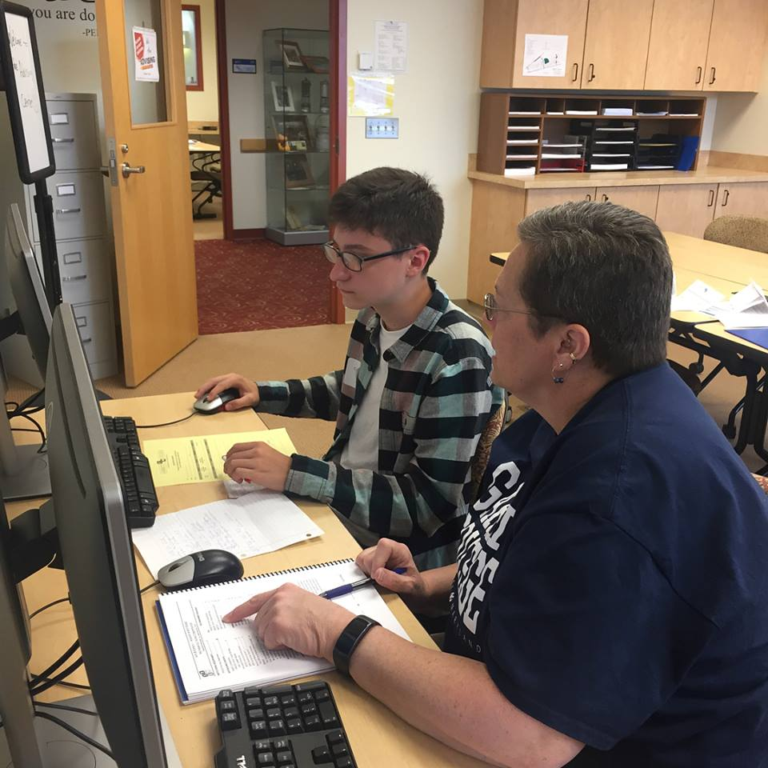
Physical Location
18,129 square feet
Co-located with Advising & Academic Success Center
9 staff offices
4 group study rooms
2 laptop testing rooms
1 information literacy classroom
2 meeting rooms
Open space with computer workstations, study cubicles, and tables

Slide 8
Notes:
Poll Title: What role does the library play in student success? https://www.polleverywhere.com/free_text_polls/OSu5MkMa17e0VmlTplqh3

Slide 9
AASC & Library
Advising & Academic Success Center
Academic Advising
Career Services
Transfer Advising
Academic Support Services
Retention Initiatives
Library
Reference Services
Information Literacy Instruction
Technology Access

Slide 10
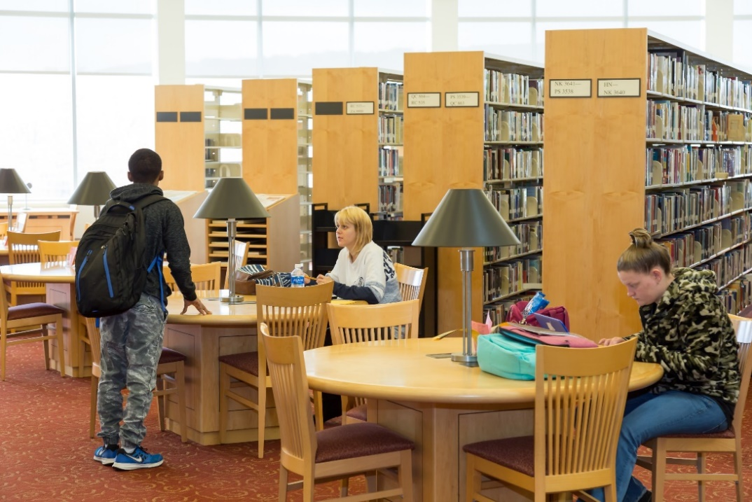
Strategic Planning
FY2017-FY2020 STRATEGIC PLAN
INITIATIVE I: PROVIDE APPROPRIATE PROGRAMS AND SERVICES TO ENABLE STUDENT SUCCESS AND COMPLETION.
Goal 1.2: To identify obstacles to student success and establish a network of support services that will help students to overcome them.
Objective 1.2.3: Adopt and implement a Learning Commons model appropriate for Garrett College.

Slide 11
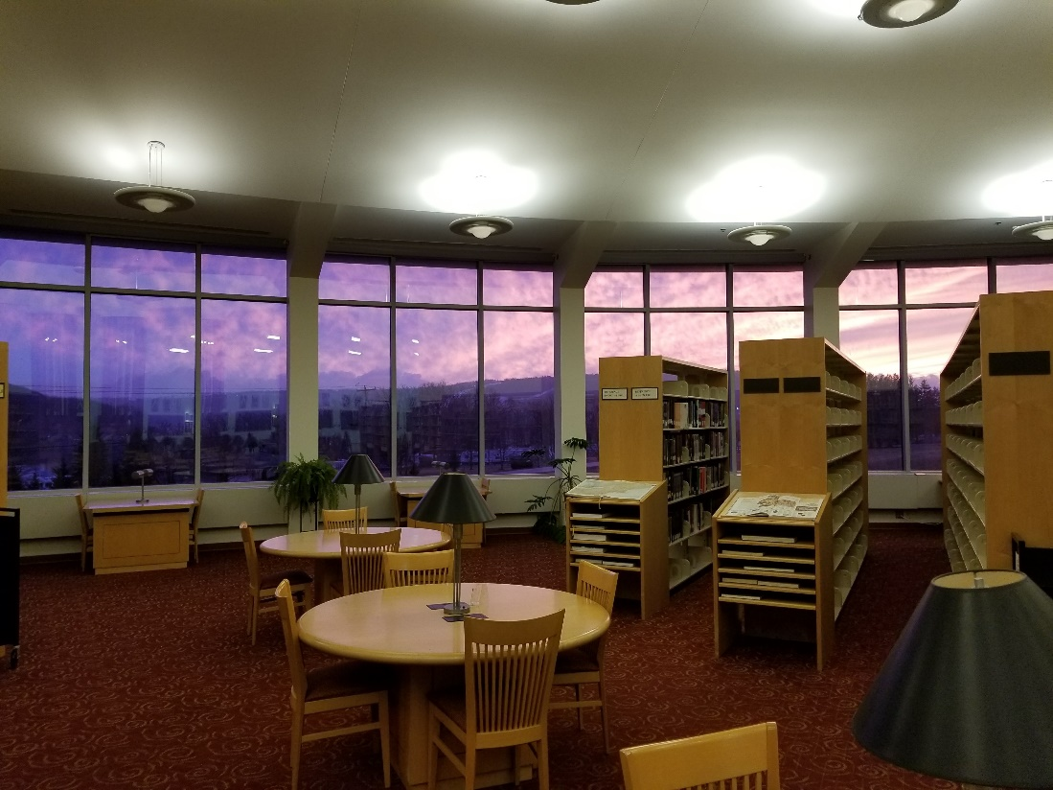
Challenges
Zero funding allocated
Budget reductions
Staff reductions
Timeline
Traditionalist culture

Slide 12
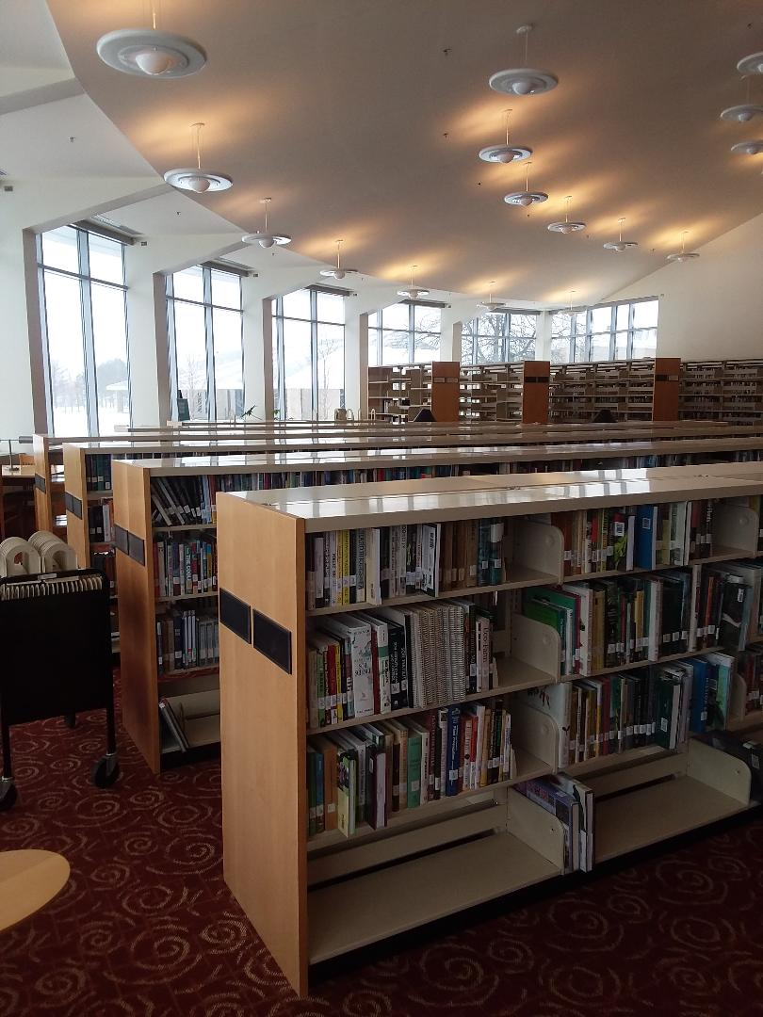
Advantages
Beautiful facility and existing infrastructure
Innovative staff
New leadership
Student-centered initiatives across campus
Talented facilities department
Exceptional marketing team
Collaborative culture

Slide 13
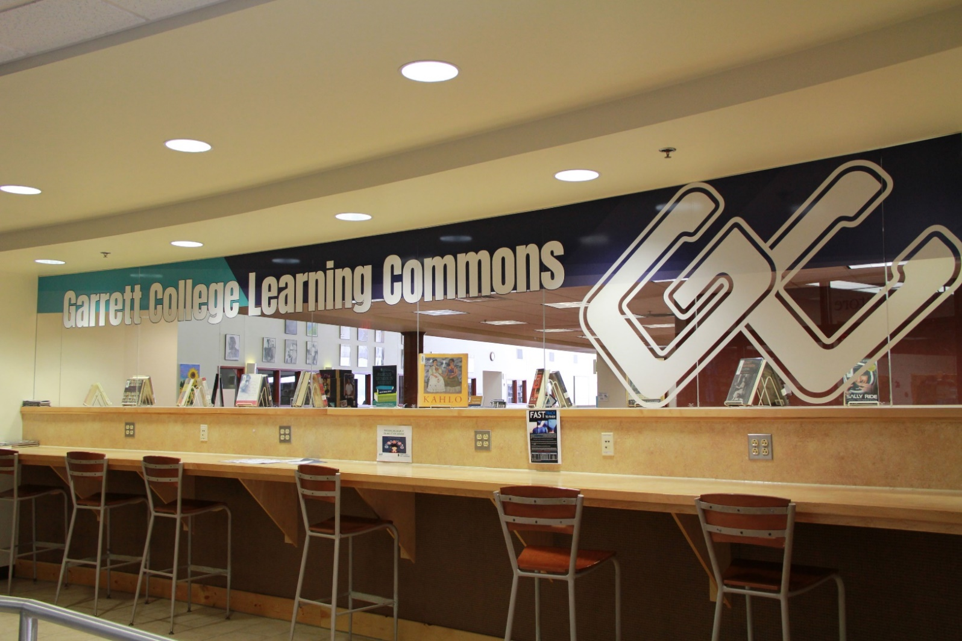
Changes
Branding
Signage
Zones
Relocating services
Tutoring
New Student Advising
Cross training staff
Artwork
Library Services
Shelves
Atmosphere and ambiance

Slide 14
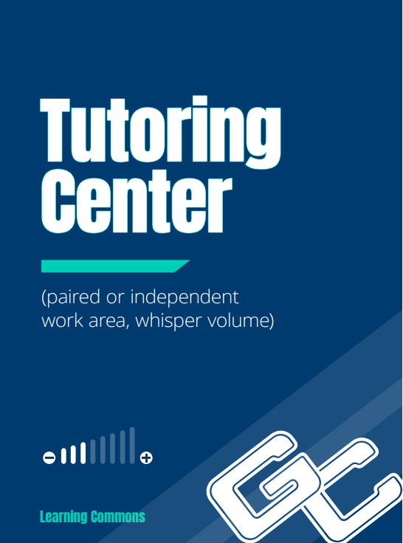
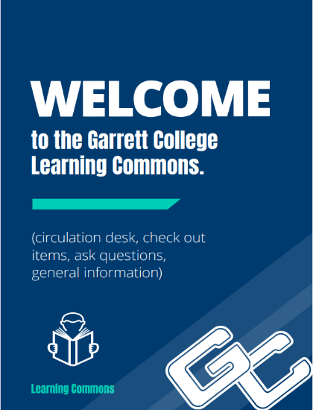
Branded Signage

Slide 15
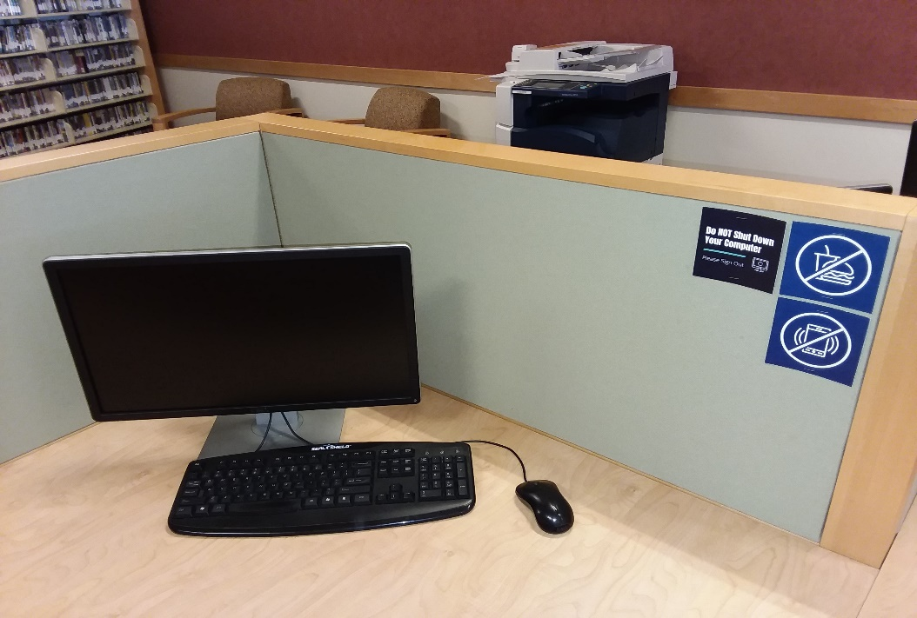
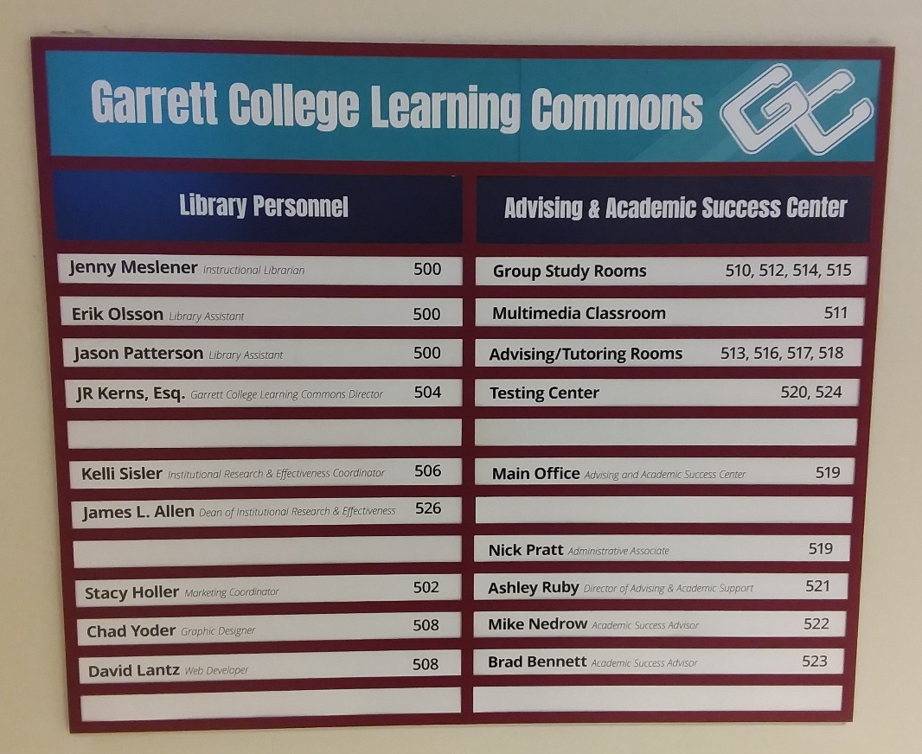
Branded Signage
Directory signage
Charging stations
Computer workstation signage

Slide 16
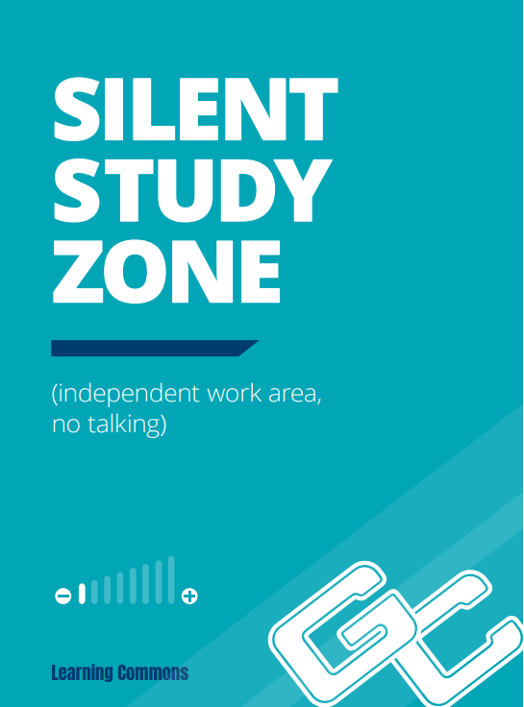
Get in the Zone

Slide 17
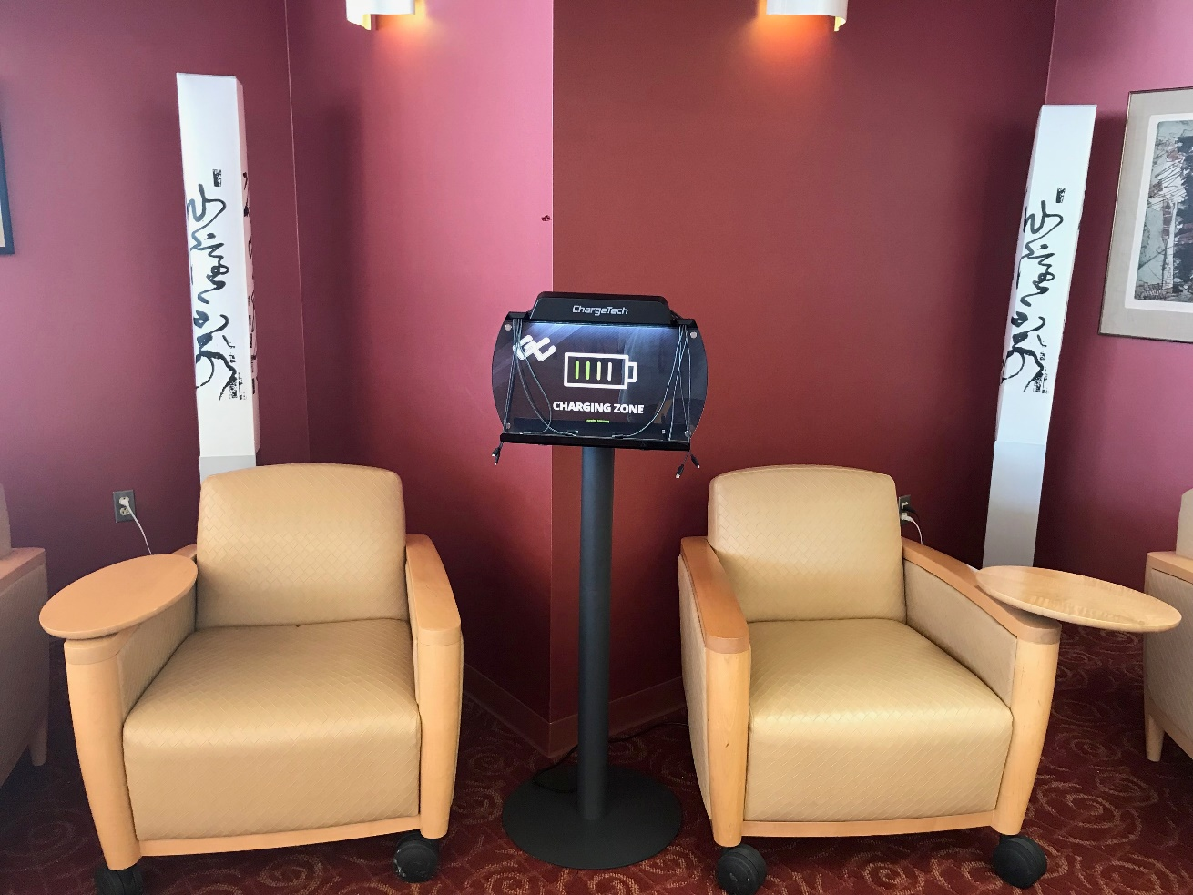
Get in the Zone

Slide 18
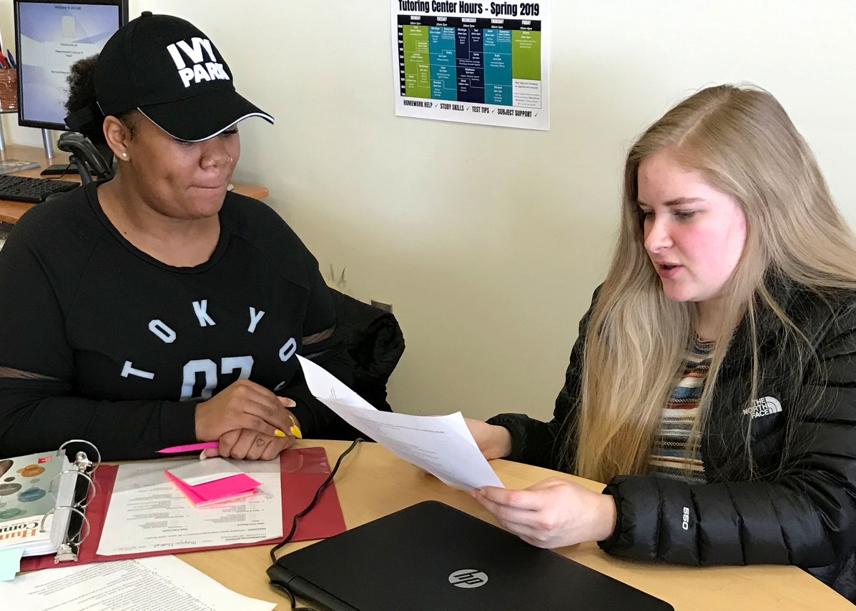
Academic Support Services
Moved to central library area
Designated computers
Whiteboard
Resource area
Collaborative workspaces
Professional and Peer tutors

Slide 19
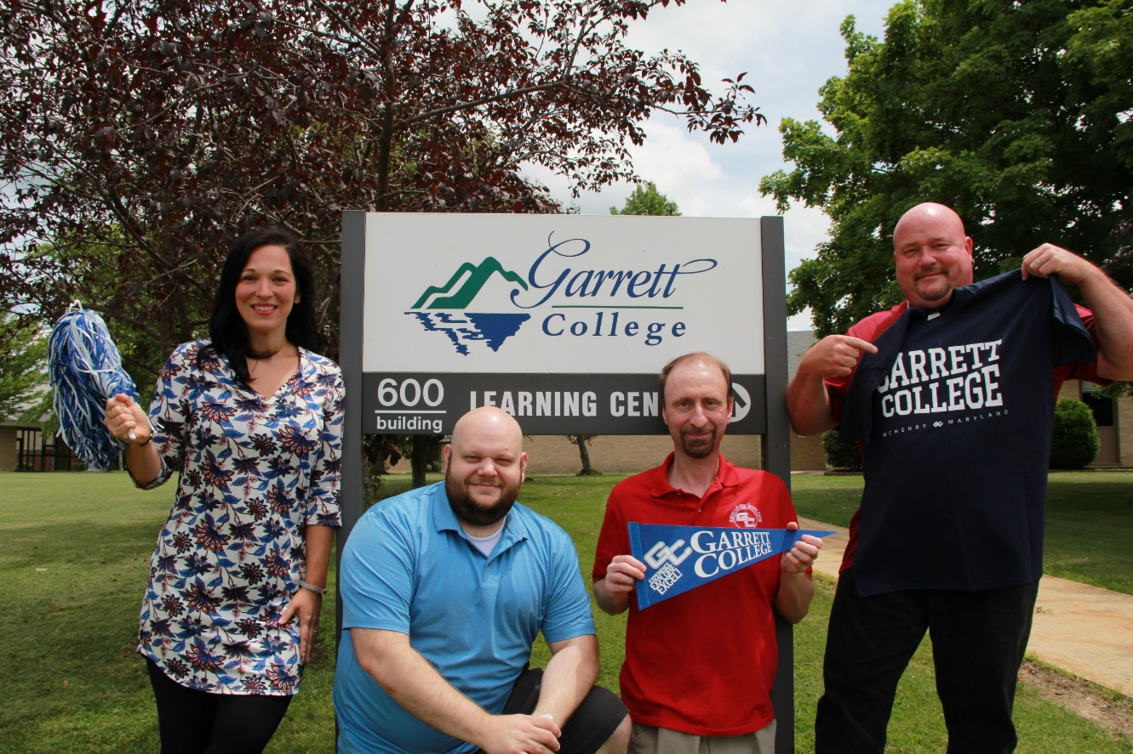
Cross Training Staff
Advising
Test proctoring
Student Self-Registration
Workshops
Circulation desk coverage
Room reservations
Digital signage

Slide 20
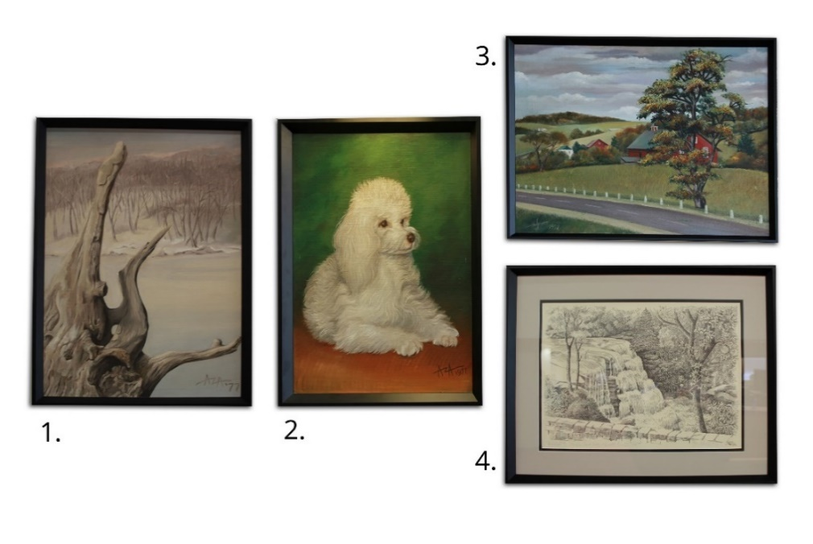
Artwork

Slide 21
Library Services
Improved Online Services
Updated website
Added LibGuides
EZ Proxy
New online reference services
Moved to online periodicals
Improved IT Services
Increased color printing
Scanner
Deselected 15,000 books
Eliminated overdue fines
OER Initiative

Slide 22
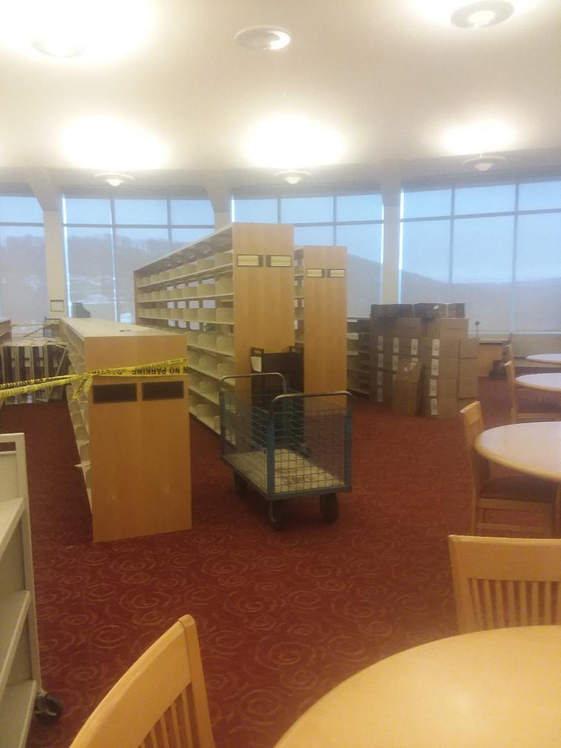
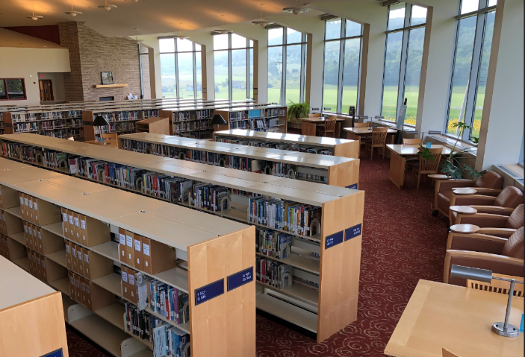
Cutting the Shelves

Slide 23
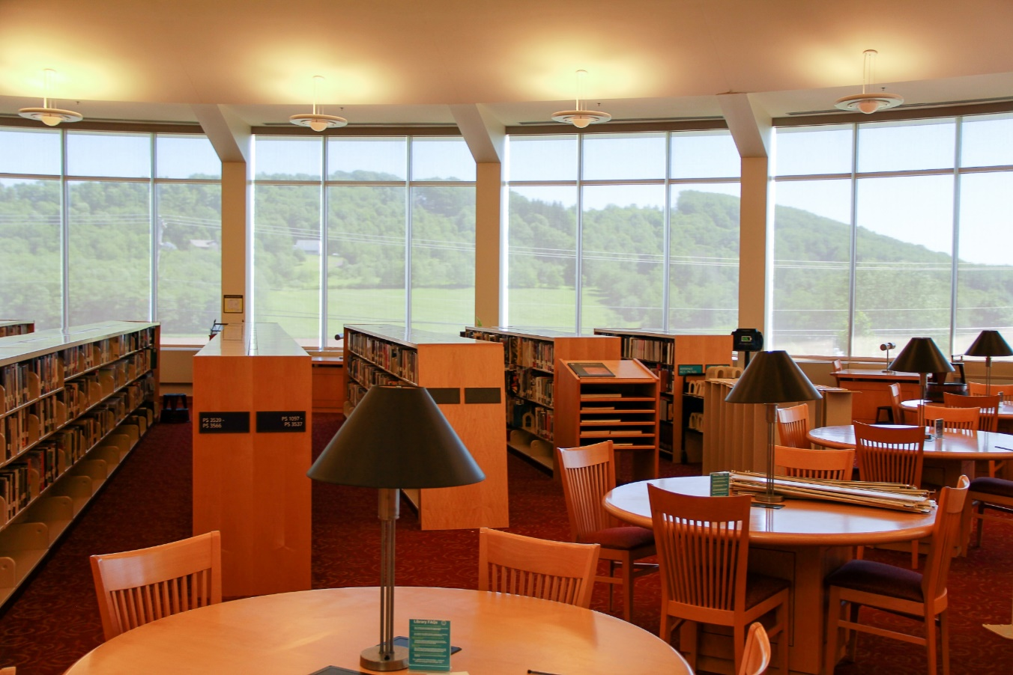
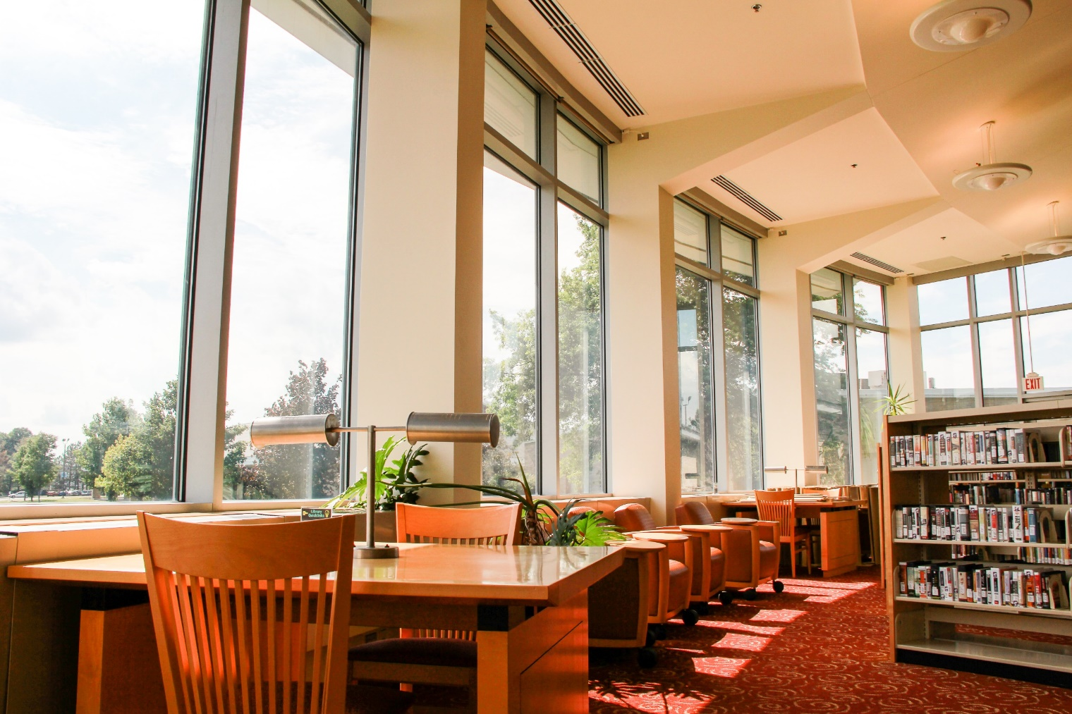
Cutting the Shelves

Slide 24
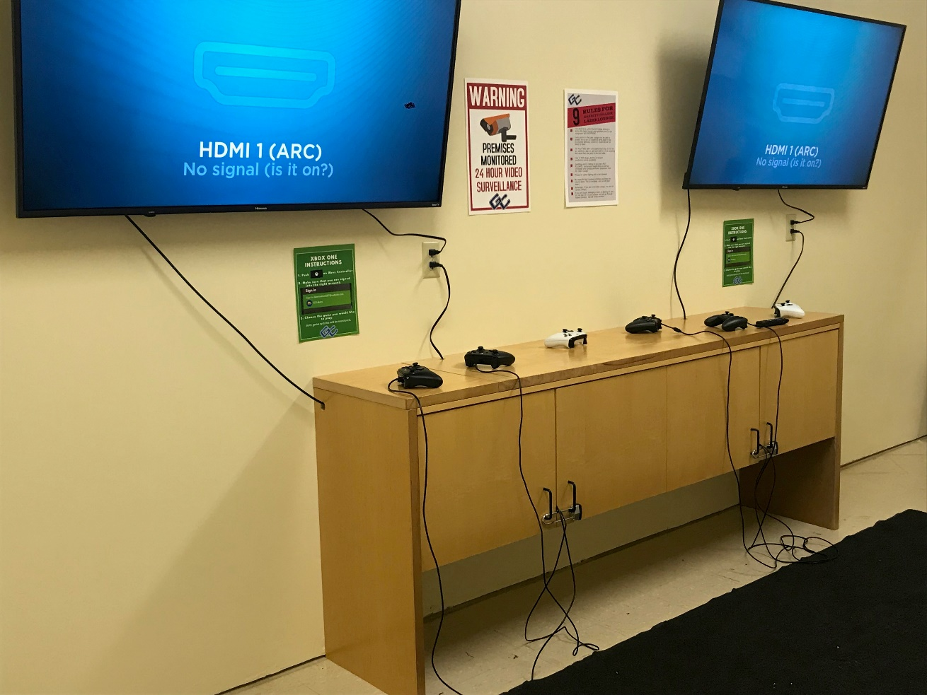
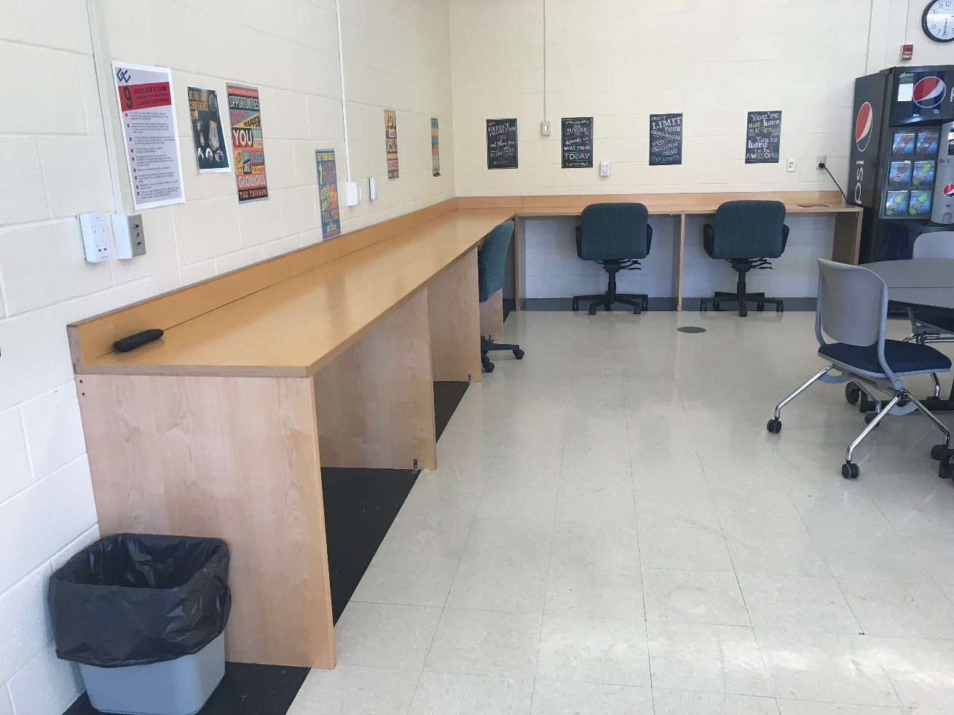
Repurposing

Slide 25
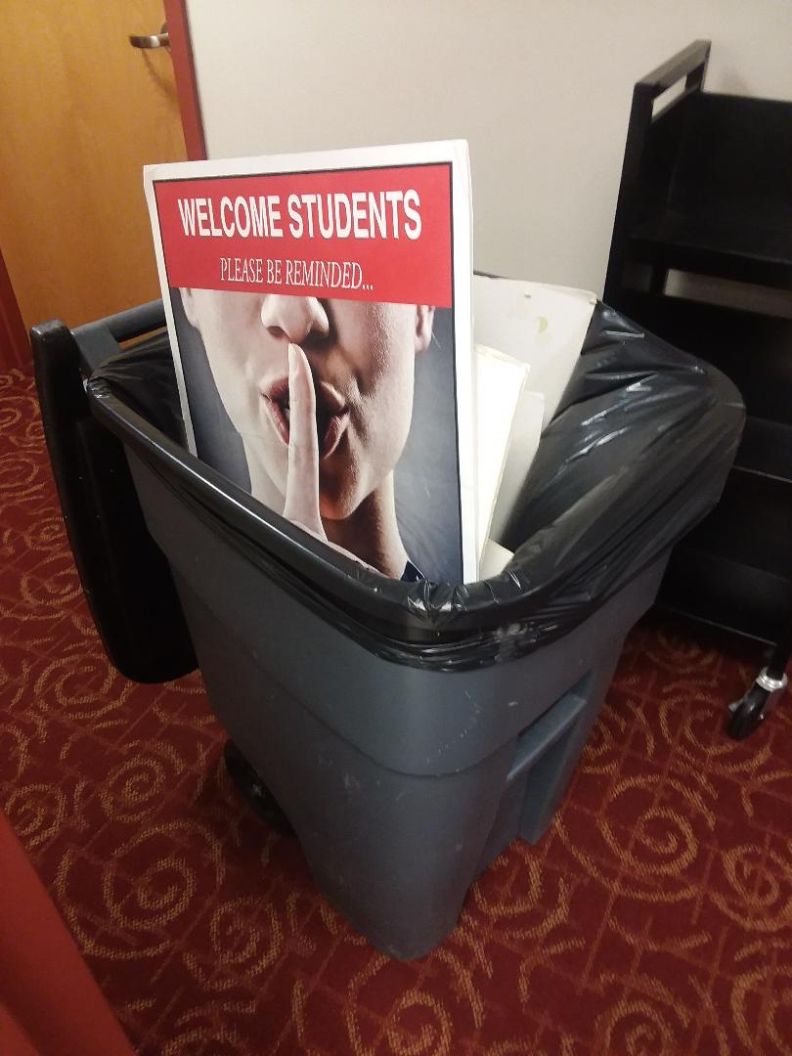
Atmosphere
Open and inviting space
Emphasis on quality customer service
Student-centered and other nontraditional activities
Partnership opportunities
Community activities

Slide 26
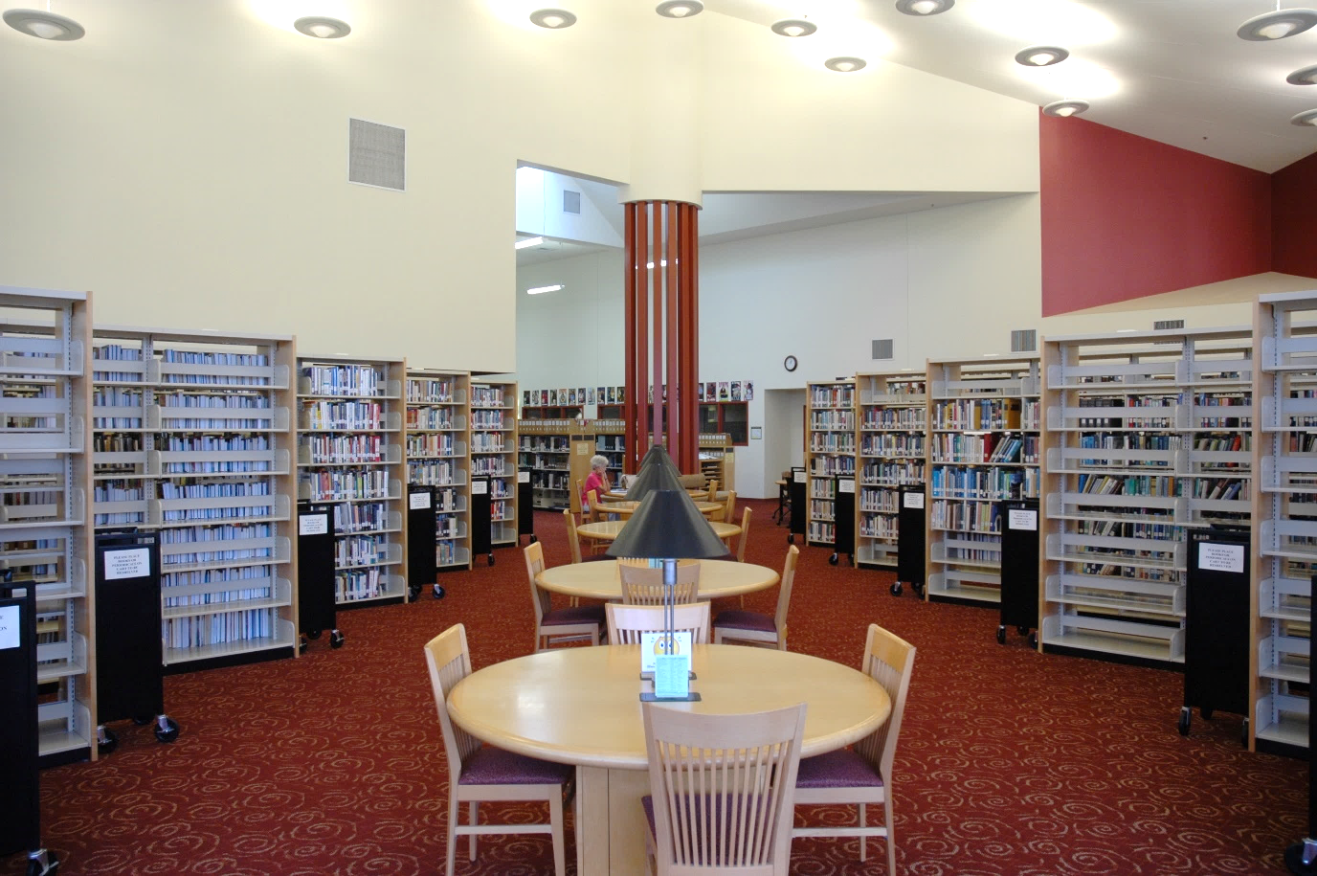
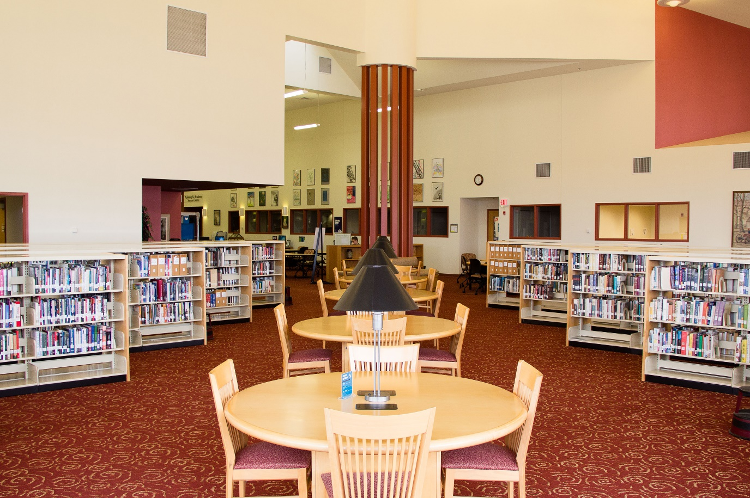
Before
After

Slide 27
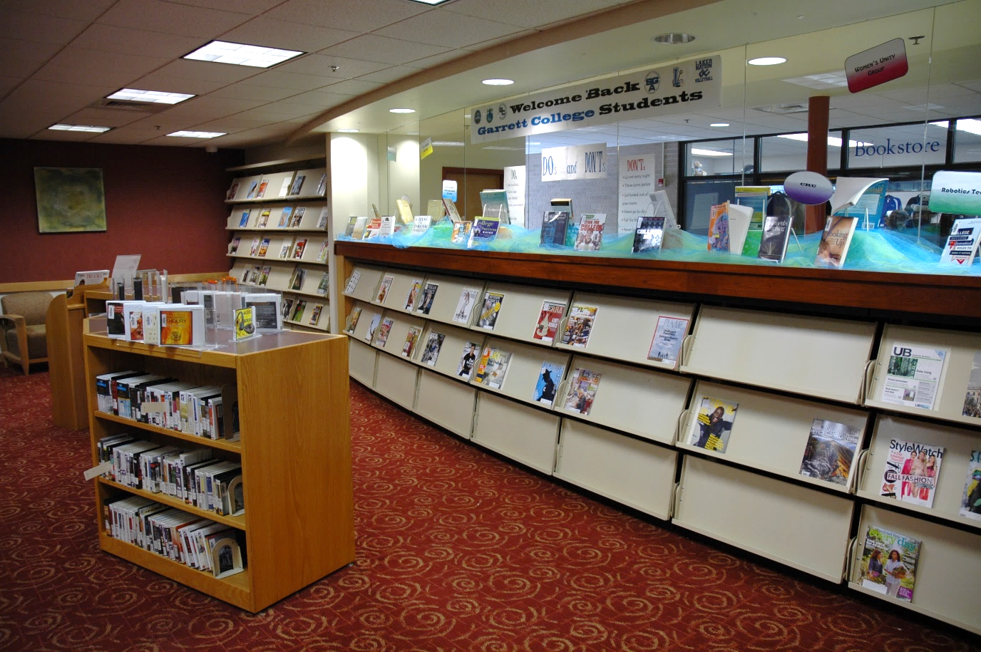
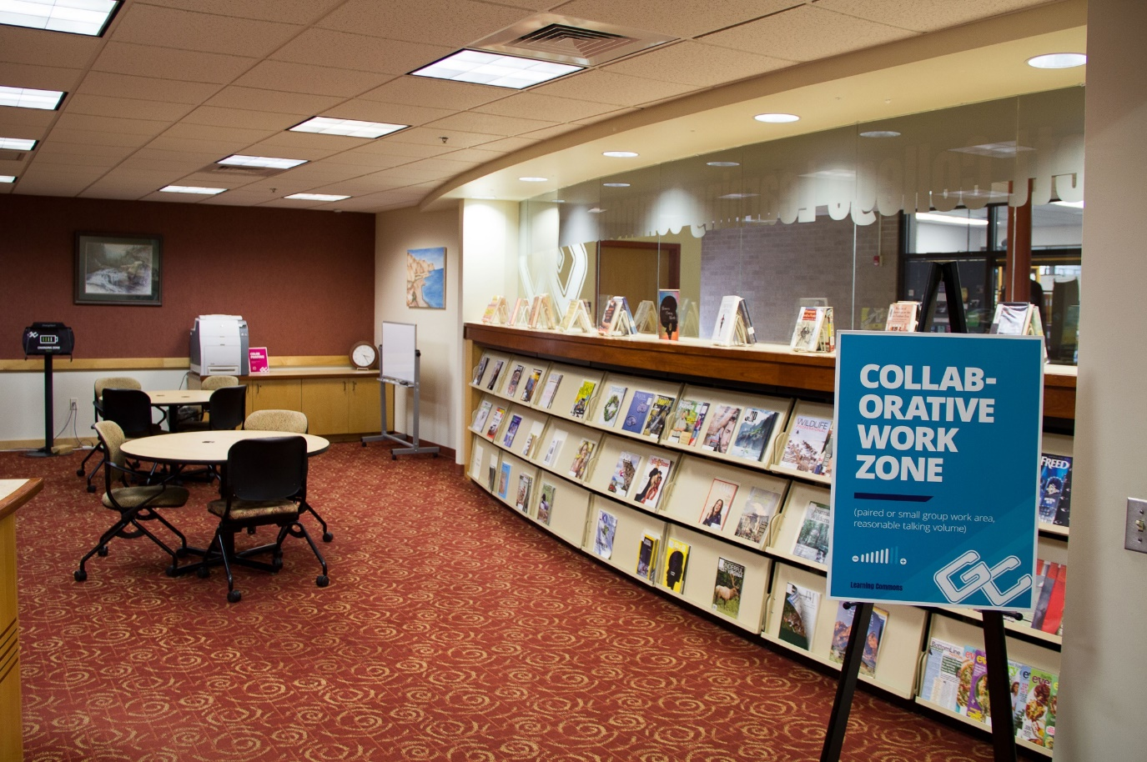
Before
After

Slide 28
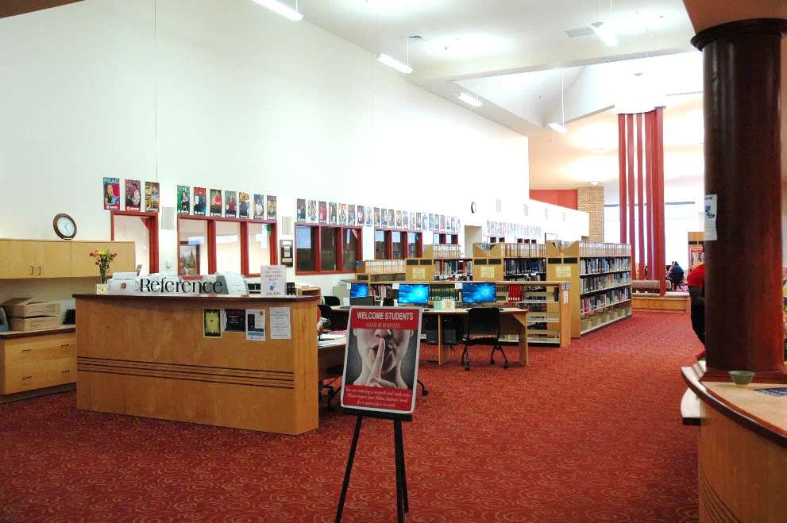
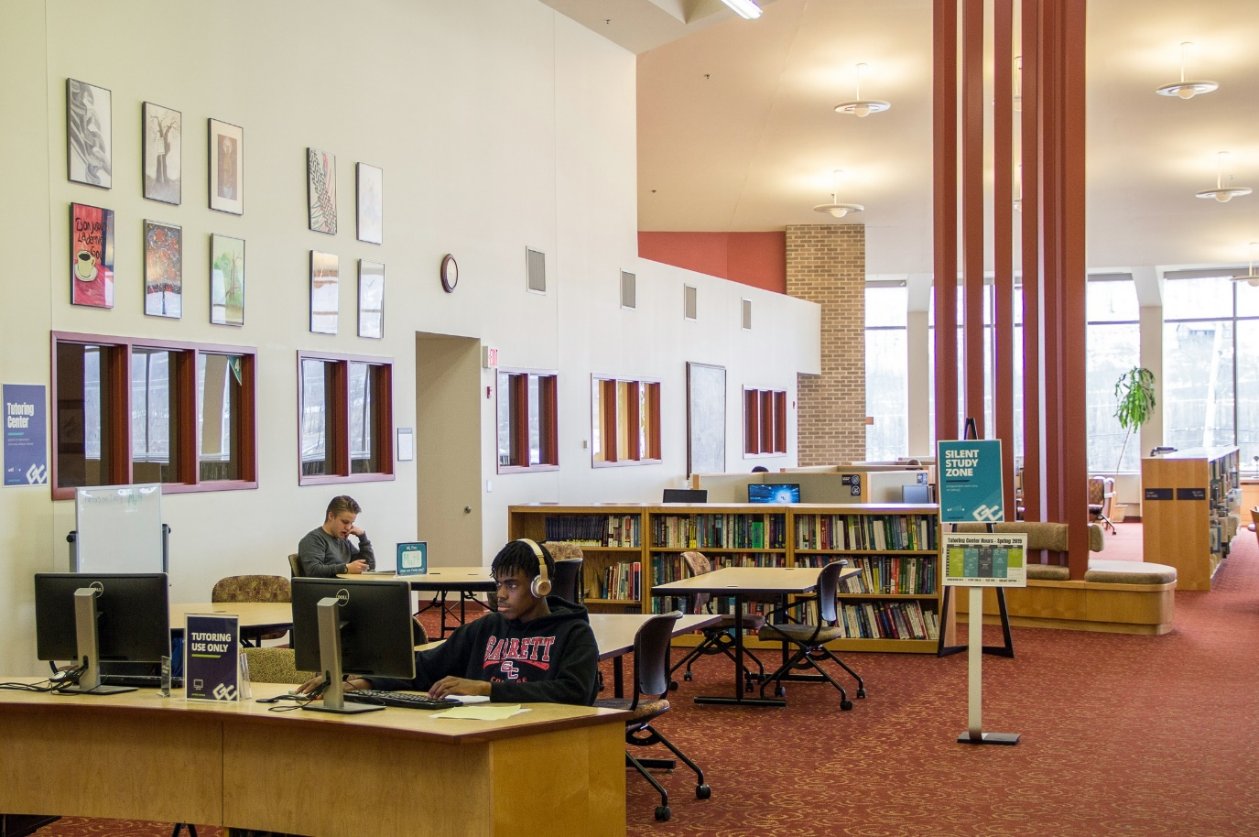
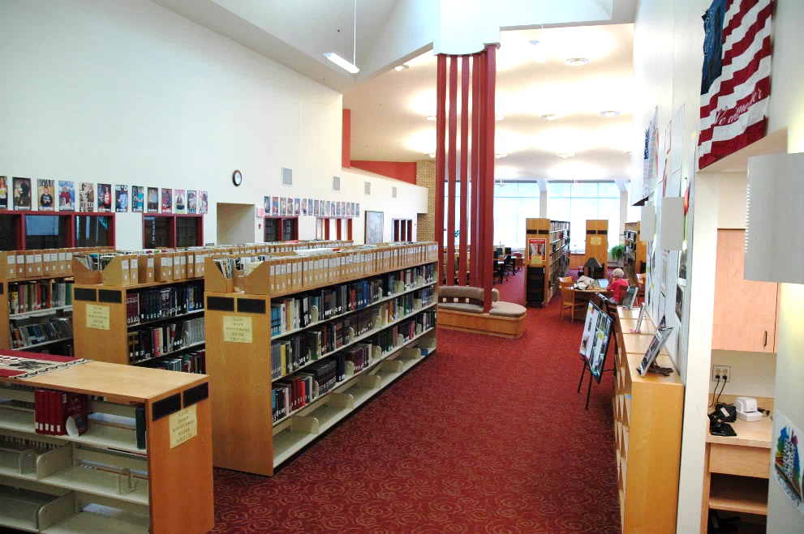
Before
After
Before

Slide 29
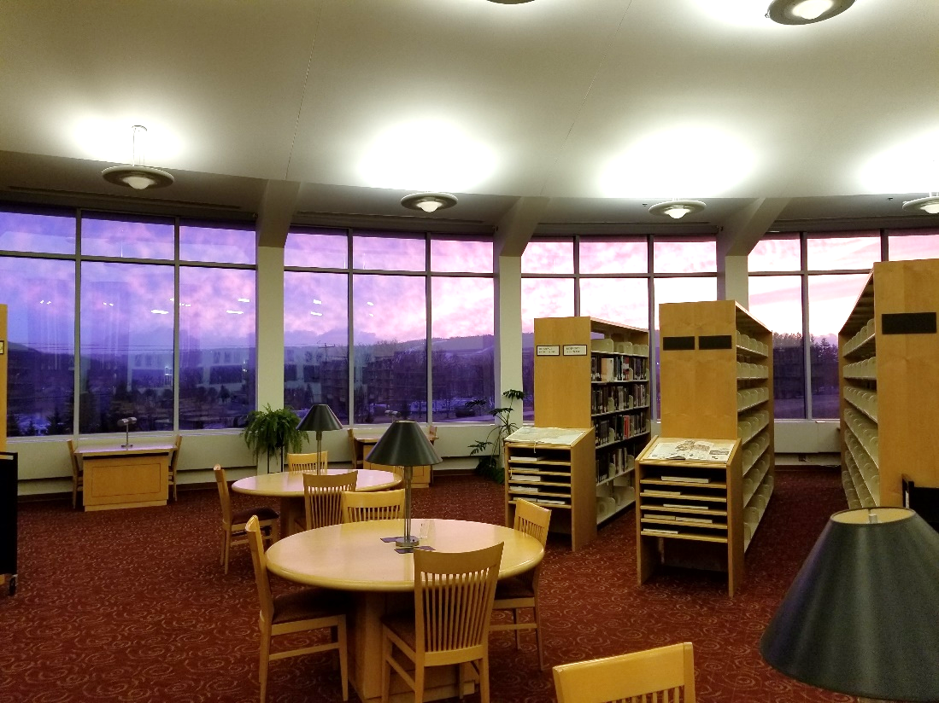
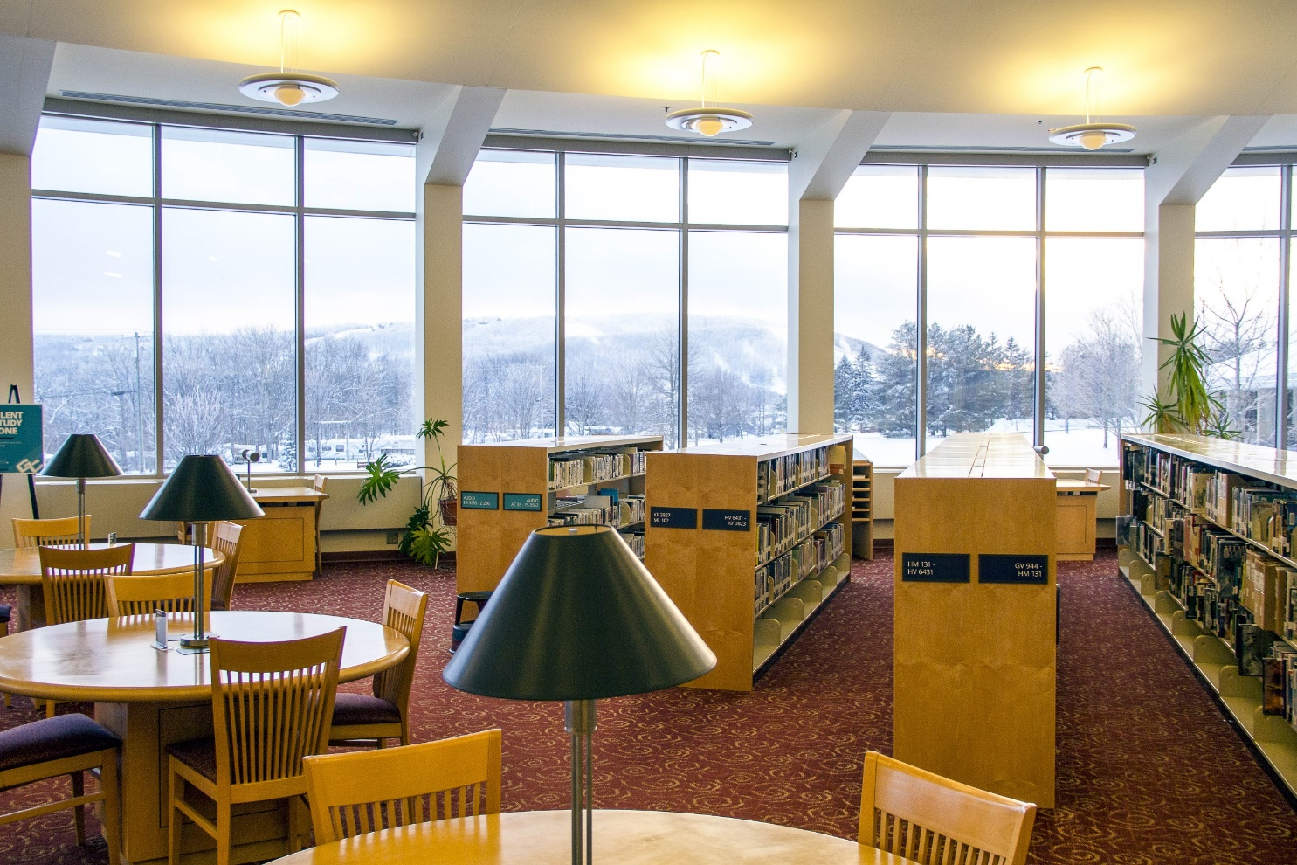
Before
After

Slide 30
Notes:
Poll Title: How much did it cost? https://www.polleverywhere.com/multiple_choice_polls/JqxJGg7pKBZ4VdjqnQmCx

Slide 31
Cost
Signage
Charging stations
Artwork frames
Keyboard and cable locks
Sign easels
TOTAL
$707
$2,352
$583
$168
$378
$4,188

Slide 32
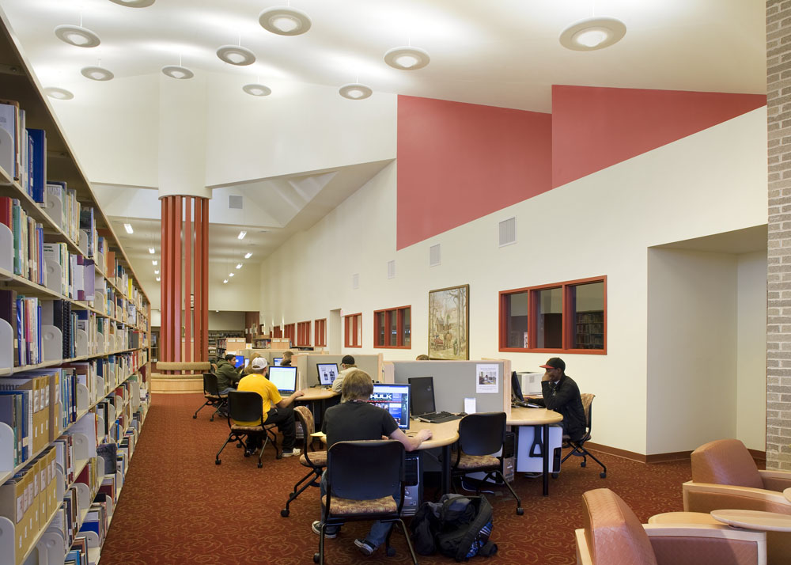
Lessons
Administrative support goes a long way
Small changes make a big impact
Expect a shift in atmospheric and campus culture
Understand the value of a collaborative working environment

Slide 33
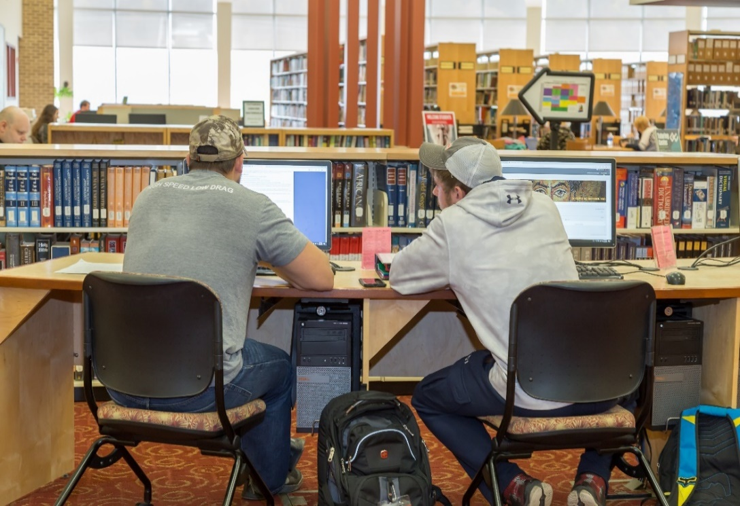
Results
Tutoring Center
Students accessing tutoring increased 23.8%
Time spent in tutoring increased 92.4%
Hours of face-to-face tutoring available increased 70.3%
Testing Center
Students accessing testing services increased 3.7%
Advising
Students accessing advising increased by over 200%
Frequency of visits increased by over 300%
Reference
Increase of 5%
Circulation
Physical circulation Increase of 3.7%
Online database usage increase of 23.5%

Slide 34
Student Outcomes
GPA
 | Fall 2016 | Fall 2018
Residential Students
GPA above 3.0 | 11.7% | 23.7%
GPA below 1.0 | 25.9% | 14.5%
Commuter Students
GPA above 3.0 | 48.2% | 53.4%
GPA below 1.0 | 12.0% | 12.8%

Slide 35
Student Outcomes
Midterm deficiency
 | Fall 2016 | Fall 2018
All Students | 41.3% | 39.2%
Residential Students | 74.3% | 64.7%

Slide 36
Student Outcomes
Academic standing
 | Fall 2016 | Fall 2018
Poor Academic Standing | 19.1% | 15.2%
Good Academic Standing | 80.9% | 84.8%

Slide 37
Moving Forward
Continued cross-training
New librarian position
Work-study students
Enhance physical & online library collections
Add ILL Services
Developmental Faculty Advisors
Athletic Advisor

Slide 38
Notes:
Poll Title: How can your college library better support student success? https://www.polleverywhere.com/free_text_polls/9CQ5U8iFmUuD4xFCz1eWS

Slide 39
Thank you Any questions?
Exceptional marketing team

