Slide 1
"Sorry, Not Sorry":
LIS Women Professionals and Our Culture of Apology
A talk by Annie Tang, Archivist
@tanganniew
Johns Hopkins University
Notes:
1 min
Song: https://drive.google.com/open?id=0B_v0I-MCCuNsWXdXb0wxSmtYeXM
[Play Bieber for 9 seconds] Stop at 3:11 left or 9 seconds into song
“Now begins the interpretive dance portion…”
Thanks for coming.
Today I’d like to speak on the overuse and sometimes unnecessary use of apologetic everyday language in the workplace that many women like myself use, and how we can use alternative language to empower and communicate our words more effectively.
Ironically for a presentation that is about NOT saying “sorry” and “apology” a whole lot, I WILL.
Remember an adapter in case!
10 min talk, 10 min activity (5 min thinkpairshare, 5 min shareout), 5 min Q&A

Slide 2
“Sorry is a sorry word.”
“For so many women, myself included, apologies are inexorably linked with our conception of politeness. Somehow, as we grew into adults, ‘sorry’ became an entry point to basic affirmative sentences.” -Sloane Crosley, The New York Times
Sloane Crosley, “Why Women Apologize and Should Stop”, The New York Times, June 23rd, 2015.
Notes:
1 min
Anecdote:
Motivation?
first year out of lib school…
-“This is the most I’ve ever heard you say sorry in all the time I’ve known you.”
-Lightning bolt revelation: insecurities and imposter syndrome created a “polite monster”
-Equated “politeness” and “professionalism”
I realized from this experience we as women can undermine what we say and ourselves
“For so many women, myself included, apologies are inexorably linked with our conception of politeness.
Somehow, as we grew into adults, “sorry” became an entry point to basic affirmative sentences.” (Elaborate)
-from good little girls, to polite women. Any nice affirmative statements we unnecessarily make, creates negative internal/external statements about ourselves

Slide 3
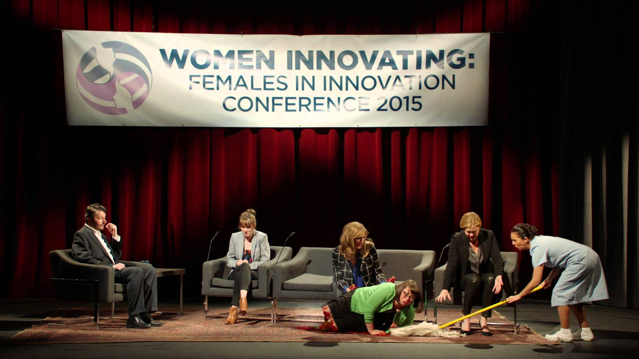
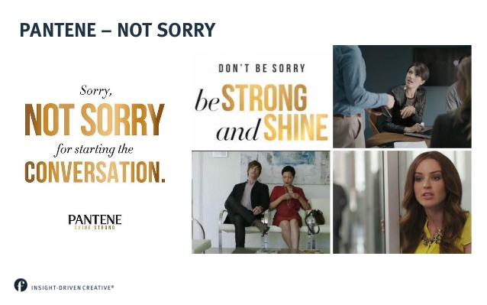
Let’s SCIENCE this!
Women have a “lower threshold” for offenses (Schumann and Ross, 2010)
Imagined apologies more valued than real-life ones
  People “rated the value of an apology much more highly when they imagined receiving an apology than when they actually received an apology” (De Cremer et al., 2011)
Sincere apologies do work (Beyens et al., 2015)
Inside Amy Schumer, “I’m Sorry” sketch, 2015.
Pantene commercial, “Not Sorry”, 2014.
Notes:
2 min
As Matt Damon stated in The Martian, let’s…
Few years ago, “sorry” had a moment in the media. Describe examples. Why? 2010 and 2011 scientific studies!
Women have a “lower threshold” for offenses
Psychological Science, 2010
https://www.ncbi.nlm.nih.gov/pubmed/20855900
“In Study 1, participants reported in daily diaries all offenses they committed or experienced and whether an apology had been offered. Women reported offering more apologies than men, but they also reported committing more offenses. There was no gender difference in the proportion of offenses that prompted apologies. This finding suggests that men apologize less frequently than women because they have a higher threshold for what constitutes offensive behavior.”
Offer more apologies, and perceive they commit more!
Imagined apologies more valued than real-life ones
Psychological Science, 2011
https://www.ncbi.nlm.nih.gov/pubmed/21123857
Elaborate quote, tongue twister, explain experiments “betrayed” by another party
“Think of the last time someone really offended you, but never apologized…”
Because we imagine apologies to be sincere, but we as humans fail so miserably at the actual ones.
Sincere apologies do work (Beyens et al., 2015)
Frontiers in Psychology, 2015
https://www.ncbi.nlm.nih.gov/pubmed/26579005
“Aggression” minimized, “forgiveness” engaged particularly with women

Slide 4
To say it or not: think-pair-share
How many times a day do you think you say the word “sorry” or “apologize”?
Please share about a time you apologized when it was absolutely unnecessary. How would you go about the same situation again?
What strategies do you implement, or what will you do, to communicate better in our culture of excessive apology?
Notes:
5 min - think-pair-share (try to find someone NOT your conference buddy! Swear you’ll be returned at the hip later.)
5 min - audience shareout
If have time or no one volunteers, offer:
ACRL
-Q&A
-Shake Shack
Skip first one, just say I did 12 once!
Just to elaborate these are bad types of apologetic behavior:
-Overapologizing
-“Sorry” at the start of every statement, de facto
-Hedging
^(“Excuse me, can I ask…”
“I might be wrong, but …”
“I don’t know, but…)
Dr. Busman. “Beginning a comment with an apology immediately puts her in a one-down position,” she explains. “It instantly delegitimizes any authority she has.”
https://childmind.org/article/why-girls-apologize-too-much/

Slide 5
Alternatives to apologetic language
“Question” or “Comment” instead of hand raising
“Thanks”
“Excuse me” (when appropriate)
Direct responses vs. Indirect
Be real
Rae Jacobsen, “Why Girls Apologize Too Much: How to help them stop saying 'sorry' and express confidence”, Child Mind Institute, accessed July 23, 2017.
Notes:
1 minute to re-iterate anything anyone else provided plus to add ones not mentioned by audience
“Question” or “Comment” instead of hand raising (or just say it!) (Hopefully whoever organized meeting is a good facilitator.)
“Thanks” (for being patient when appropriate.. Late is late is late.)
“Excuse me” (when appropriate,interrupting convo for real )
Direct responses vs. Indirect
^(Indirect response: “Sorry, I’m not really an expert, but maybe I can help?”
“Direct response: “I know how to do this, would you like me to show you?”)
Be real
(Does matter. Remember that study? Why people so disappointed with real-life apologies?)
https://childmind.org/article/why-girls-apologize-too-much/

Slide 6
Intersectional in the library
Women in leadership
  4.6% in 1972 => 52.1% in 2004 (Deyrup, 2004)
POCs
  12% (ALA Office for Research & Statistics, 2010)
Salary disparities
  7% pay gap between men and women (AFL-CIO, 2014)
Notes:
2 min
Women in leadership
4.6% in 1972 => 52.1% in 2004 (Deyrup)
“In 1972, the year Title IX was implemented, women held only 4.6% of high-level administrative positions at research libraries. By 2004, that percentage had grown to 52.1%.” (“Is the Revolution Over: Gender, Economic, and Professional Parity in Academic Library Leadership Positions,”)
POCs
12% in 2010 (ALA Office for Research & Statistics)
Almost 88% white, more than 12% POCs in credentialed librarianship
Salary disparities
7% pay gap between men and women
-we make 93% of what men make
For those of us who have worked so hard to get here, who paid so much literally in money, but also in effort in effort, particularly the women in high-level management, and who earn less than a lot of our male counterparts, do not apologize for your own existence in this field. It is hard enough as it is. Particularly for those of us who are POCs and in leadership. What it seems like you’re saying is, I’m sorry I’m here, I’m sorry I’m your only option, I’m sorry my words don’t mean as much. Do not apologize for you are.

Slide 7
Speak for yourself, not down to yourself
“It’s not what we’re saying that’s the problem, it’s what we’re not saying. The sorrys are taking up airtime that should be used for making logical, declarative statements, expressing opinions and relaying accurate impressions of what we want.”-Sloane Crosley, “Why Women Apologize and Should Stop”
Notes:
Conclusion
1 min
I’d like to conclude this talk with a call to speak for yourself and not down to yourself. I think Sloane Crosley said it best...
Do not mask your best qualities and strengths, professional or personal, in self-deprecating remarks or take fault when unnecessary.
Otherwise these are psychological hits to your self-esteem and to your outward persona to others, internalizing or externalizing what’s not really true.
Be sorry when you mean it, when it counts, and sincerely. But most of don’t apologize for who you are. Thank you.
Politeness is not necessarily professionalism

Slide 8
Resources cited
AFL-CIO, Department for Professional Employees, “Library Workers: Facts & Figures”, 2016, accessed July 20, 2017, http://dpeaflcio.org/programs-publications/issue-fact-sheets/library-workers-facts-figures/.
American Library Association, Office for Research & Statistics, “Diversity Counts”, 2012, accessed July 20, 2017, http://www.ala.org/offices/diversity/diversitycounts/divcounts.
Urielle Beyens, Hongbo Yu, Ting Han, Li Zhang, and Xiaolin Zhou, “The strength of a remorseful heart: psychological and neural basis of how apology emolliates reactive aggression and promotes forgiveness”, Frontiers in Psychology, Volume 6 (2015).
David De Cremer, Madan M. Pillutla, Chris Reinders Folmer, “How Important Is an Apology to You?: Forecasting Errors in Evaluating the Value of Apologies”, Psychological Science, Volume 22, Issue 1 (January 2011).
Sloane Crosley, “Why Women Apologize and Should Stop”, The New York Times, June 23rd, 2015.

Slide 9
Resources cited, continued
Marta Mestrovic Deyrup, “A Career of Our Own: Academic Librarians Reflect on Gender and Leadership”, American Libraries , March 9, 2015, accessed July 20, 2017, https://americanlibrariesmagazine.org/2015/03/09/a-career-of-our-own/.
Rae Jacobsen, “Why Girls Apologize Too Much: How to help them stop saying 'sorry' and express confidence”, Child Mind Institute, accessed July 23, 2017, https://childmind.org/article/why-girls-apologize-too-much/.
Karina Schumann and Michael Ross, “Why women apologize more than men: gender differences in thresholds for perceiving offensive behavior”, Psychological Science, Volume 21, Issue 11 (November 2010).

