Slide 1
Girls Who Code project
Sandbox presentation
April 29, 2020

Slide 2
Agenda
overview -how it gets started
What have we done
What are some challenges
Ideas for simple coding projects
Q&A
Notes:
Li

Slide 3

Overview
Introduction and overview of this GWC project
Notes:
Mahnaz

Slide 4
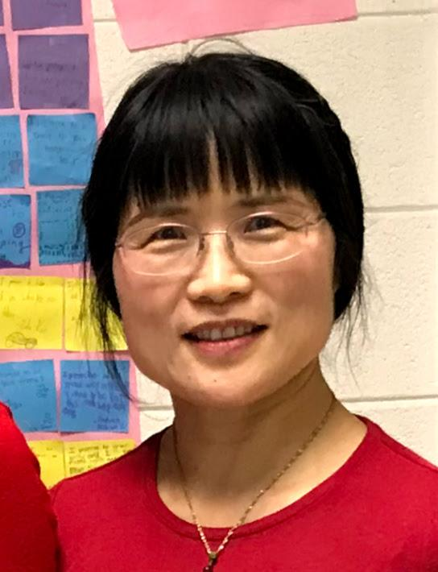
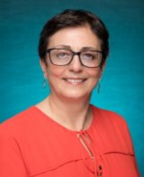
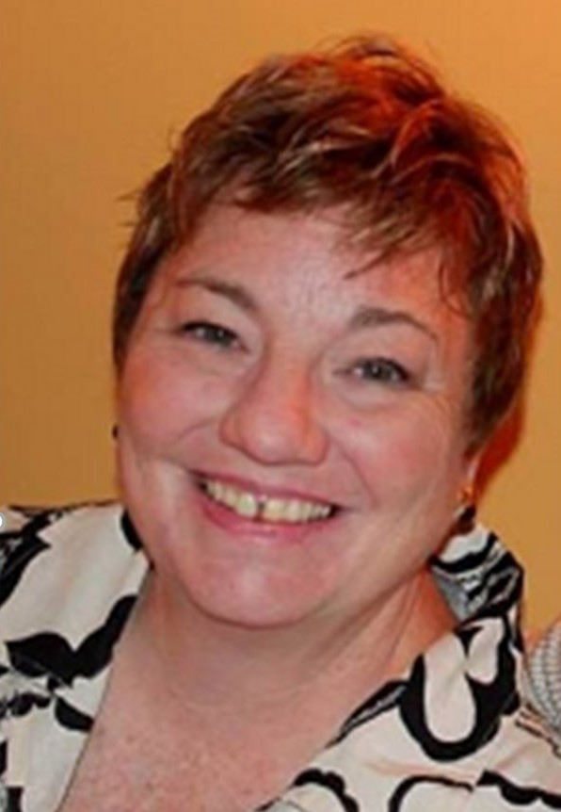
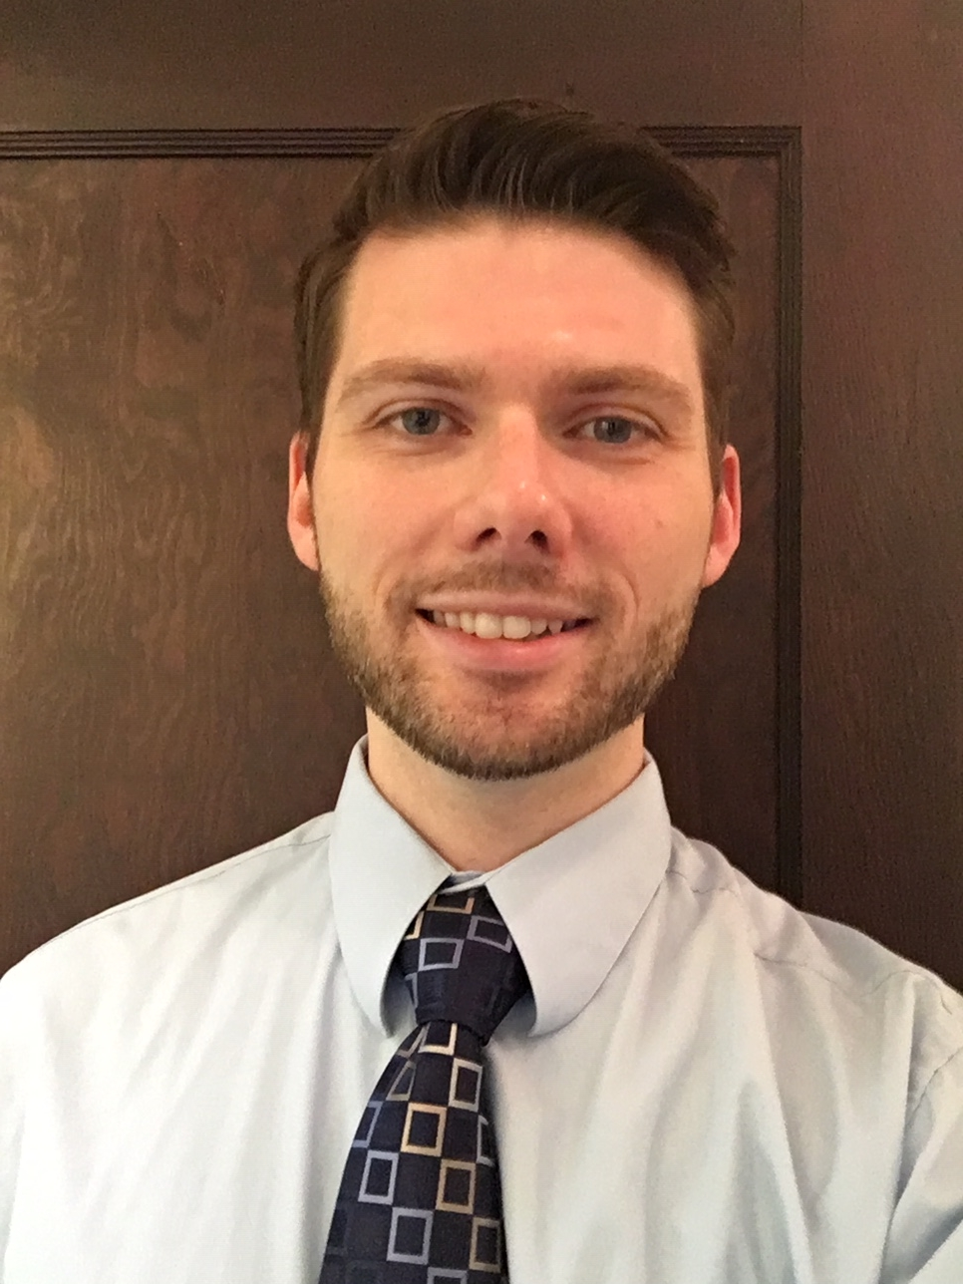
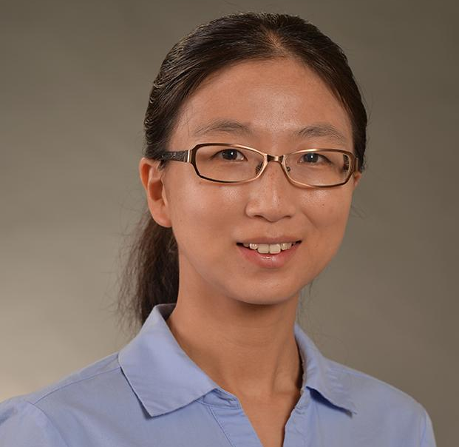
Team
Qing
Suzanne
Mahnaz
CEO
CFO
Sales Director
Berry Books
Vinny Viewer
Vicky
Cheryl
Joe
Notes:
Li

Slide 5
Phases
Initial stages
Recruiting participants
1
3
Getting financial support
TU Foundation
BTU
2
4
Implementation
Notes:
Li

Slide 6
Financial support
TU Foundation
-1st COE project funded
-focus on marginalized girls
-promote equity in computing and education
-pipeline for
*cs students
*diverse teachers
-improve their interest in computing
-knowledge and skills in computing
-awareness of the rolfe of women in computing and STEM
BTU
https://www.towson.edu/campus/community/
Partnerships for Greater Baltimore
Notes:
TUF-Li
BTU - Vicky

Slide 7
Recruitment
Refugee Youth Project http://www.refugeeyouthproject.org/
Patterson High School https://www.baltimorecityschools.org/schools/405
Transportation
Notes:
Suzanne

Slide 8



Technology
Resources for facilitators
Tutorials and activities for the students
Coding animations, stories, and games
Stores projects
Stores information for our individual club
Provides blog space for student reflections
Concludes with students designing a page to exhibit their project(s)
Notes:
Joe

Slide 9
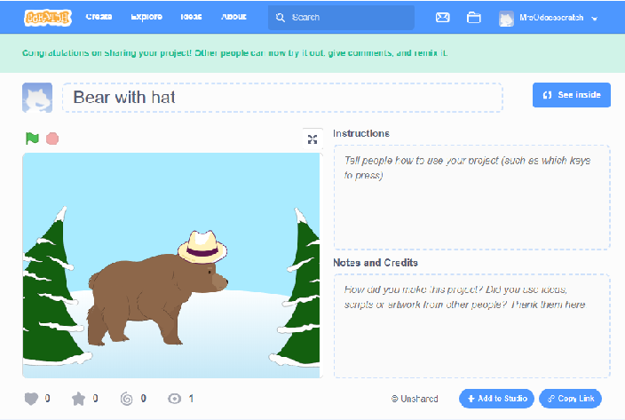
Coding with the girls
We started using Scratch on the first day!
Demo
Everyone got in and started sharing Scratch ideas
Experienced girls helped newbies - very collaborative
Click bear to open the quick project. Spacebar makes bear speak. Click her hat!
Notes:
Suzanne

Slide 10
Designing / Implementing GWC Sessions
Session 2 on March 7, 2020
https://docs.google.com/presentation/d/19EouMcGWOTvdGDZHE7aQjbuMcDvaXHxsvcB_mgXSsv8/present?ueb=true&slide=id.g7ef1d5b2e8_1_14
Notes:
Vicky

Slide 11
Coding for faculty and teacher candidates
It’s easier than you think, I promise!
Get a start on coding for kids
Watch TedTalk “Let’s Teach Kids to Code”
https://www.ted.com/talks/mitch_resnick_let_s_teach_kids_to_code?language=en
Give it a try with One Hour of Code
https://studio.code.org/hoc/1
Try Scratch
https://scratch.mit.edu/
Notes:
Suzanne

Slide 12
Implementation & Challenges
Disruption due to the pandemic:
-virtual sessions? (marginalized girls)
-important to keep them connected
-created Edmodo shell
-starting newsletter series
-email communications
2 successful sessions
-introduce software
-forming groups
-starting collaboration
-formulating ideas
Notes:
Li

Slide 13
Q & A
What are your thoughts re. how we should respond to the needs of CS education?
What should be the COE’s next steps?
How can we get there?
Suggestions?
Notes:
all

Slide 14
Thank you!

