Slide 1
Why Did I Create Girls Who Code Club?

Slide 2
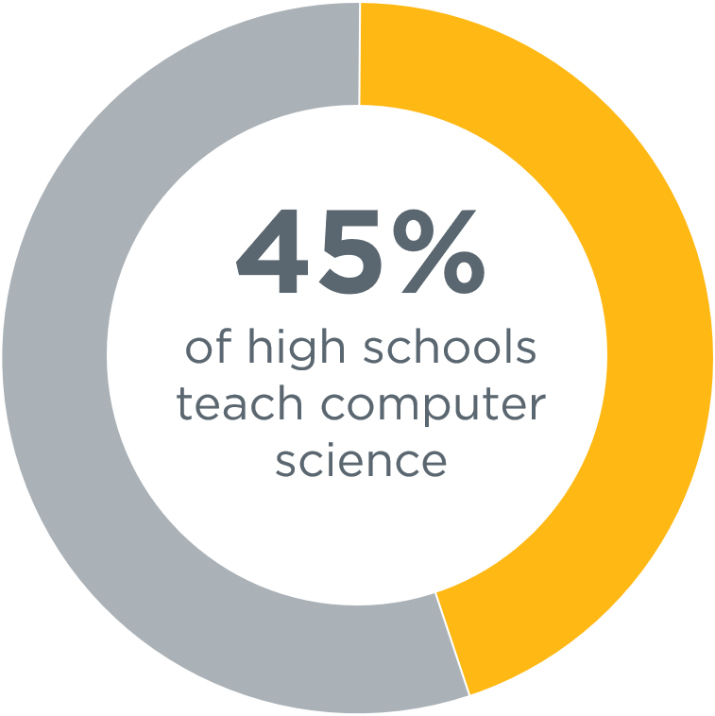

Slide 3
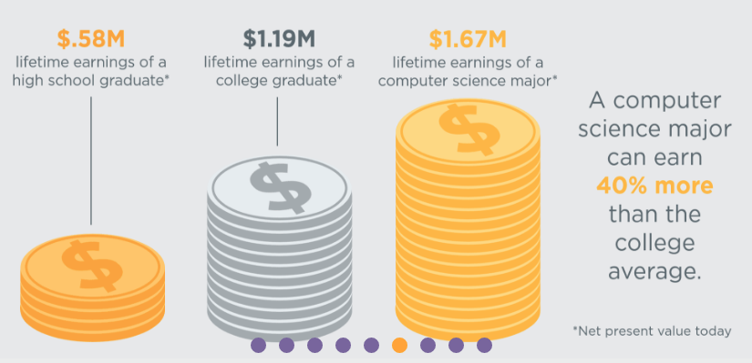

Slide 6
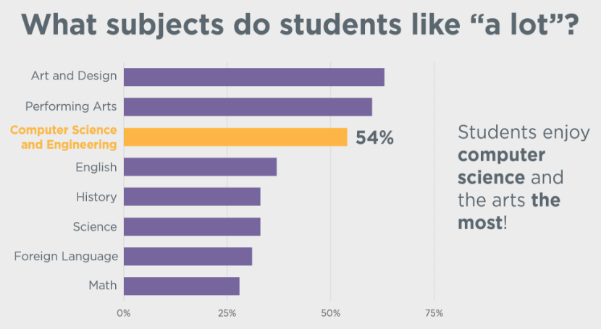

Slide 7
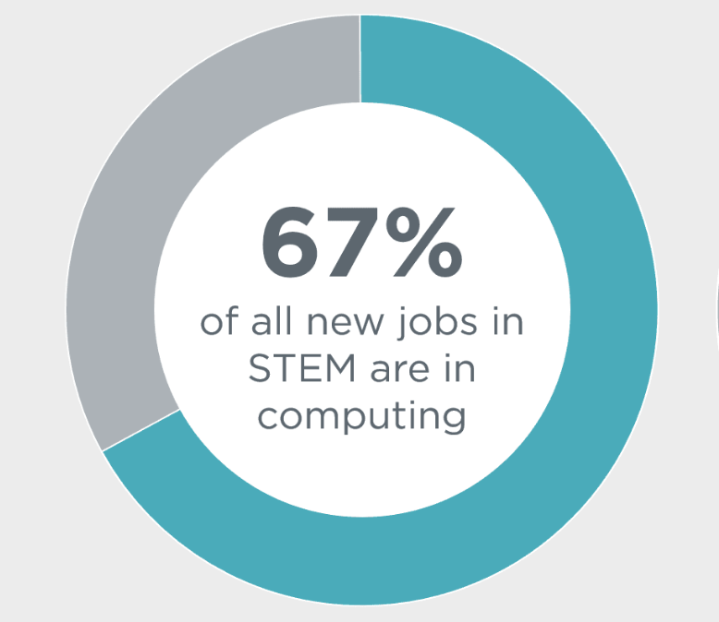

Slide 8
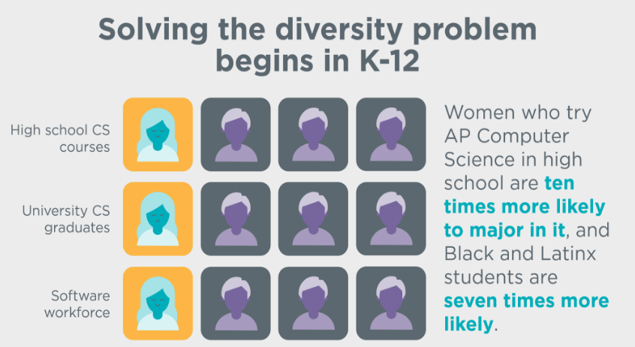

Slide 9
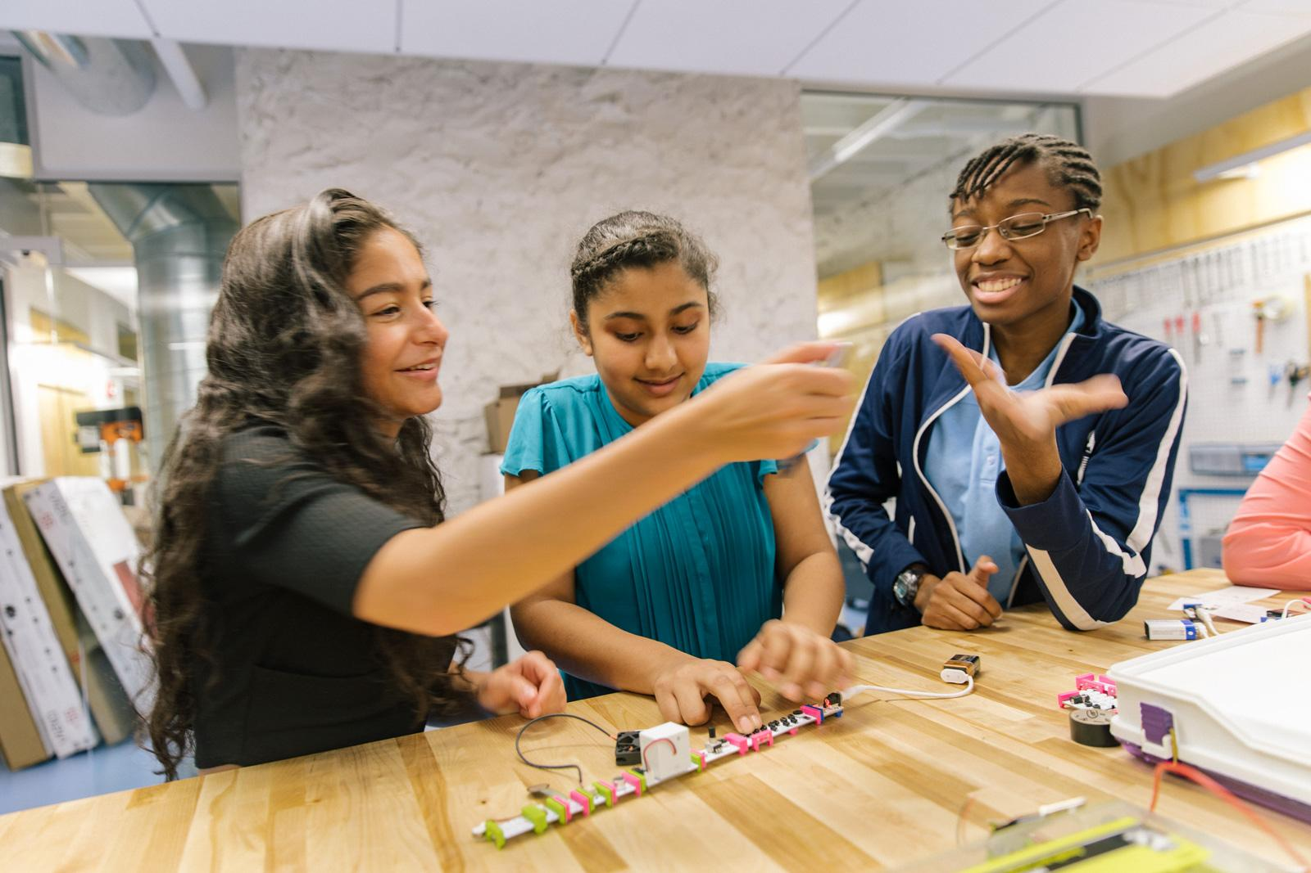
TU-COE-Girls Who Code Appeared to be a Great Approach
GWC is a free enrichment program associated with the GWC non-profit organization dedicated to closing the gender gap in technology.
Notes:
Girls Who Code is a non-profit organization dedicated to closing the gender gap in technology.
Tech jobs are among the fastest growing in the country, but less than a quarter of computing jobs are held by women. Girls Who Code aims to change that!

Slide 10
What Did We Want the TU-COE-Girls Who Code Club Offer?
Learn computing using fun and organized activities
Build animations, games, apps and other related projects
Learn to use Scratch or similar programming tools
Improve communication and team work skills
Build confidence and learn how to problem solve

Slide 11
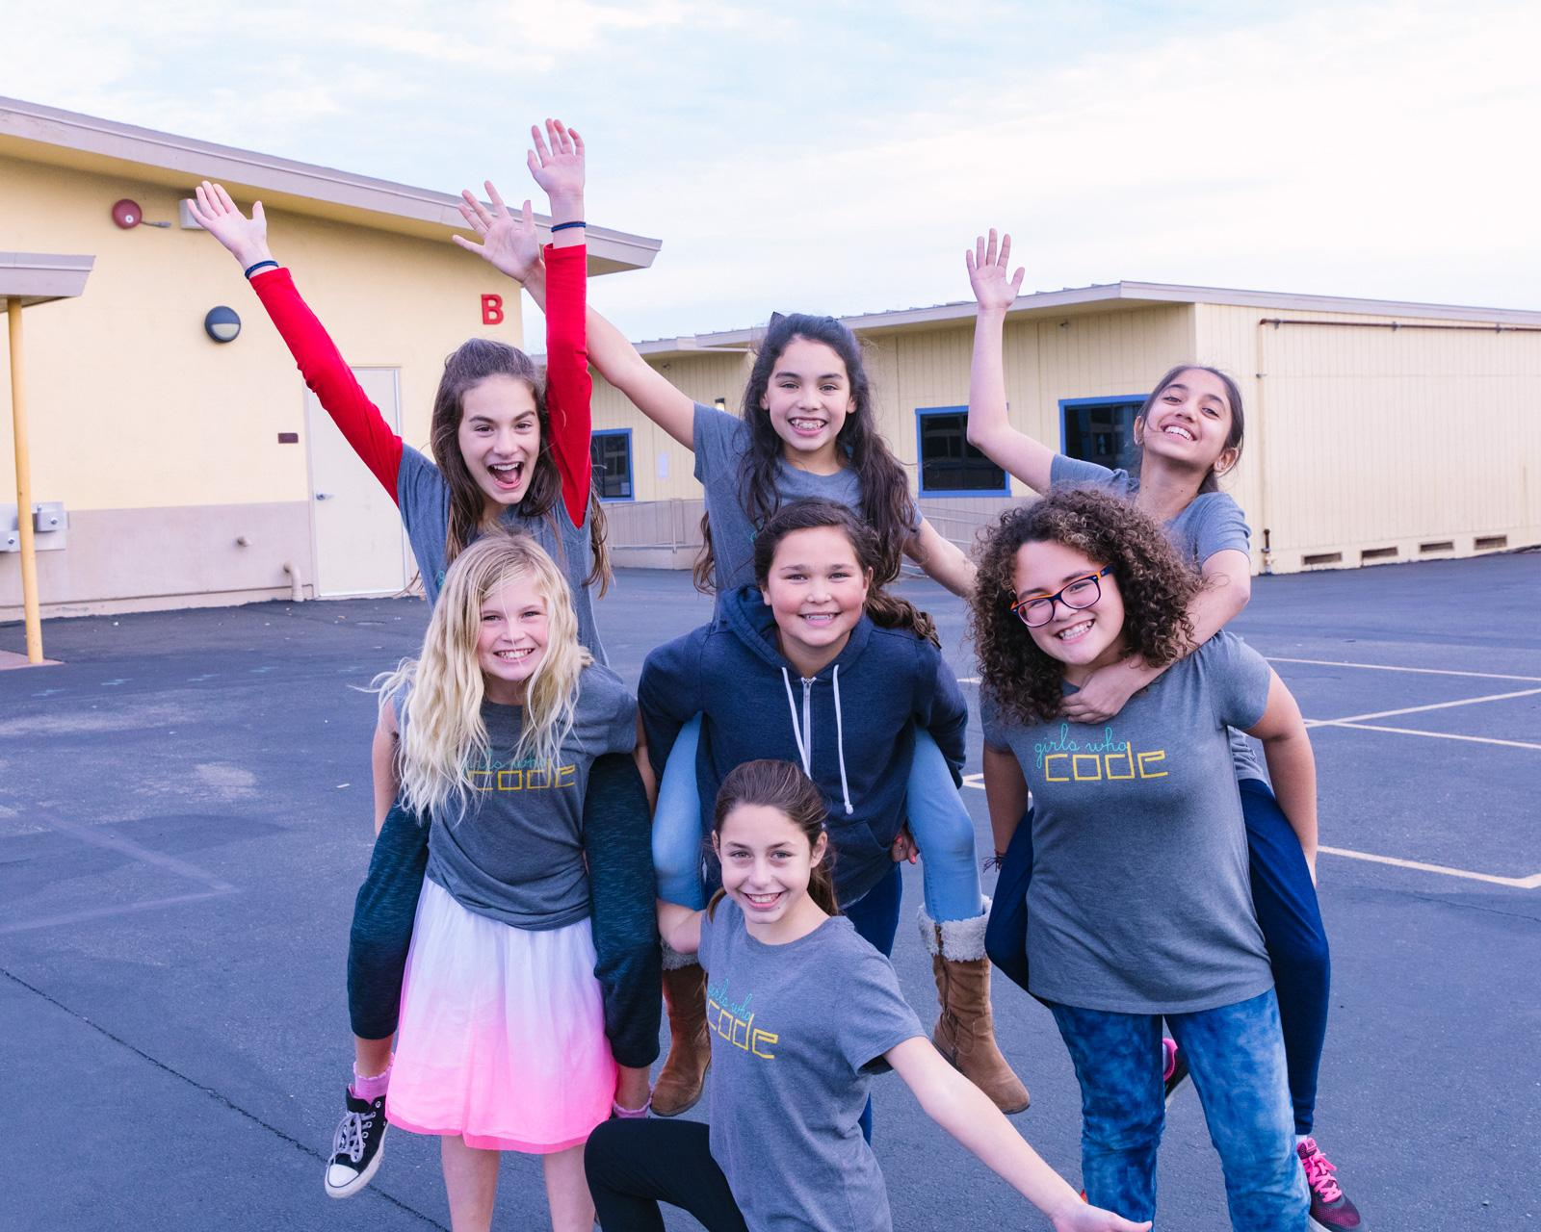
Additionally, In the Club Girls
Learn about and from inspiring role models
Work in teams to design and build projects that solve real world problems you care about through code
Impact your community in a positive way through code
Impact
Notes:
Clubs teach girls:
Sisterhood—In a Girls Who Code Club, you’ll meet other girls who are learning to code and having fun doing it. You’ll join a safe and supportive environment of peers and role models, and you’ll gain an alumni network of girls across the country.
Code—Learn concepts that form the basis of all programming languages—whether you want to build a website, an app, or a robot. If you already have some coding skills, you can deepen your knowledge through extended activity sets.
Impact—You’ll solve real-world problems you care about through code with your team’s CS Impact Project.

Slide 12
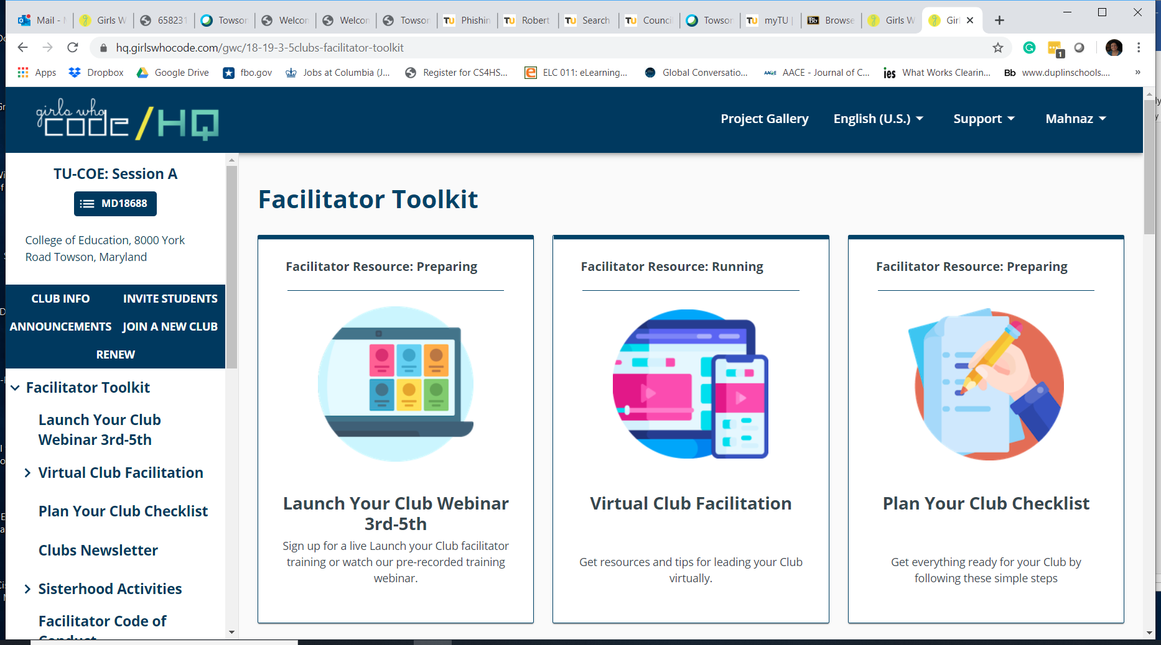

Slide 13
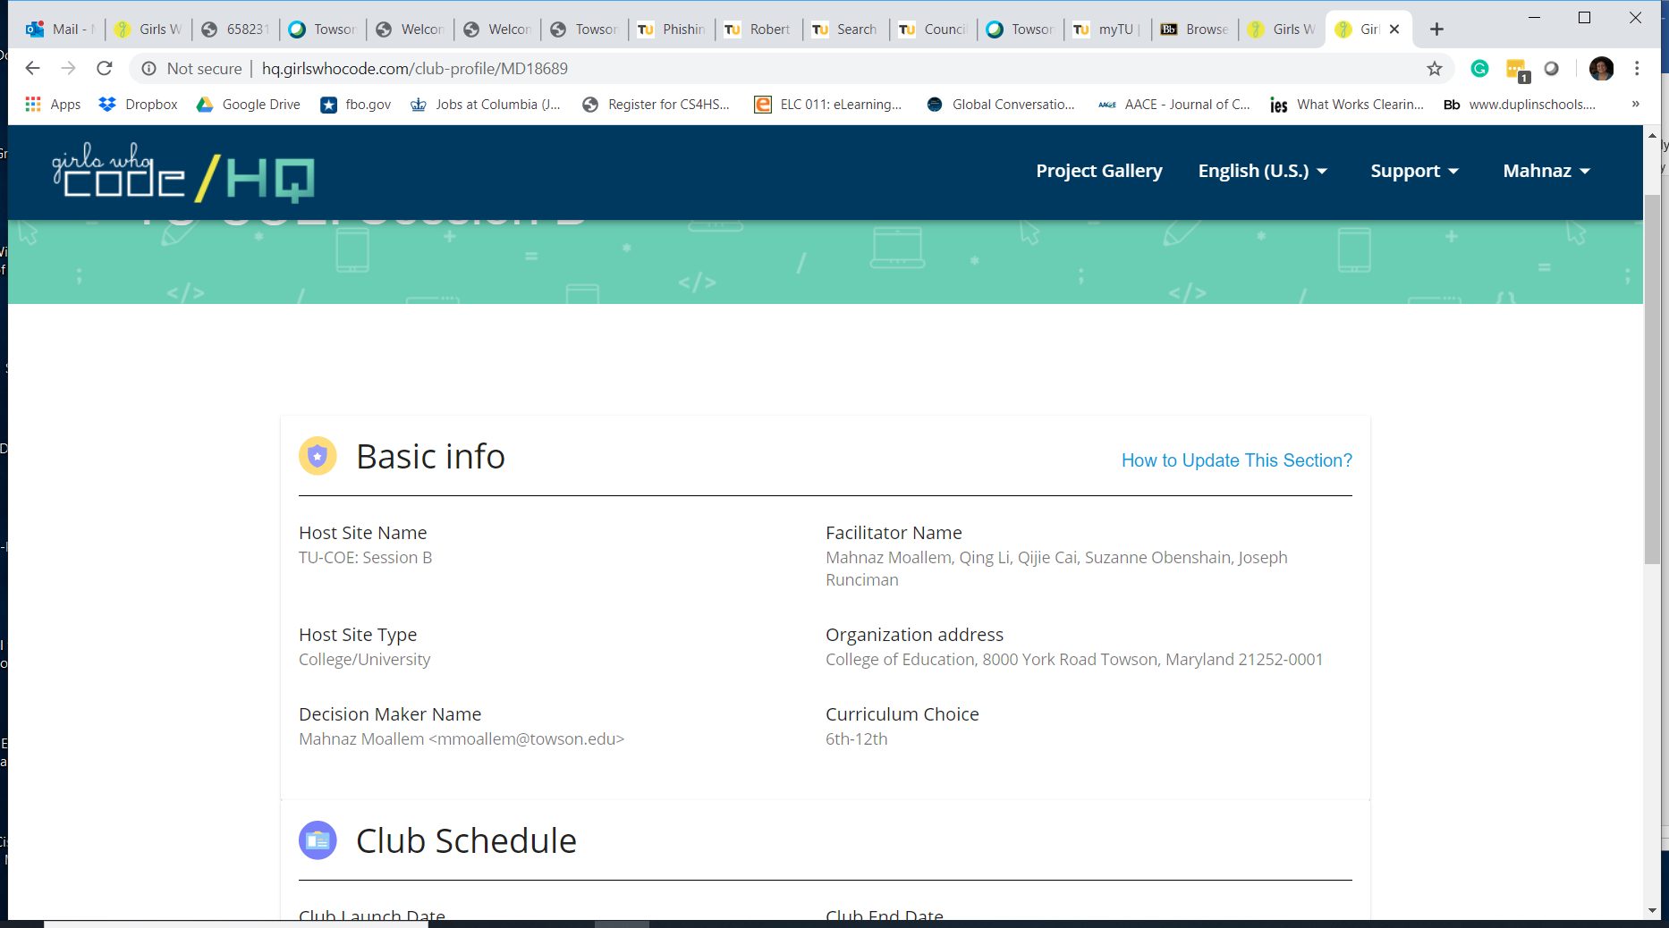

Slide 14
Teaching CS in Teacher Education Programs to Teach CS in K-12 Classrooms
How TU-COE-GWC Club Can Help?

Slide 15
How other Universities in MD are incorporating CS in Teacher Education (MCCE)
Loyola
Frostburg
Hood
Notes:
Maryland Center for Computing in Education

Slide 16
What should be the COE’s next step?

