Slide 1
Swivl

Slide 2
COLLEGE OF EDUCATION
Workshop 1 : Swivl Basics (November)
In this workshop faculty and students will learn the basic features of Swivl. Attendees will learn how to :
Set up account and use Swivl App
Record and share videos
Use Swivl robot
Workshop 2 : View and Collaborate using Swivl (December) In this workshop faculty and students will learn how to view and collaborate using videos. Attendees will learn how to: 1) View videos through a secure platform 2) Make notes for self reflection 3) Provide feedback 4) Integrate in courses

Slide 3
Swivl.com
COLLEGE OF EDUCATION
Two Types of Accounts --Standard free and Pro paid
Standard free account --upload and download ability with unlimited storage --able to share a link for each video --all uploaded Pro videos remain accessible
Pro paid account -provided by COE for selected classes each semester (cost $50 each; license for 1 yr, transferrable) -account becomes Standard at the end of the semester (license is reissued next semester) --faculty may accounts remain Pro upon request.

Slide 4
Swivl.com
COLLEGE OF EDUCATION
Advantages of Pro --When using robot to record, able to ‘mark’ while recording by pressing remote --Direct share so others may add comments --create Team members (time consuming management)
Pro Account Requests (beginning of each semester) --HLP Fellows have first preference --email Debbie Fuller dfuller@towson.edu (Course, section) --students are added using class roster --students are switched to Standard account at the end of the semester

Slide 5
Swivl.com
COLLEGE OF EDUCATION
Access to Pro account --Debbie will add each student using their Towson NetID (email address) from the class roster. --Go to Swivl.com and choose to Sign in (not sign up) --Request to change password.
Note: Students will receive and invitation email with a link, but it’s not necessary to use this link to access account.

Slide 6
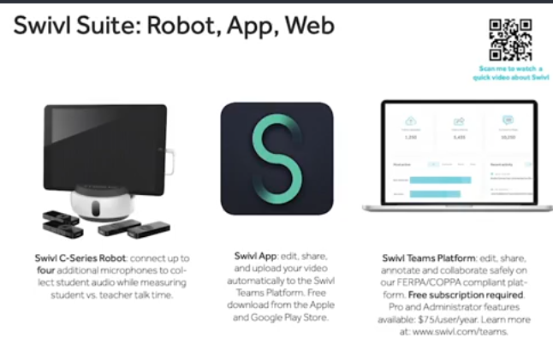
Direct upload using Swivl app
COLLEGE OF EDUCATION

Slide 7
Record and Upload
COLLEGE OF EDUCATION
Open Swivl App
Press red REC button to begin and again to end.
Type a title/date
Press Done (auto upload in Settings)
Shows Library (your videos) -may direct Share from this screen.

Slide 8
Swivl.com
COLLEGE OF EDUCATION
Swivl Setup Guide (User Guide Download and Video) Quick view points ---
Go to 3:55 mins to view how to Download app
7:25 Turning on robot
9:00 Pairing markers
10:41 Record and upload
12:05 Settings (auto upload enable)
Access PDF Starter Guide while watching this video to get even more information! Available on www.swivl.com/setup under First Time Users. See links in the comment box.

Slide 9
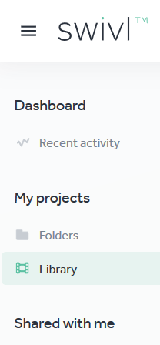
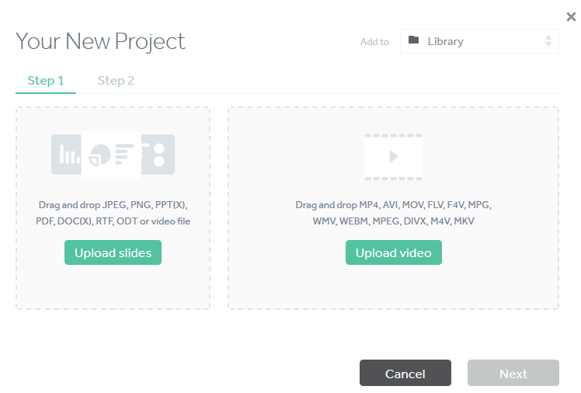
COLLEGE OF EDUCATION
Upload video recorded without using Swivl app
Log into your Swivl account, Dashboard, Library, new project, click Upload video, select the file from your computer. Note: If the file is on your phone, save it to a laptop or tablet before trying to upload to Swivl.

Slide 10
COLLEGE OF EDUCATION
How-to-Guides, Swivl
Swivl Setup Guide (User Guide Download and Video)
Sandbox links
https://wp.towson.edu/sandbox/about/
Swivl Cloud Storage Site (PDF)
An app and cloud storage site for students to upload their classroom teaching practice for informal observation and self-reflection.
Deborah Fuller, Sandbox, HH 210 . 11/13/19

