Slide 1
FYE Advising Group Meeting
Fall
2022

Slide 2
Agenda
Current Semester Reminders
Minimester Registration
Spring Registration
Upcoming Individual Appointments

Slide 3
Academic Calendar
Withdraw Deadline:
Mon Nov 7
To withdraw from a class, drop online through your Student Center
Receive a grade of W on your transcript; not factored into GPA
Pass Grade Deadline:
Mon Nov 7
To switch to the Pass Grade option, submit a Pass Grade form online
cannot be used for Major, Minor, or Honors College classes
A C or higher in the class = grade of Pass (PS); not factored into GPA
A D+, D, or F, grade received as usual and factored into GPA
Thinking about a Withdraw or Pass Grade?
Schedule a meeting with me prior to the Nov 7 deadline so we can discuss!

Slide 4
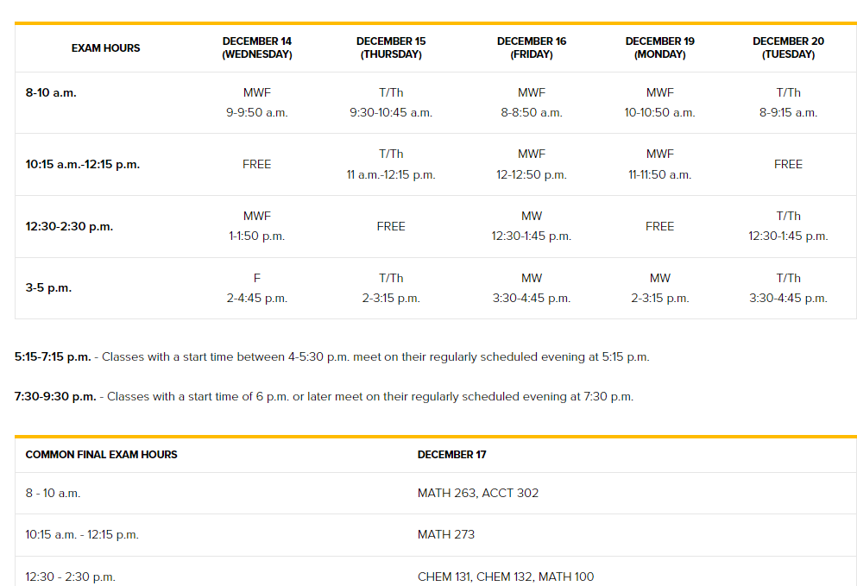
Academic Calendar
TU uses a campus-wide schedule for finals:
Should match what’s on your syllabus for each class, but can check the schedule online:
towson.edu/registrar/calendars/exams

Slide 5
Academic Commons
One-stop shop for academic support
libraries.towson.edu/academic-commons

Slide 6
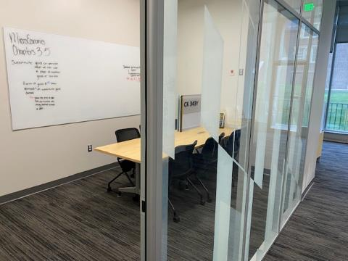
Academic Commons
Private & group study areas
Including booths for synchronous Zoom classes

Slide 7
Honors College
Why Honors?
Small class sizes
Opportunities for individualized learning
Join a community of engaged learners
Interdisciplinary: open to all majors
Deadlines
Spring 2023 admission: November 15
Fall 2023 admission: March 1
Apply at
towson.edu/honors/admission/apply
Notes:
FAQs
~Admissions~
*Applicants have to submit a 500-750 word essay and a list of activities, which are reviewed alongside their GPA and curriculum.
*Applications are reviewed after the end of the fall 2021 term.
*Students should register for classes as if they would not be admitted to Honors. The Honors College will work with admitted students to adjust their schedules to incorporate at least one Honors course.
*Applicants should have 60 or fewer credits before their intended term of entry. Students with slightly over 60 credits may be considered on a case-by-case basis.
*An applicant with 29 or fewer college credits will have to complete 24 Honors units. An applicants with 30-60 credits will have 21 Honors units.
*Still no scholarships for applicants joining as current students ☹ If anyone complains they are encouraged to contact the provost.
~Housing~
*Living in Douglass House is not required for students who join the Honors College as a current student. Students who wish to move into Douglass mid-year must go through HRL’s room change process, which begins before Honors decisions are made. Getting a spot in Douglass mid-year is highly unlikely as space is only available if current students move out. Conversely, students who want to move into Douglass for the fall term will have priority for Douglass as Honors students.

Slide 8
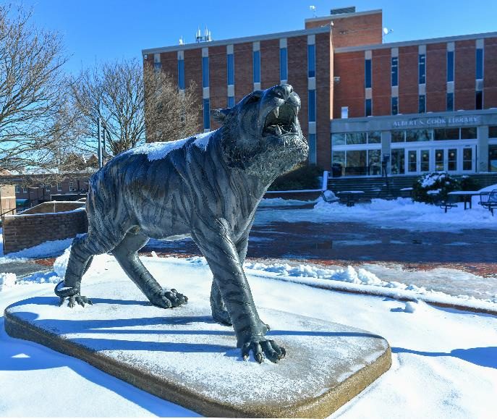
Minimester Registration
3-week winter term at TU (Jan 3-23)
Registration now open
Can take one course (up to 4 credits) at TU in Minimester
Can also take a course at community college or other school near you
Can discuss options during one-on-one appointment

Slide 9
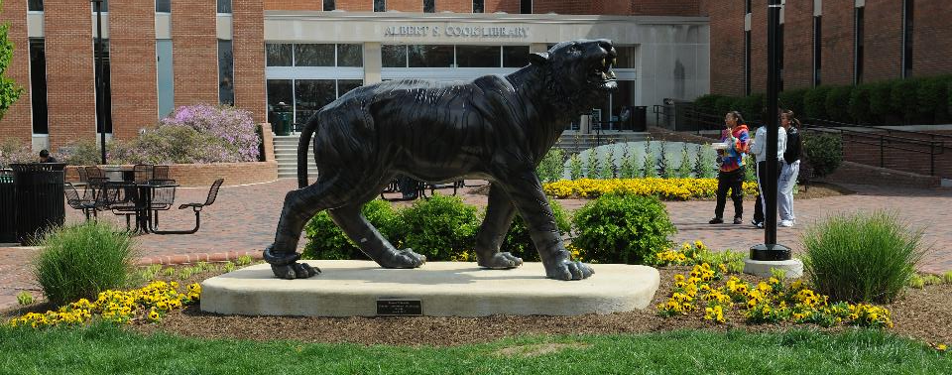
Spring Registration

Slide 10
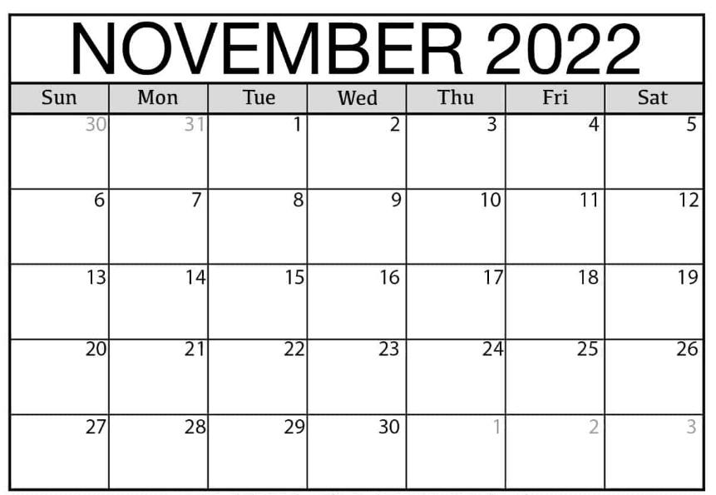
Spring 23 Enrollment Timeline
Special Populations: Nov 8
Seniors: Nov 9 & 10
Juniors: Nov 11 & 14
Sophomores: Nov 15 & 16
Freshmen: Nov 17 & 18
Enrollment time slots:
7:30 am
9:30 am
11:30 am
1:30 pm
3:30 pm
Priority Registration
Seniors
Enroll
Freshmen Enroll

Slide 11
Key Classes to Register For
1) First-Year Benchmarks:
ENGL 102
TSEM 102
(check topics here: towson.edu/advising/current/seminar)
MATH

Slide 12
Key Classes to Register For
2) Major Requirements:
Use catalog for requirements & suggested 4-year plans
Online at:
catalog.towson.edu/undergraduate/
Also use Academic Requirements Report to see list of your major classes needed
(in your Student Center; see slide 12)

Slide 13
Key Classes to Register For
3) Core Curriculum classes:
14 Core categories, need 1 class from each
Use Academic Requirements Report to see which Cores still need
Check for any overlap between Core & major classes
Remember Core rules:
- Cores 4 & 5 must be different subjects
- Cores 7 & 8 must be different subjects or sequenced courses
- Grade of C needed for Cores 1, 2, & 9

Slide 14
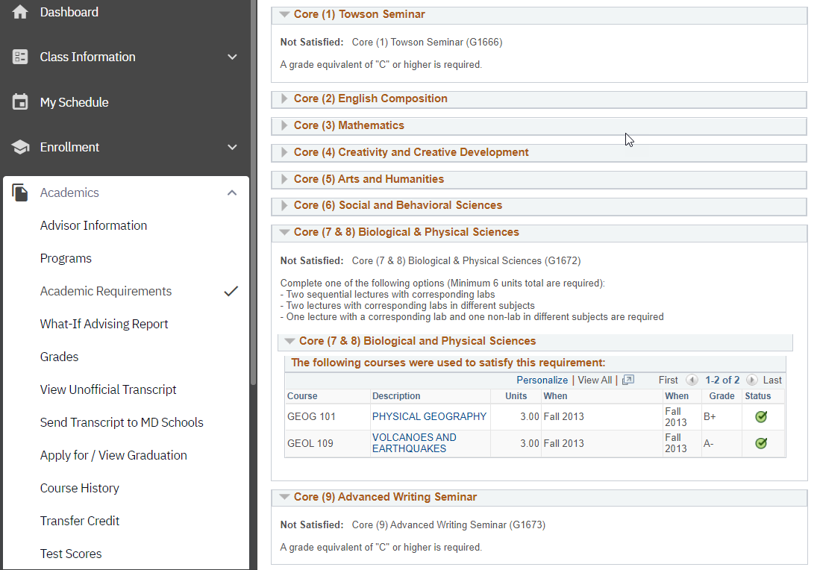
Academic Requirements Report
Use to check on classes needed (Core and major)
to plan your Spring classes

Slide 15
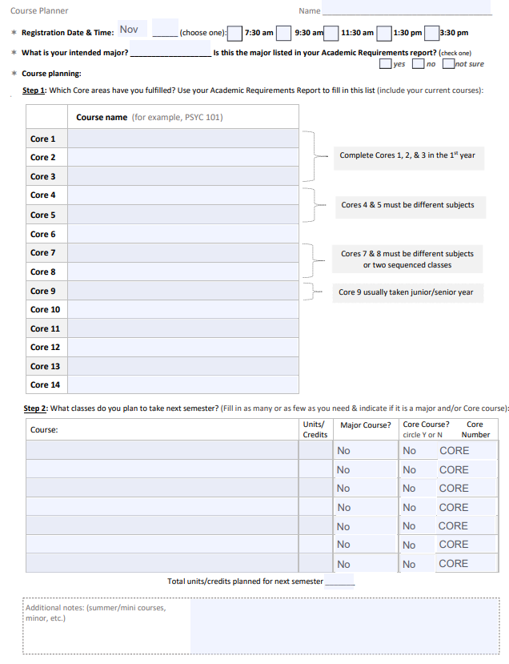
Class Planner Worksheet
Use Academic Requirements Report to fill in

Slide 16
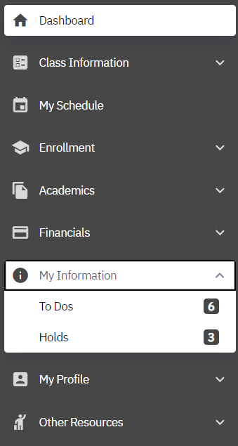
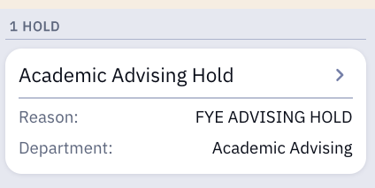
Check your holds in your Student Center
Registration Steps

Slide 17
Check your holds in your Student Center
Registration Steps
Holds that prevent registration:
Academic Advising hold (will be lifted at your one-on-one advising meeting)
Student Account hold (owe > $250)
Immunization hold
Student Conduct hold
Degree Completion Plan hold
Holds that do NOT prevent registration:
Student Bill hold (owe < $250)

Slide 18
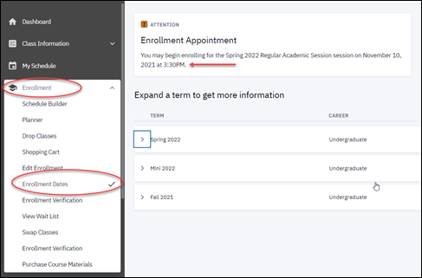
Registration Steps
Check your Enrollment Appointment in your Student Center
Your enrollment appointment is the day & time you can begin enrolling in the spring classes you’ve selected

Slide 19
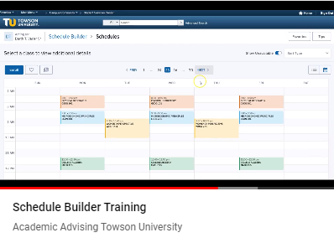
Registration Steps Helpful Resources for Enrollment:
Enrollment YouTube Demo
Schedule Builder & other support dox
towson.edu/registrar/registration
New Student Guide
youtube.com/watch?v=sf1IqHUyjww

Slide 20
Advising Appointments
One-on-ones

Slide 21
Individual Advising Appointments
Prepare for your appointment:
Check your holds
Check enrollment date & time
Review Academic Requirements Report
check which classes still needed
check to make sure major is listed correctly
complete Change of Major form online if not
Review major requirements in online catalog
(or ideas for majors interested in if still deciding)
Select 5 classes for Spring, plus backups in case
first choices fill up
Link to schedule: https://wp.towson.edu/nalkharo/schedule-2/
Come prepared, or you’ll need to reschedule & might have to register late

Slide 22
Questions? ….

